Slide 1

Nutrition for Health Embracing our Namibian Food Systems
Slide-Set
4 of 4

Slide 2
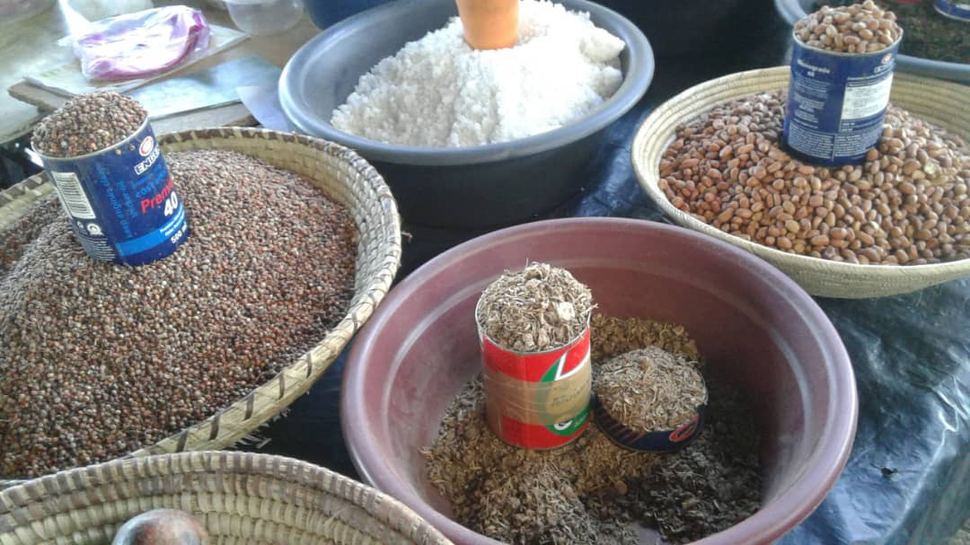

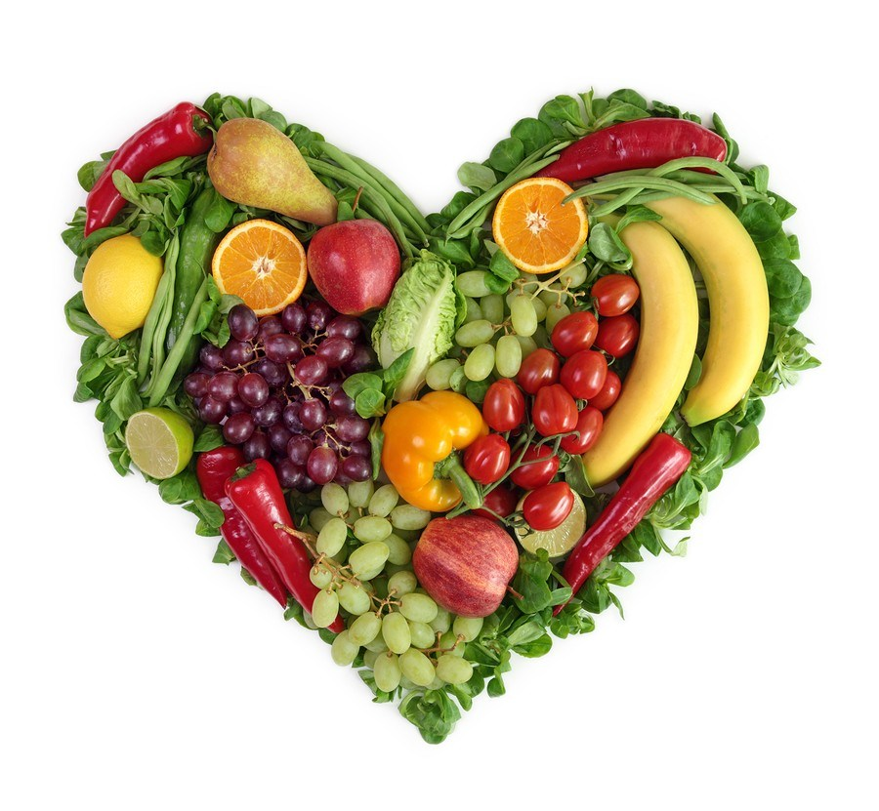




Nutrition for Health
Embracing our Namibian Food Systems

Slide 3
The Food We Grow:
Exercise 7
Notes:
Exercise instructions: pp. 43-44 in the Manual.

Slide 4
Food Safety &
Food Preparations

Slide 5
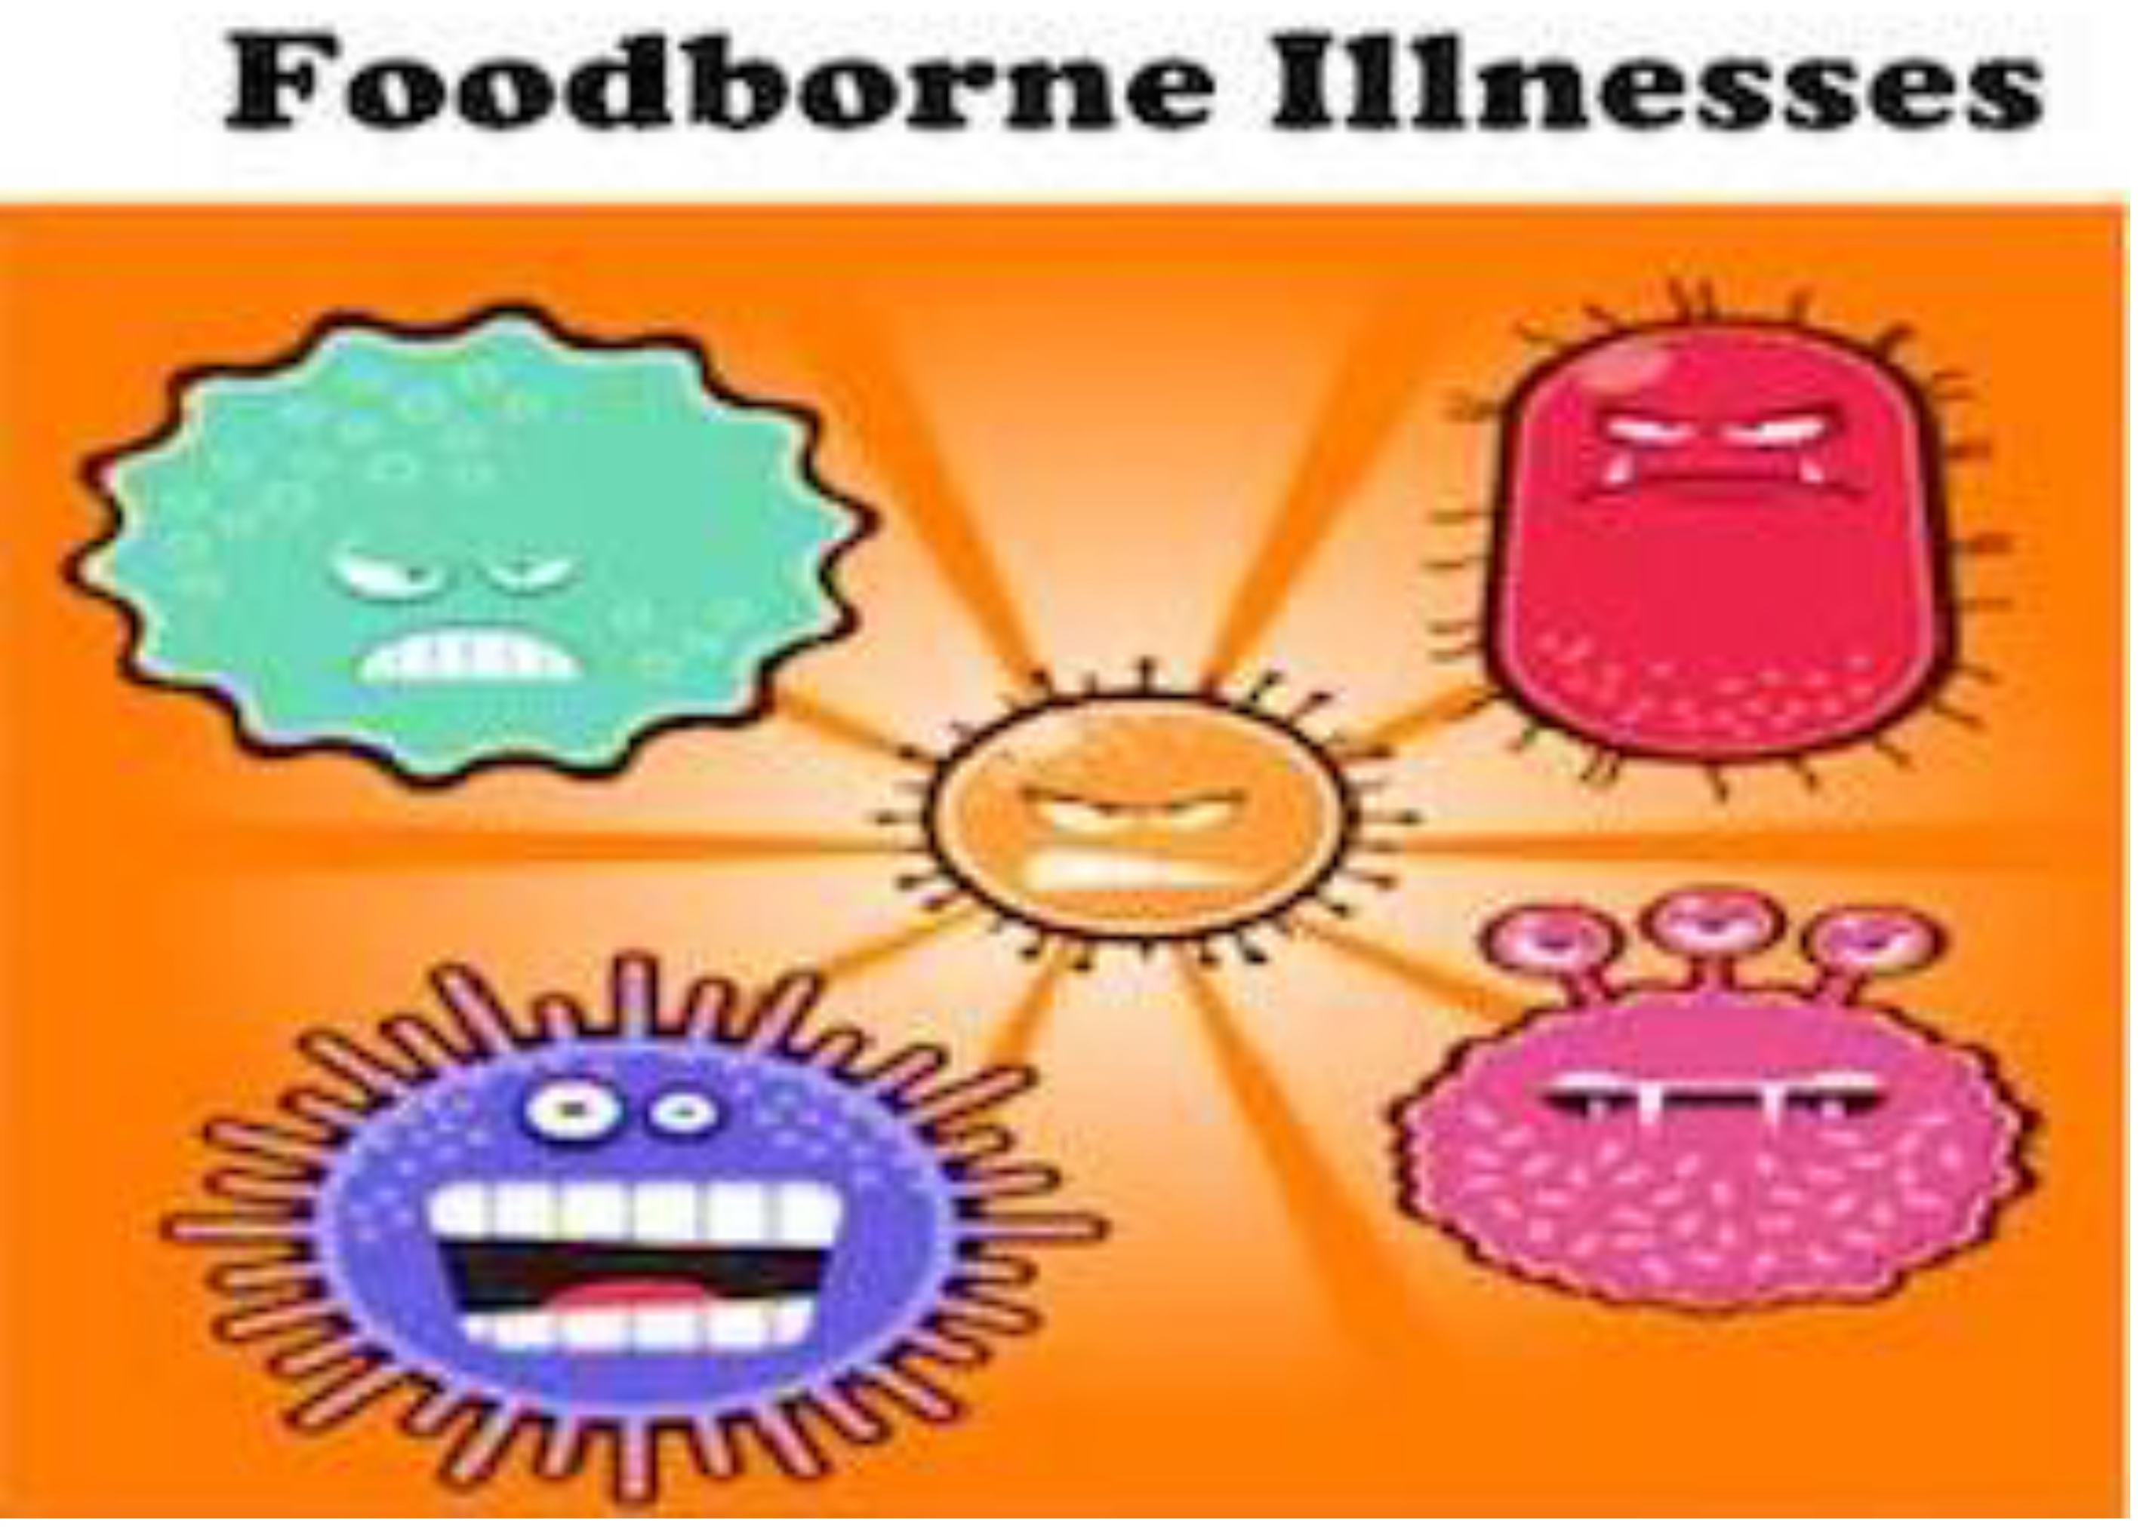
Notes:
Food-borne illnesses happen through food or drinks contaminated with bacteria, viruses, or parasites • Toxins or chemicals through contaminated water, soil, air, or through unsafe food storage/processing • Symptoms can be mild or severe, including diarrhea, vomiting, fever, and even lead to cancer • Commonly known examples of food-borne illness: Hepatitis A, Listeriosis and Salmonellosis

Slide 6
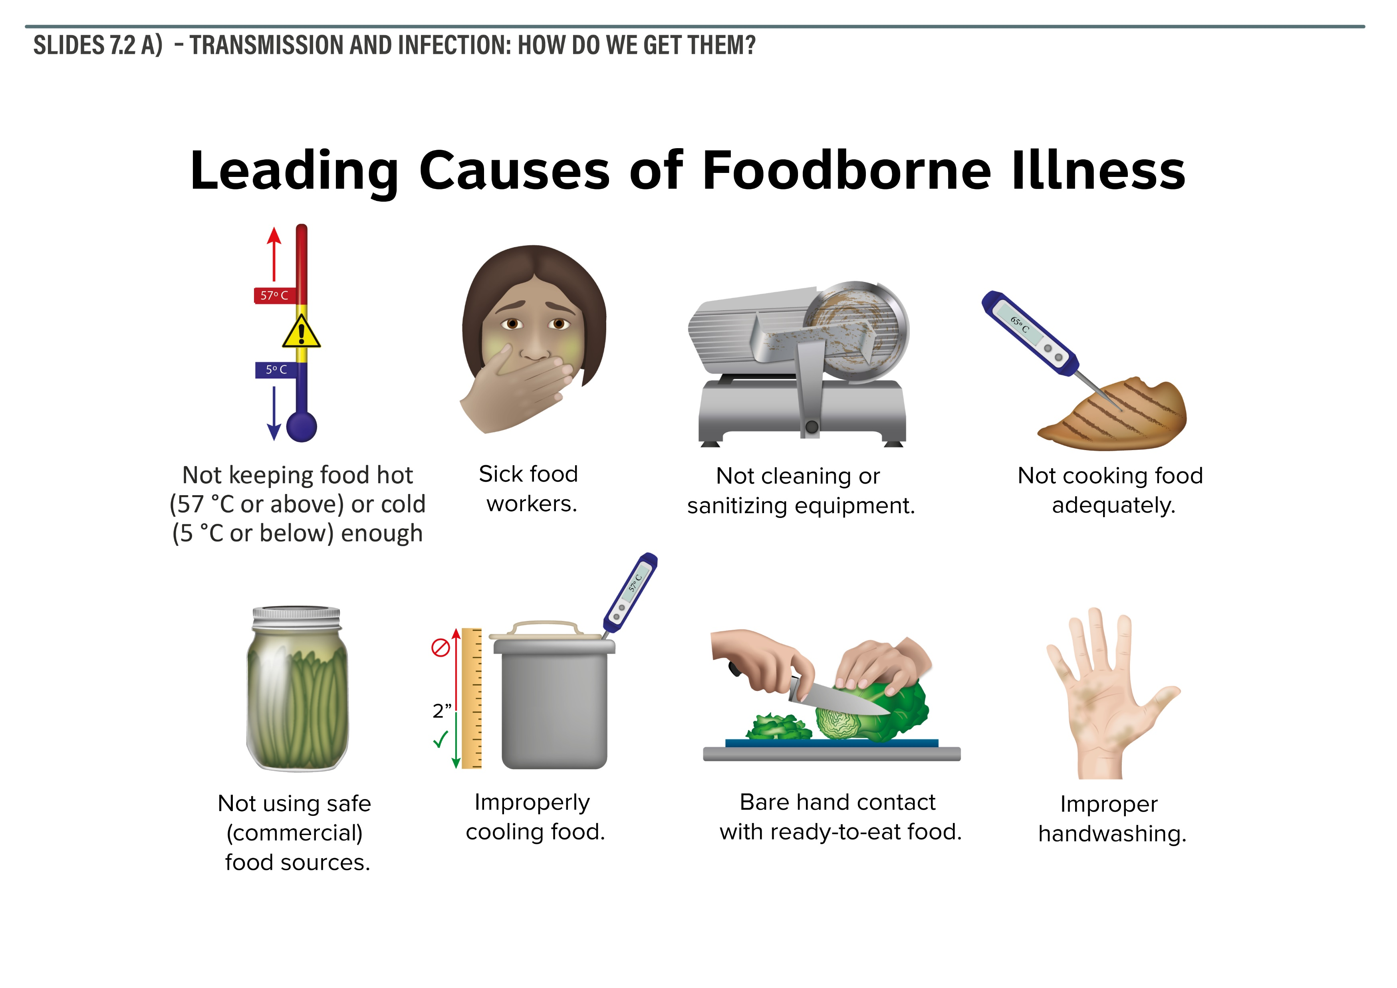
Notes:
Sources of food-borne illness are most often contaminated water, food that has gone bad, infections from unclean hands or equipment, or when using the same cutting board for meat and for vegetables.

Slide 7
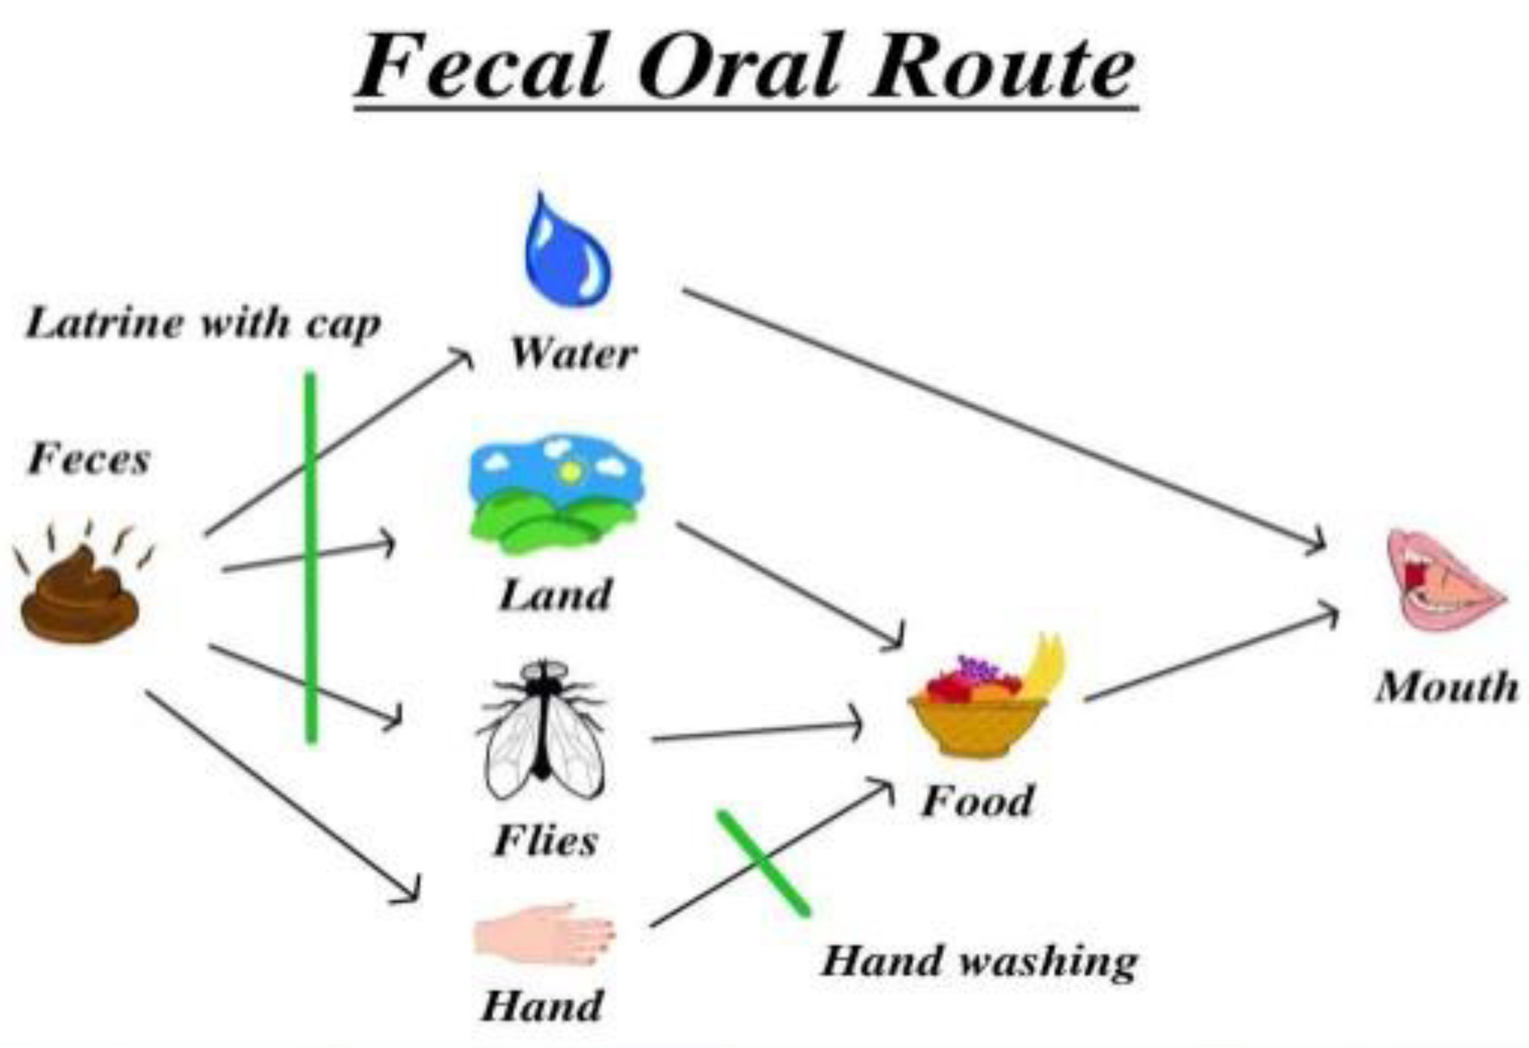
Notes:
Infectious diseases often occur using the fecal oral route: faeces --> flies --> food --> mouth It can also happen when watering plants (where the edible part is not under the surface) with water that was contaminated by human sewage/faeces or with animal manure

Slide 8
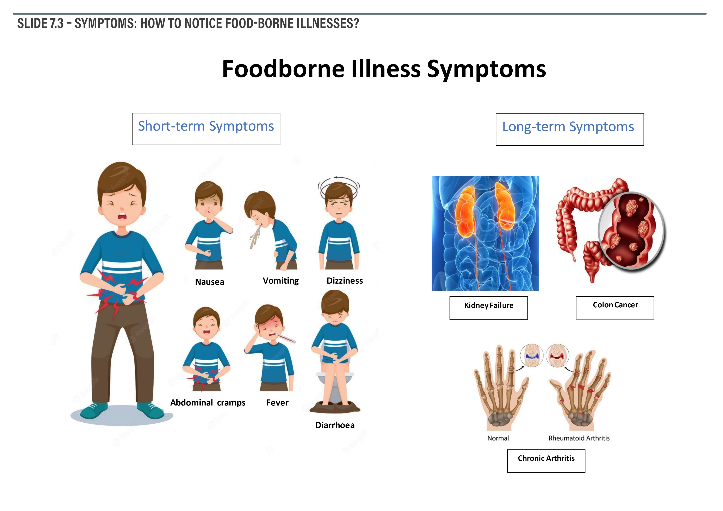
Notes:
Short-term symptoms: nausea, diarrhea, vomiting, cramps, headache, fever, muscle weakness etc. One of the main dangers hereby are dehydration, internal bleeding, and extremely high fever Possible long-term symptoms: cancer, kidney failure or even death

Slide 9
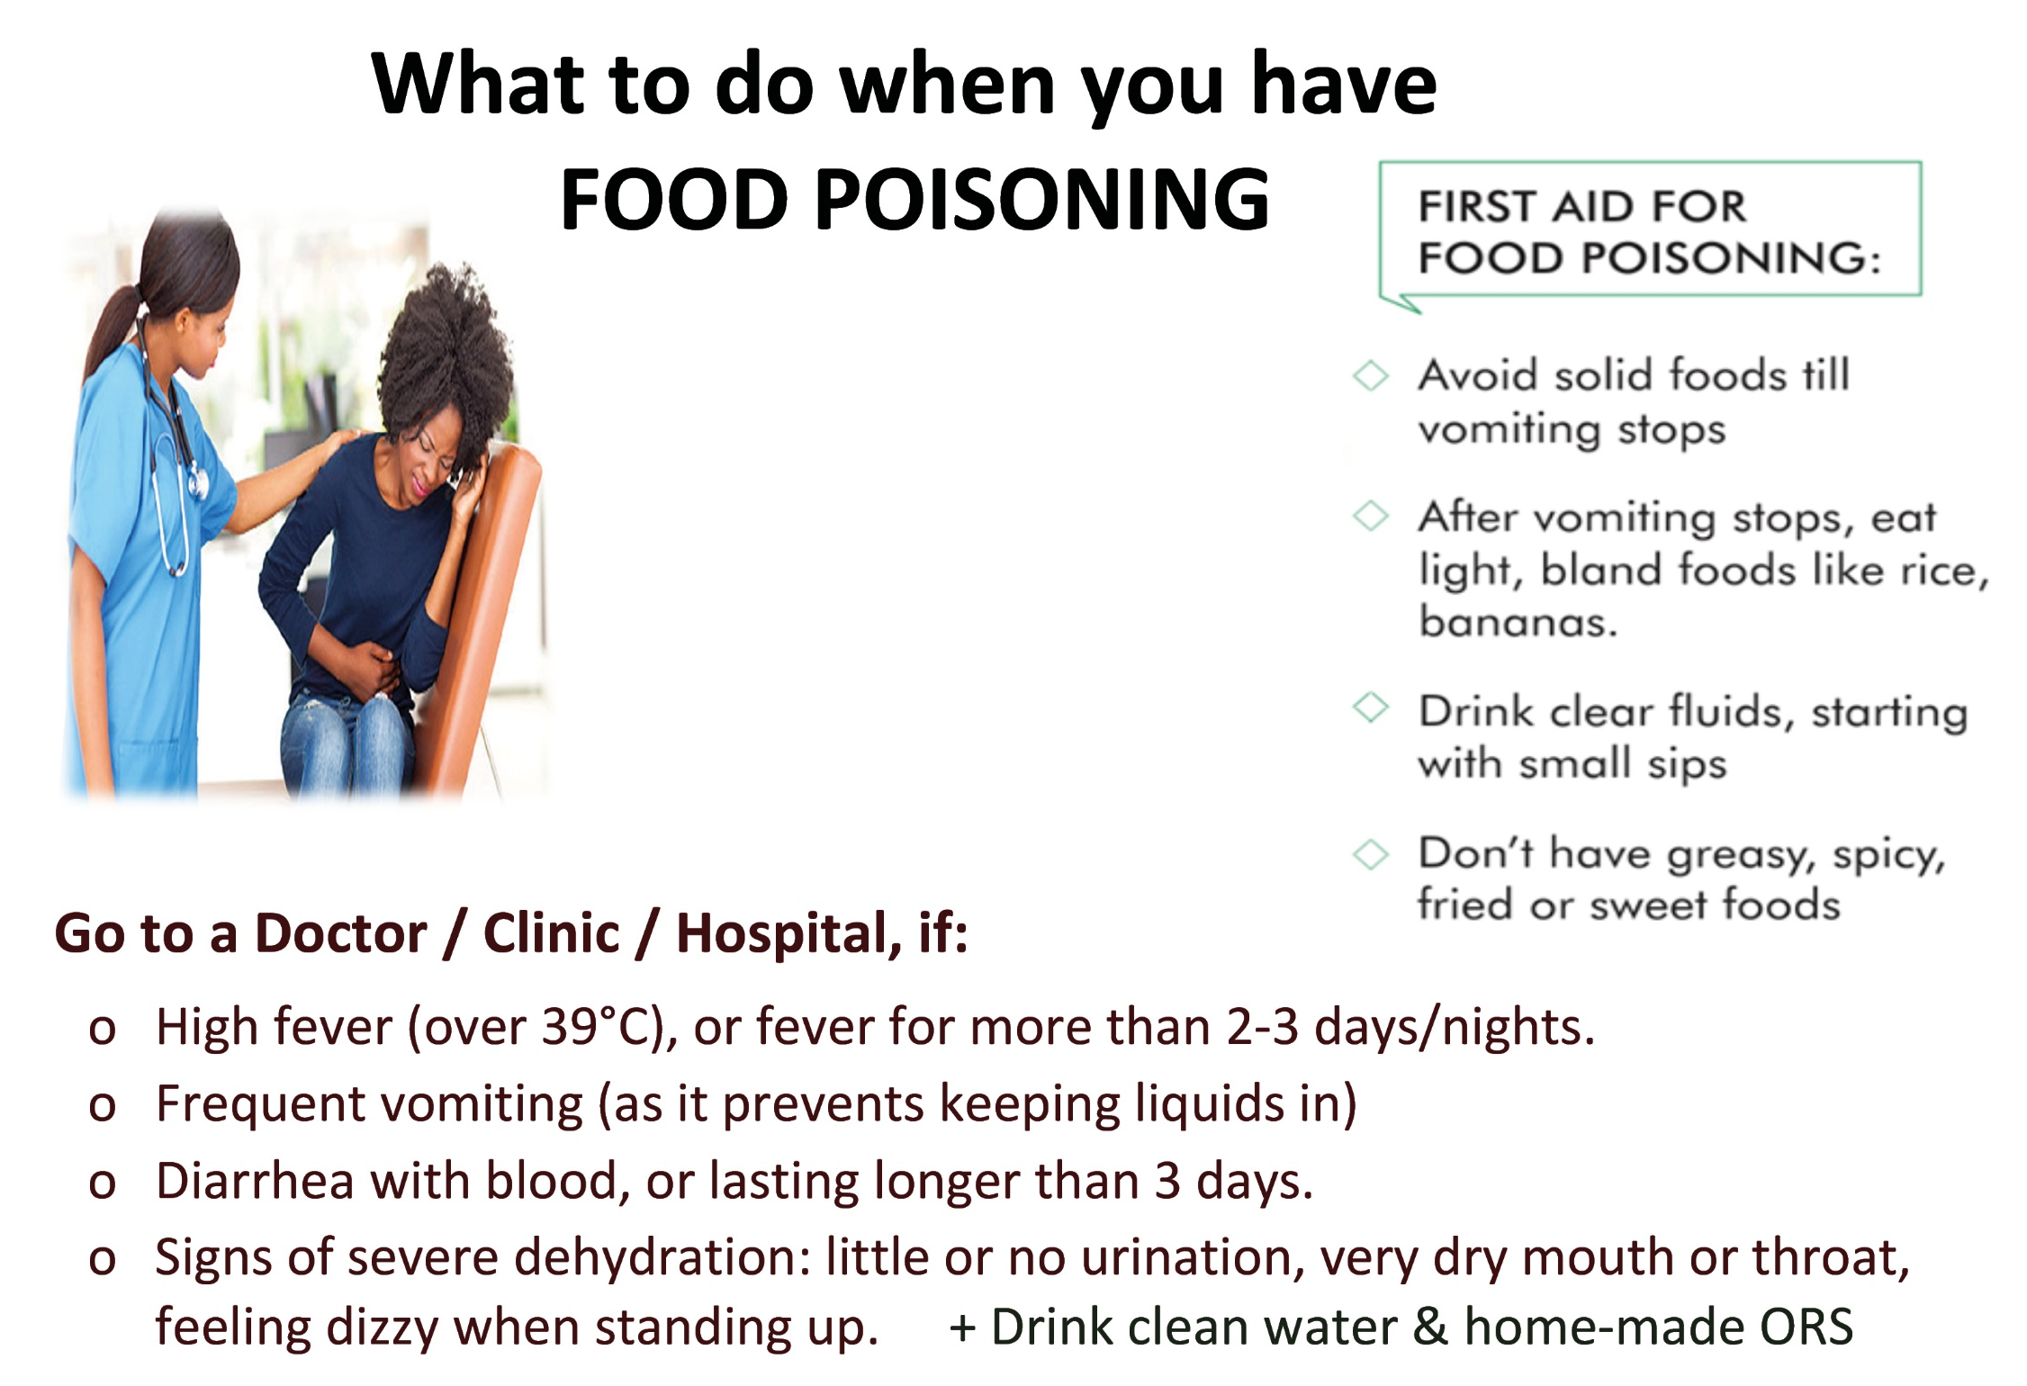
Notes:
First aid: drink lots of water, get proper rest, eat light food like bananas, apples, crackers, bread, rice What to avoid: alcohol, fried, fatty or spicy foods, meat, eggs, milk-products, coffee and smoking Severe symptoms = see a doctor: bloody diarrhea or diarrhea for more than 3 days, frequent vomiting, signs of dehydration (no/little urine, dry mouth/throat, dizziness), fever is high (39°C+) or lasts 3+ nights Canned food should be taken out of the can immediately after opening.

Slide 10
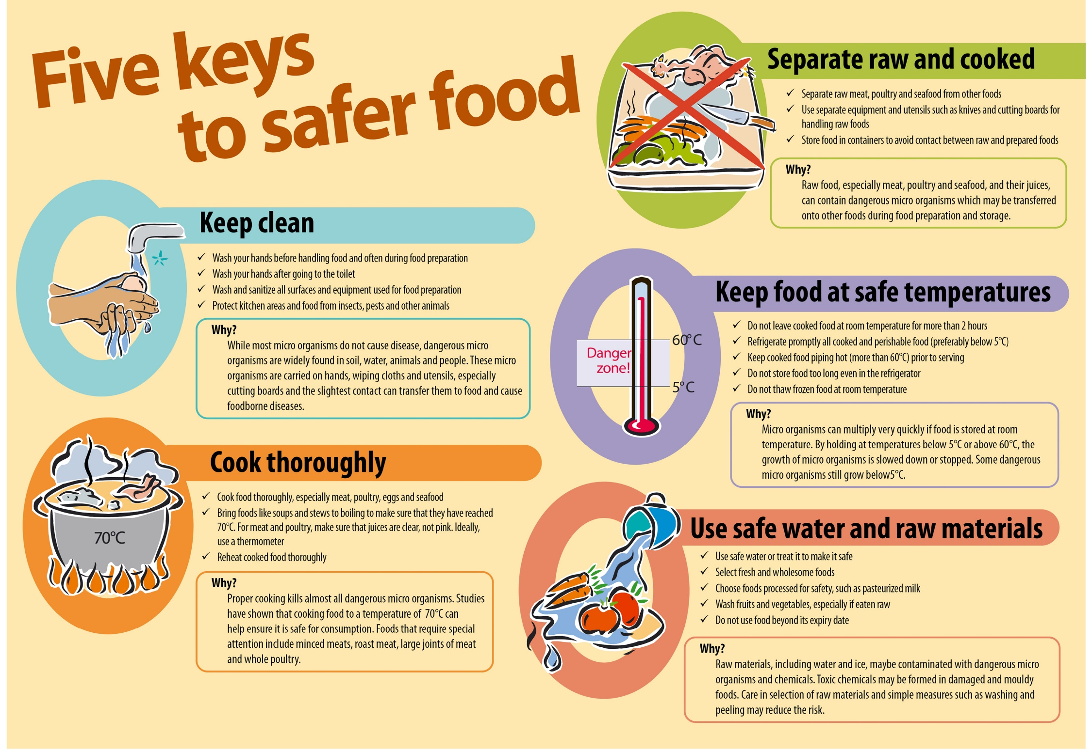
Notes:
5 Keys to SAFER FOOD: 1 - Keep clean 2 - Separate raw and cooked food 3 - Cook food thoroughly (while not overcooking) 4 - Keep at safe temperature 5 - Use safe water and raw materials

Slide 11
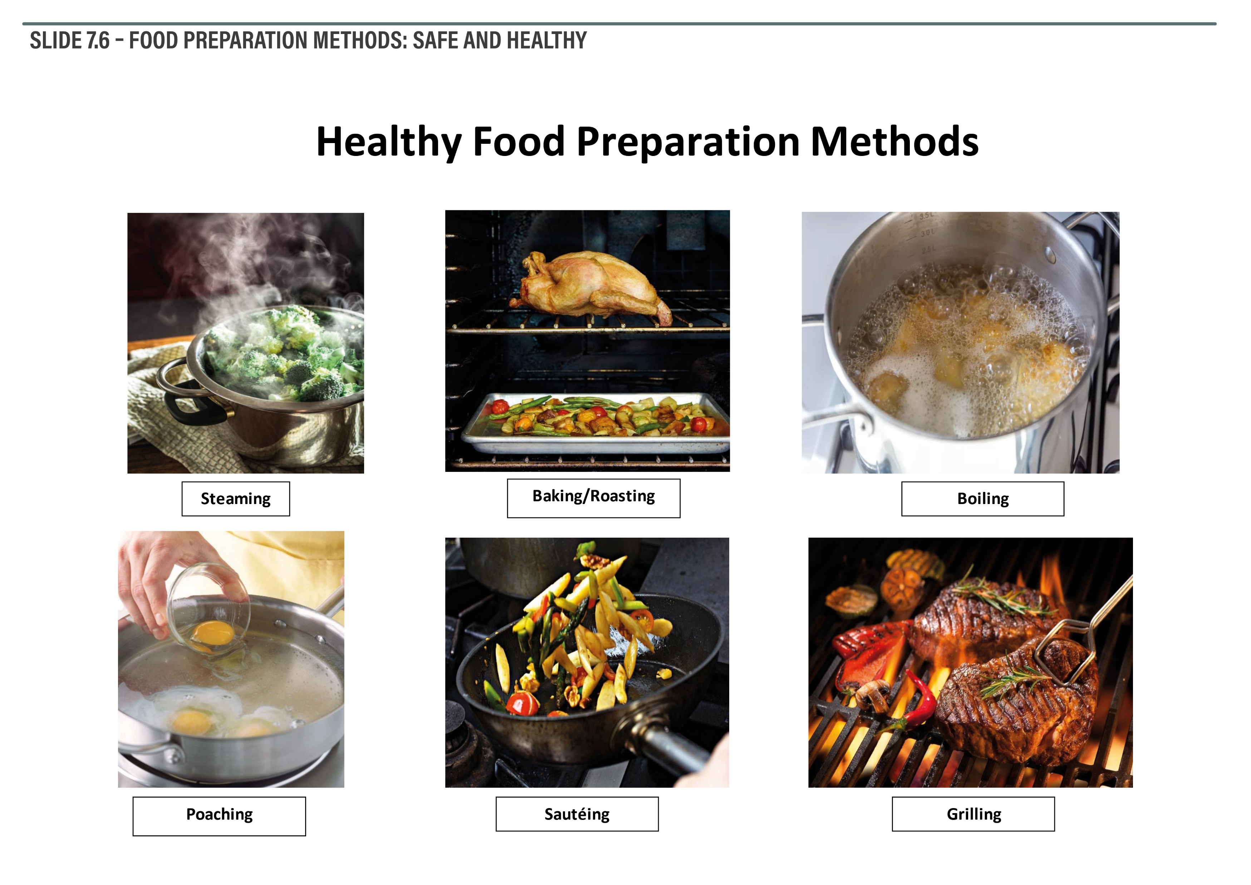
Notes:
Healthy food preparation methods: steaming, boiling, baking, grilling etc

Slide 12
How we conserve food:
Exercise 8
Notes:
Exercise instructions: p. 49 in the Manual, and Worksheet on p. 85

Slide 13
Food Preservation, Storage, and
Waste Reduction

Slide 14
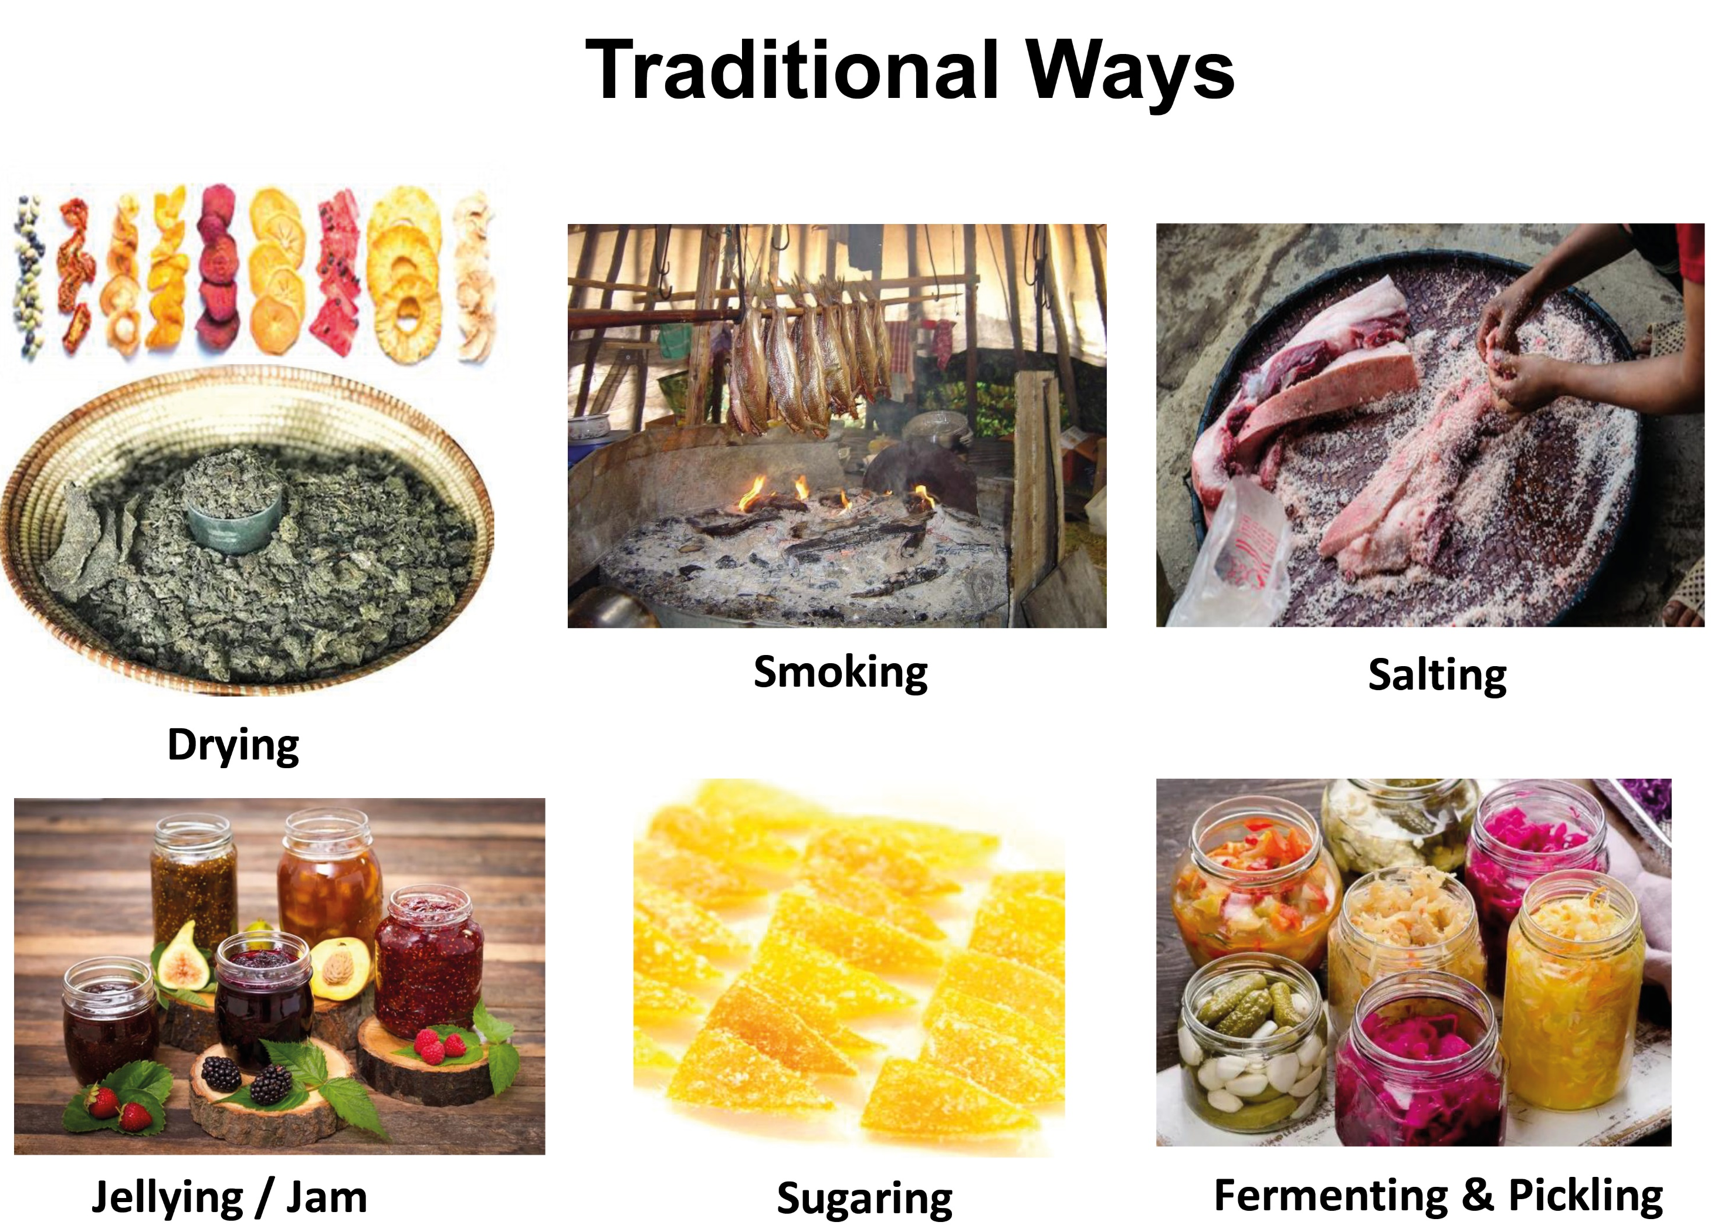
Notes:
Traditional methods: drying, salting, smoking, fermenting, sugaring, jellying, pickling

Slide 15
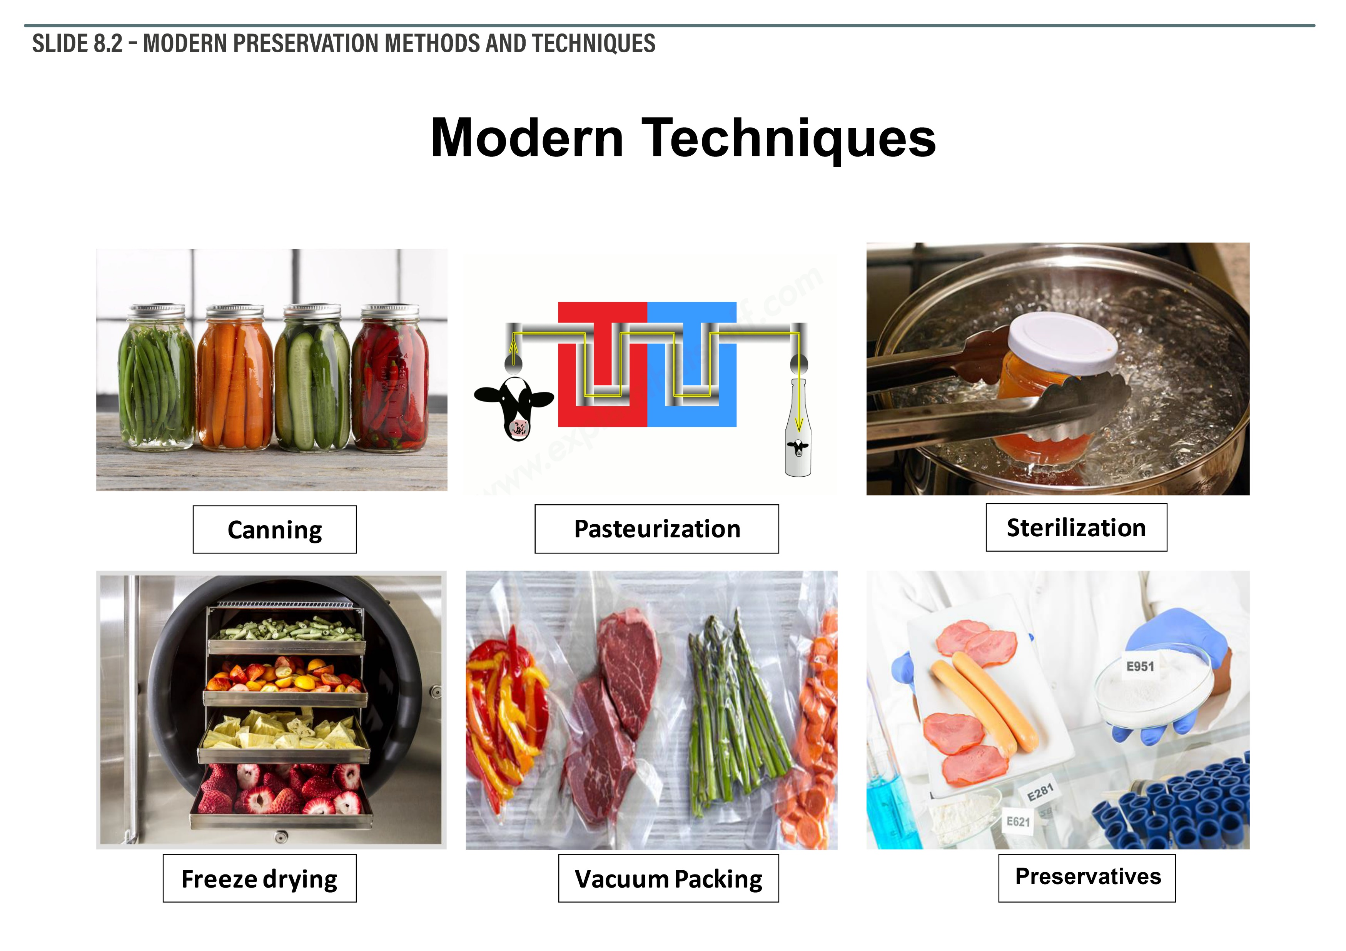
Notes:
Modern methods of food preservation: canning, bottling, vacuuming, freezing, sterilisation, pasteurisation, preservatives, and irradiation

Slide 16
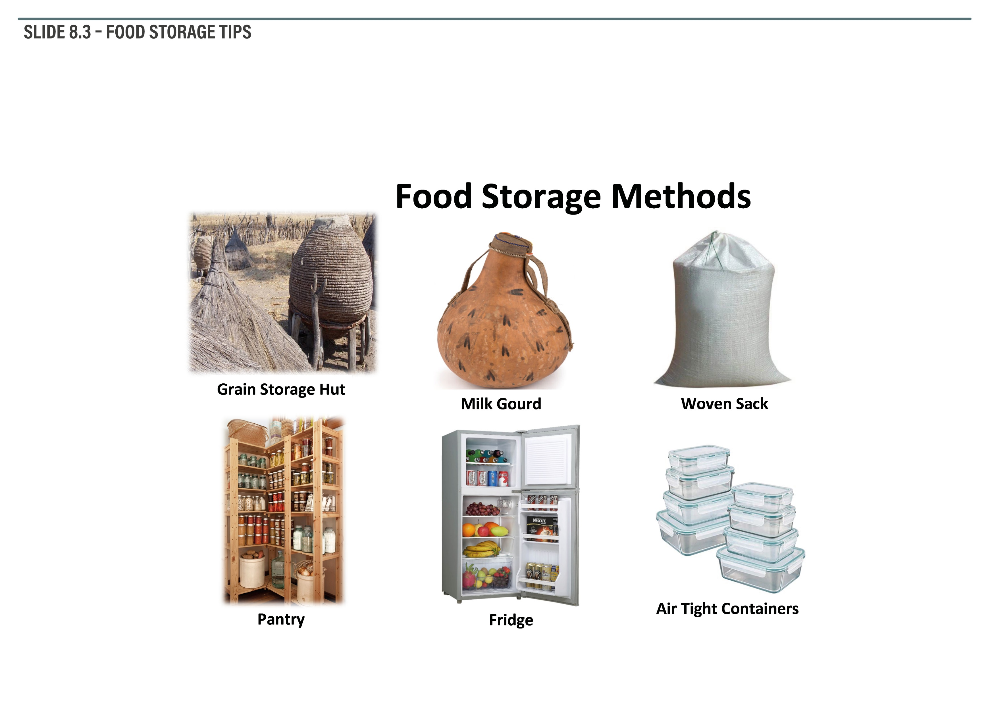
Notes:
Different old and new methods of food storage: grain storage hut, pantry, fridge, freezer Food storage tips: store your dry food (pasta, sugar, rice) in a cool dry place Easily perishable food (meat, fish, milk products, fresh fruits/vegetables) to be stored cool + covered

Slide 17
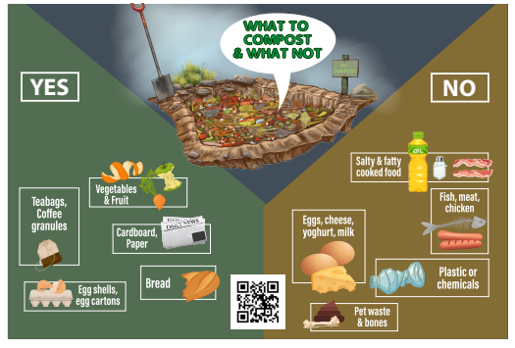
Notes:
Some of our food waste can become fertile soil through composting. This can be a simple pit compost (= hole in the ground) that is being fed regularly with organic materials (as shown on the poster) and occasionally watered.

Slide 18
Challenges, Opportunities and Ways Forward:
Exercise 9
Notes:
Exercise instructions: p. 53 in the Manual p. 53, and`workw Sheet on pp. 80-81

Slide 19
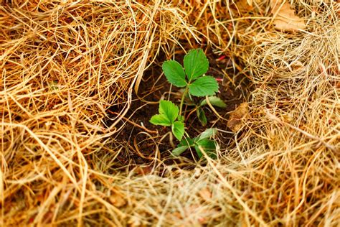
Thank you!
More information:
www.nafsan.org/N4H

