Slide 1

Nutrition for Health Embracing our Namibian Food Systems
Slide-Set
2 of 4

Slide 2
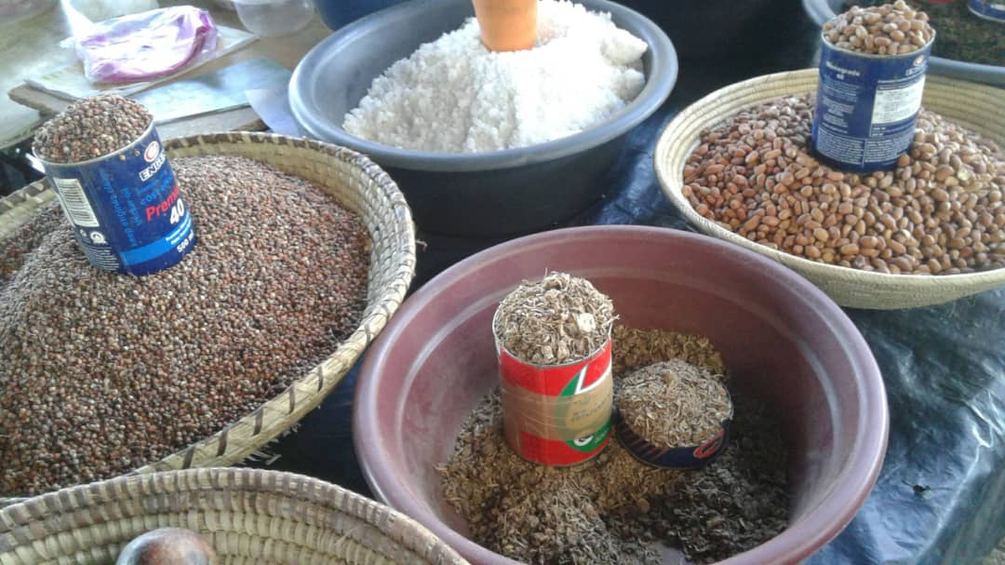

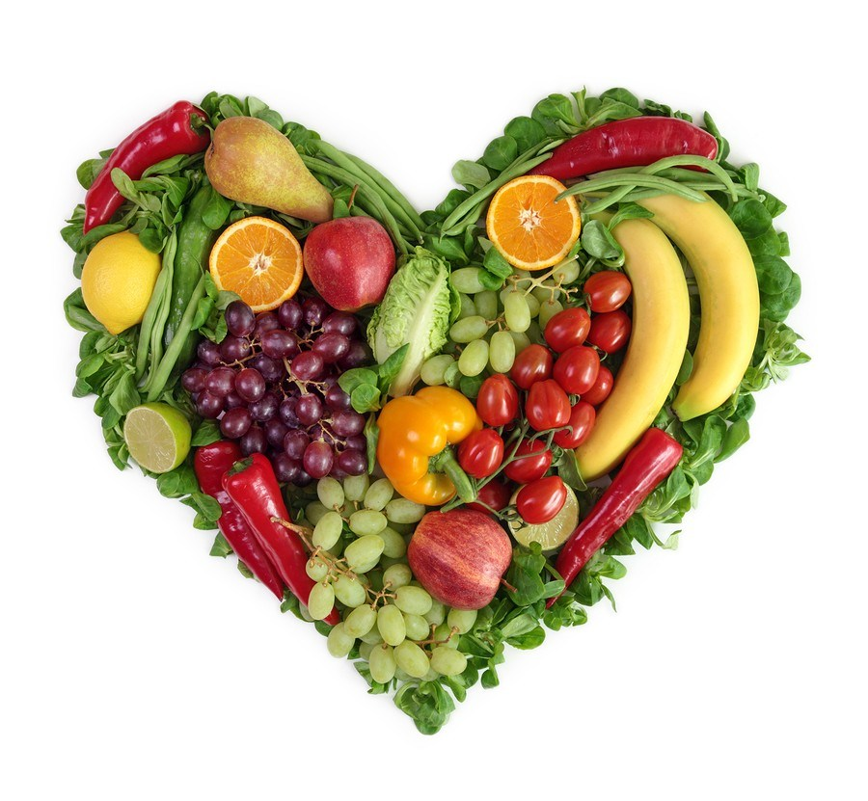




Nutrition for Health
Embracing our Namibian Food Systems

Slide 3
Hidden Sugars and Fats

Slide 4
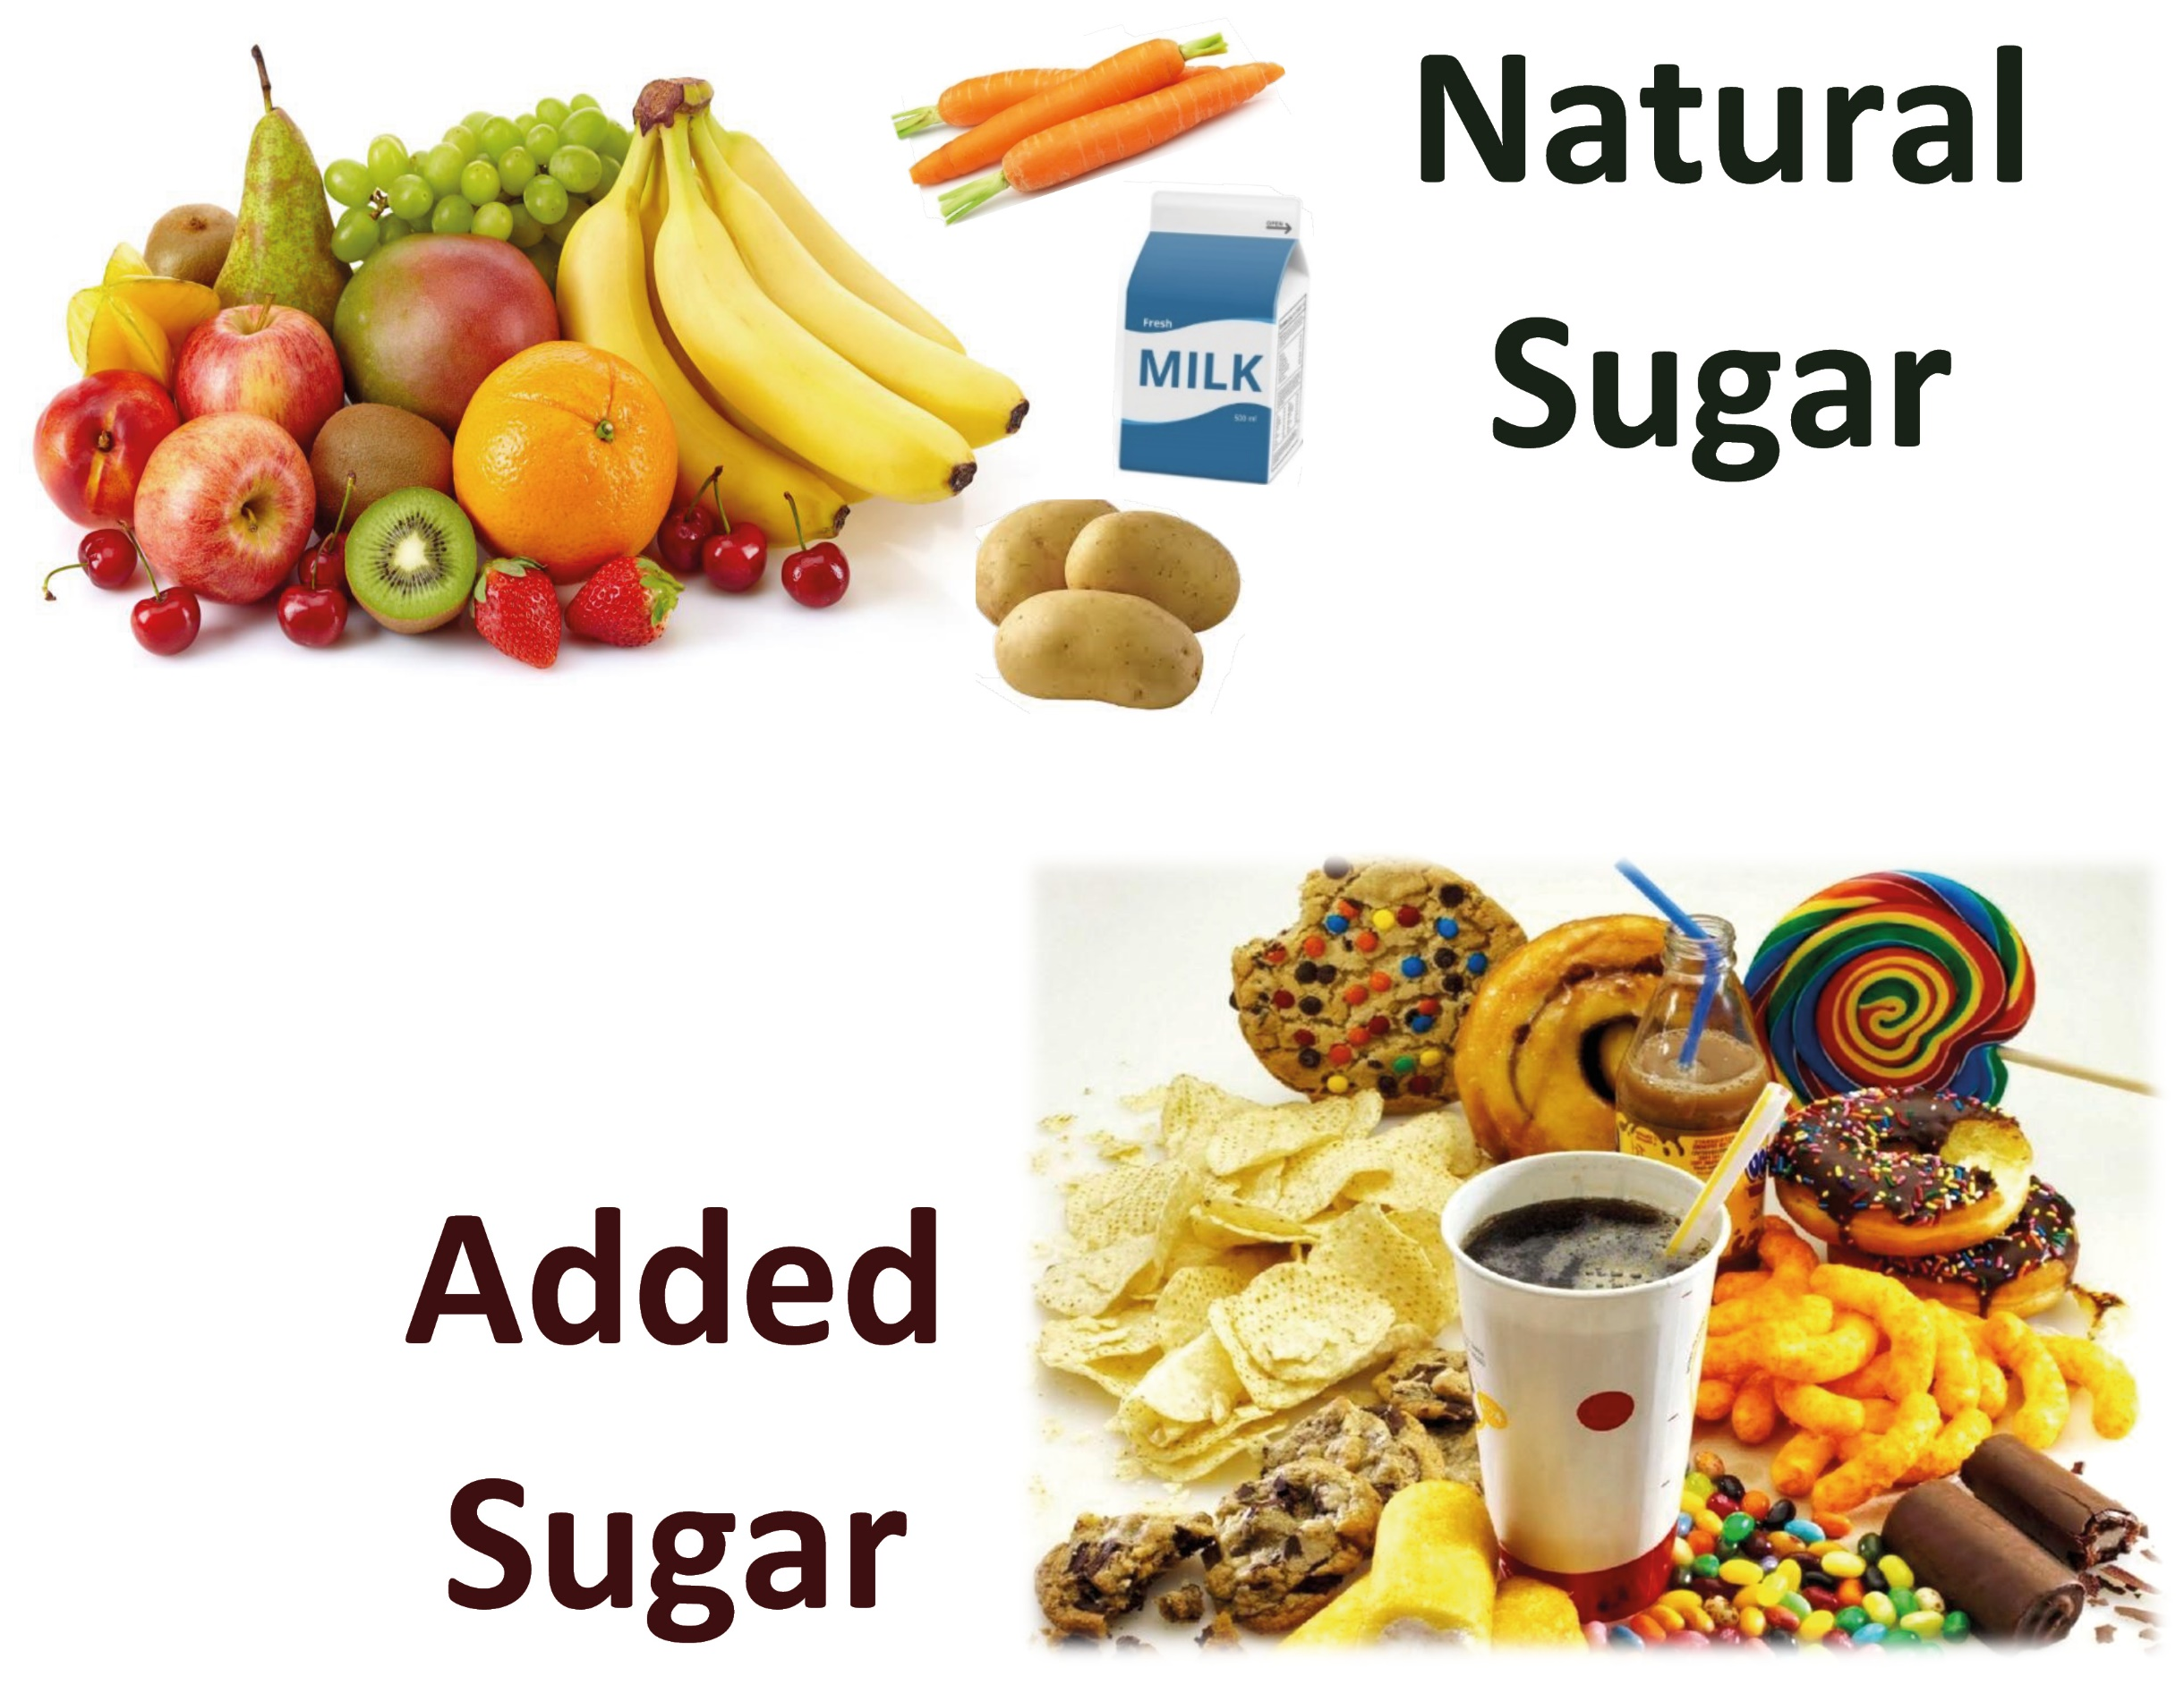
Notes:
Natural sugar is mainly in fruits, yet also in milk or in starchy foods, such as bread, corn, pasta, legumes etc.
- Because starchy food is converted into sugar in the body during digestion. 100% pure fruit juice (freshly prepared – unlike most ones from the shops) contains no “added sugar”, yet the amount of natural sugar in it is still high, as 1 glass of apple juice contains the sugar of about 3-4 apples. We would not eat 3-4 apples (or oranges) at the same speed as we drink 1 glass of juice. A medium-sized apple contains ±15g sugar, yet also healthy fibers and micro-nutrients. Added sugar is either visibly added (e.g. spoons in tea) but is most often hidden in beverages and in all kinds of food, especially processed food. Hidden sugar is not only in ‘sweet stuff’ (see picture), but also in other food, as we shall find out soon

Slide 5
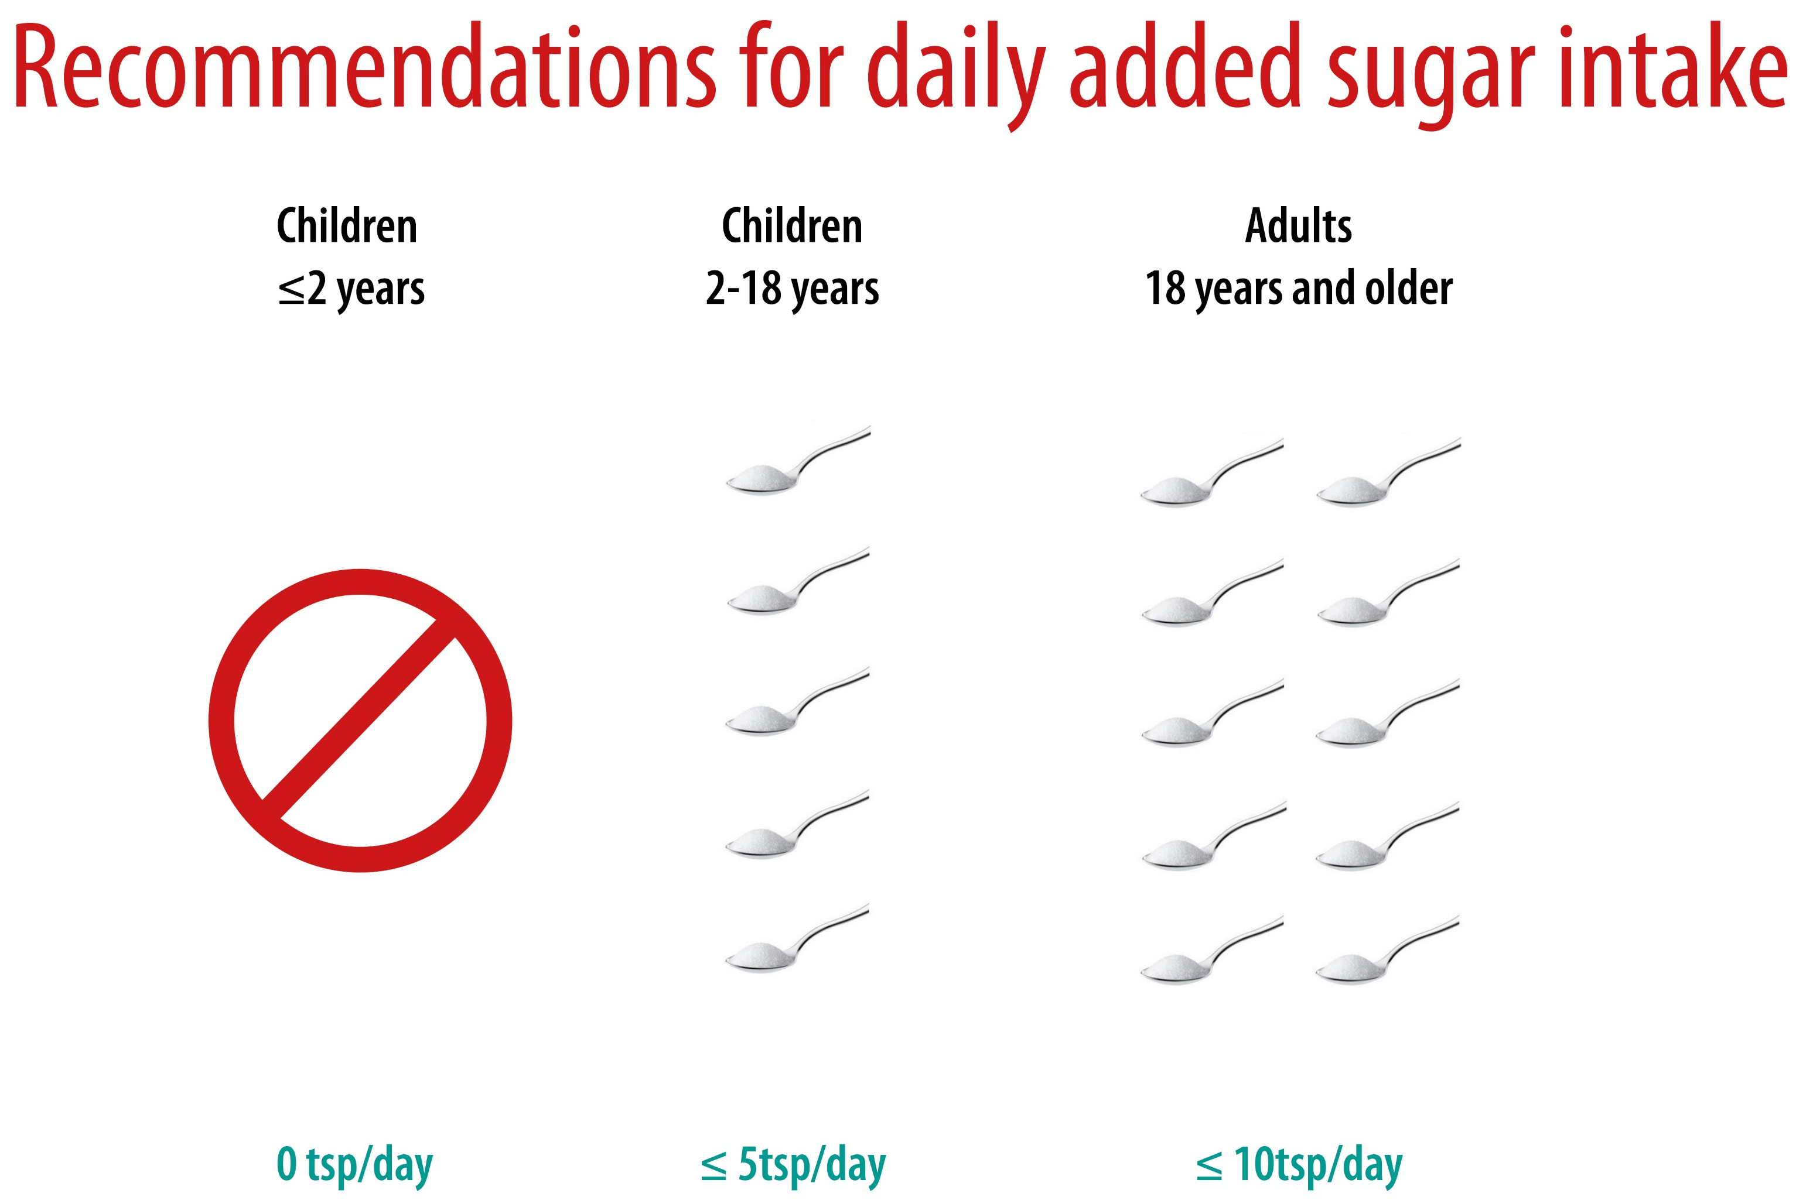
Notes:
Healthy and recommended maximal total daily sugar intake: under 2 years = no sugar at all! Maximum added sugar for adults: 50g (10 teaspoons) and 25g (5 teaspoons) for children (2-18 years). Young children are still developing their sense of taste, so they easily get addicted to sugar at a very early age, yet when raising them without or with less sugar, they will not like sweet stuff too much.

Slide 6


Slide 7
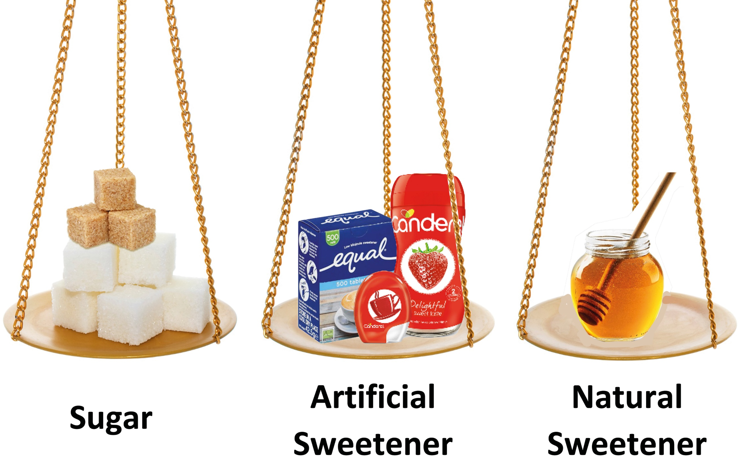
Notes:
Artificial sweeteners are sugar substitutes, providing a sweetness similar to sugar yet with less food energy.
Risks of artificial sweeteners are unknown and still being explored, with some – like Aspartame – having been linked to cause cancer and Alzheimers, and they may affect our eating habits in other ways.
Honey is good for medicinal purposes, yet it is still a form of ‘sugar’ and should not be over-consumed. Honey must not be given to children under 1 year of age! It may cause severe health risks as children need time to develop the necessary enzymes to deal with certain bacteria in honey. The same applies to Goat milk (only after 1 year of age).

Slide 8
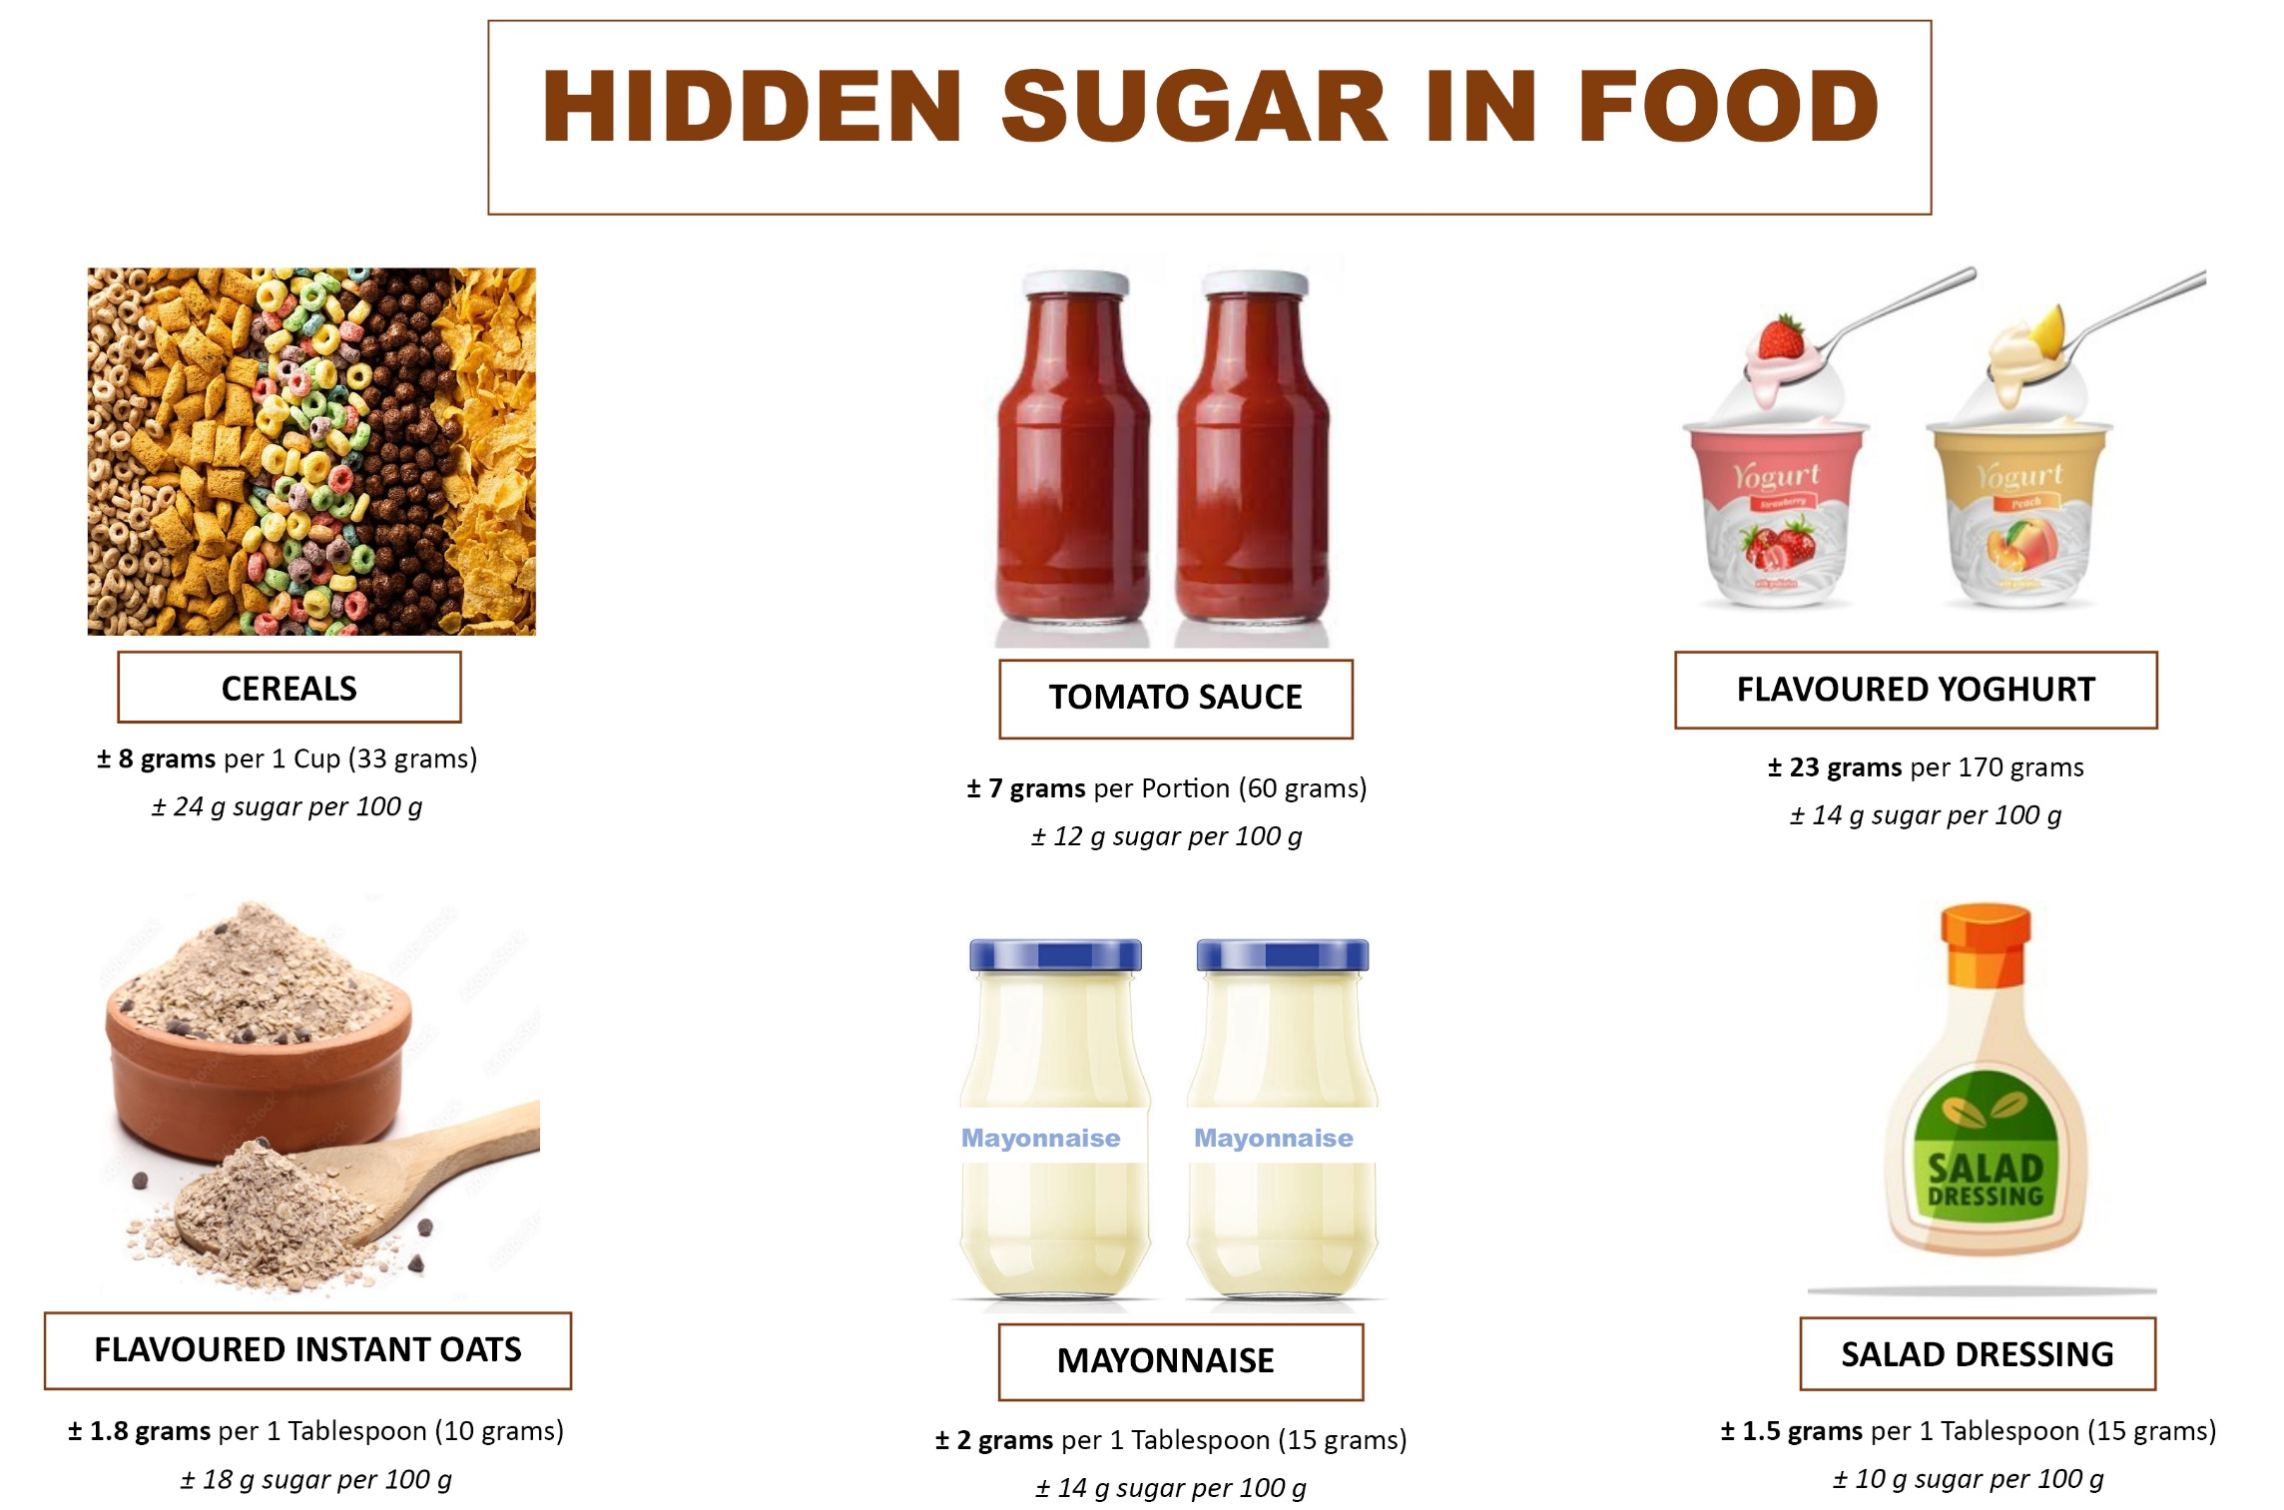
Notes:
Even salty food – especially when processed – contains a lot of hidden sugars, such as tomato sauce, mayonnaise, flavored yoghurt, and breakfast cereals.
Sugar is added in so many foods and drinks, it has become an often invisible addiction in our lives!
Advise participants to read food labels.

Slide 9

Notes:
Benefits of unsaturated fats: reduce the risk of stroke, boost brain health, good cholesterol level
Fats to ‘Love’ (= eat more of): nuts, oils and seeds, avocado
Fats to ‘Limit’: cheese, butter, saturated fats (animal fats)
Risks of saturated and artificial fats: risk of heart attacks, strokes, and type 2 Diabetes
Fats to ‘Lose’ (= avoid): fatty foods (deep fried), pastries (cookies, cakes), margarine, and also Canola oil Health Warning: Reusing (reheating) cooking oil increases risks for cancer, obesity, high blood pressure, strokes, Diabetes, heart diseases, and acidity/indigestion (= burning sensation in throat and stomach).
Do not reuse/reheat oil more than 3 times!!!

Slide 10
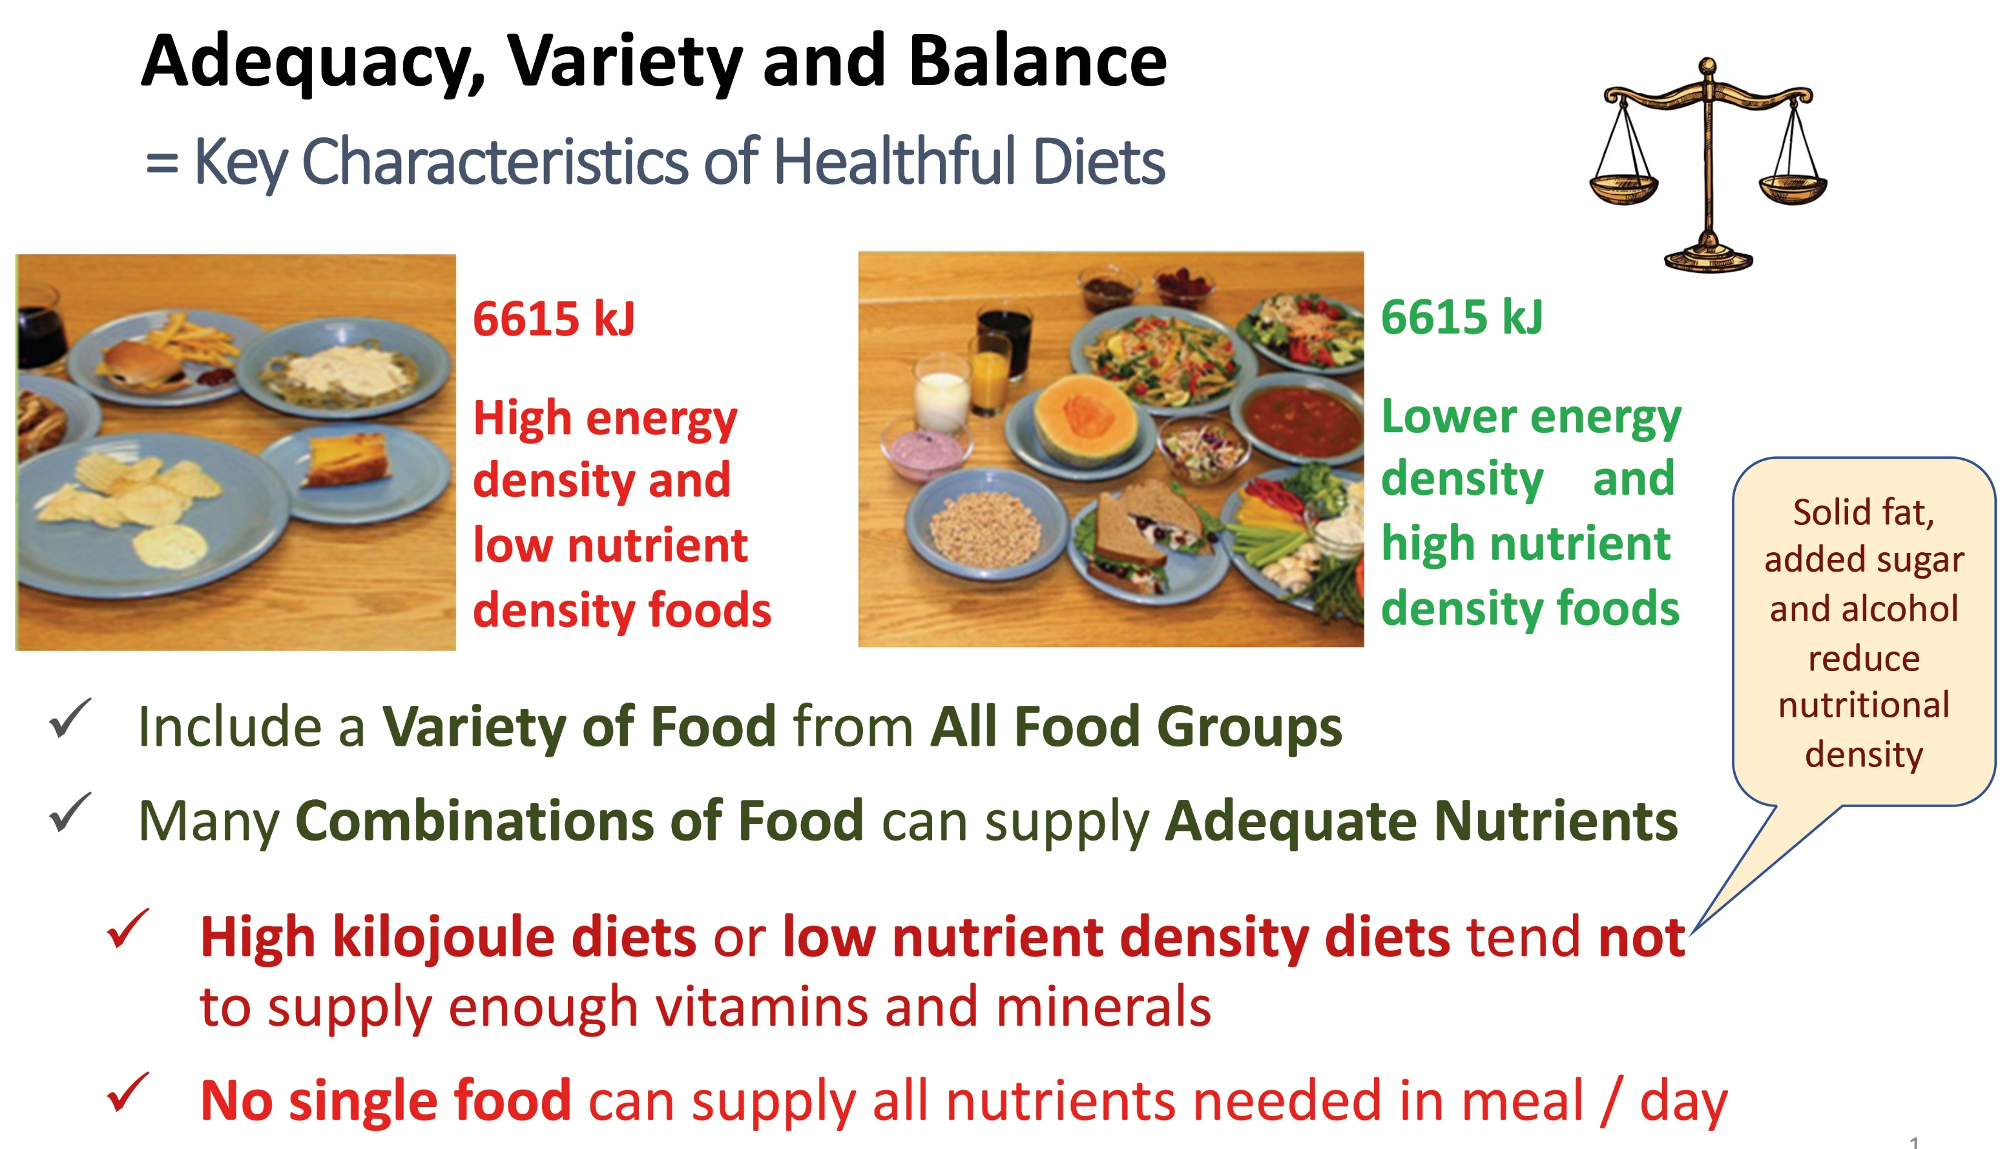
Notes:
Healthy means to eat enough (= adequate), different foods (= variety) and not too much from the one or the other (= balance).
Food should come from “All Food Groups” - something we will explore next, after lunch. Check for and read food labels

Slide 11
Food Groups:
Exercise 3
Notes:
Exercise instructions: pp. 23-24 in the Manual, and Cheat Sheet on pp. 80-81

Slide 12
Food Groups and their
Nutritional Value

Slide 13
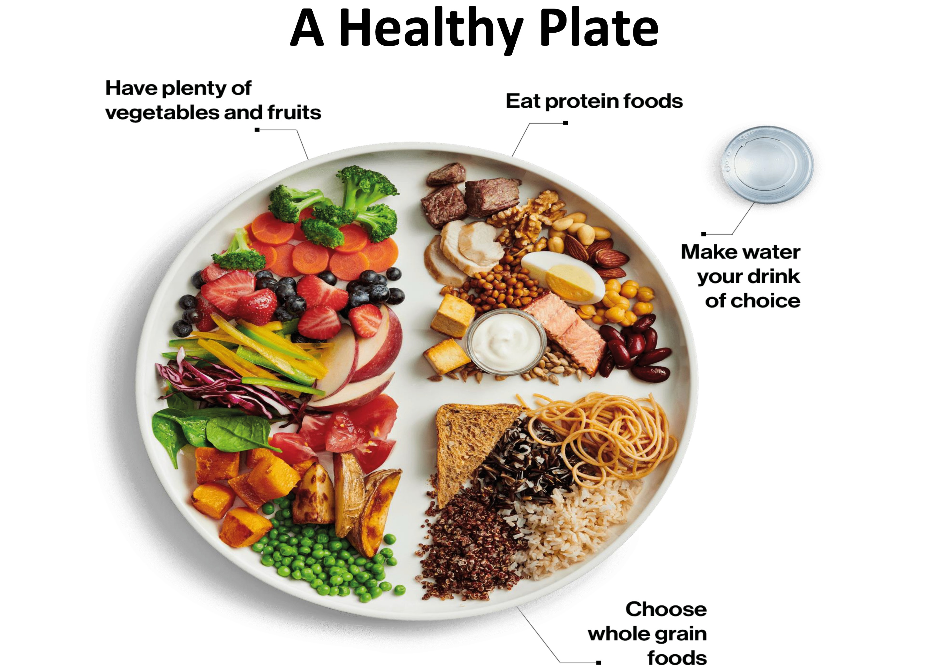
Notes:
Various food groups on a plate are often visible through different colors
Eating a variety of food is important, ideally from each food group
Portion sizes matter: ½ plate = vegetables, ¼ = cereals (staple foods), ¼ = proteins Fruits should not be part of the main meal but rather as a snack.
If eating with the meal then they should be eaten before a meal (or 30 minutes after), because they are being digested much faster!

Slide 14
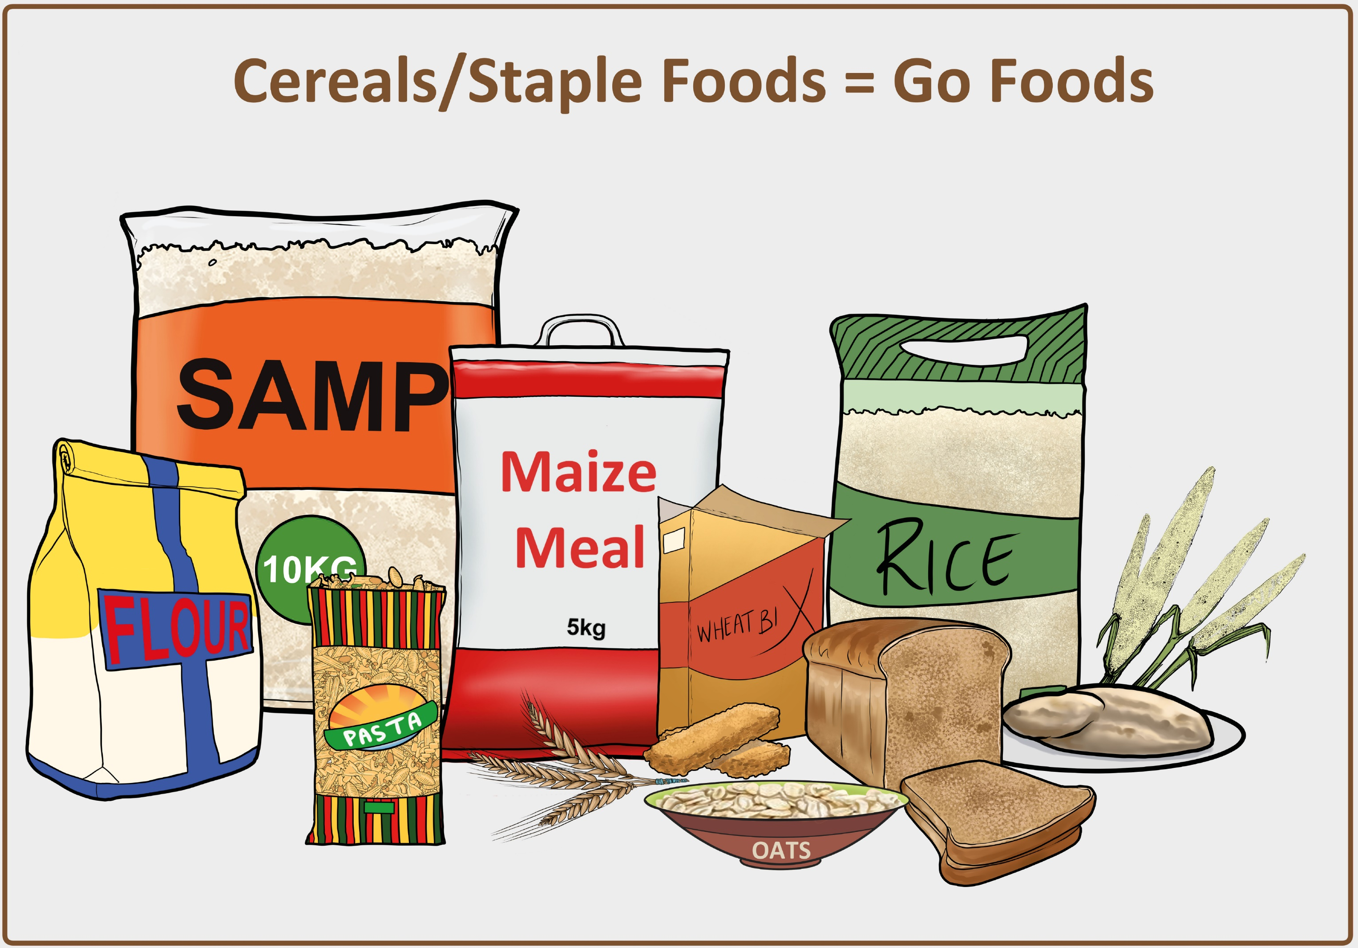
Notes:
Staple foods (cereals) in their most natural and unprocessed form (e.g. omahangu or maize, potatoes, brown bread, brown rice contain “complex carbohydrates” with healthy fiber and starch. BROWN bread/rice is recommended. Important to give the body energy to support all bodily functions and physical activity = “GO-food” There are also “simple carbohydrates”, e.g. in fruits (yet here together with good fiber), milk and honey, but mostly in refined sugar and candy/sweets. This also gives us “energy” but only for a very short period, and here we can observe an unhealthy ‘sugar high’ or a ‘sugar rush’, especially among young children.
Note, there is no real difference and no health benefit of brown sugar compared to white sugar!

Slide 15
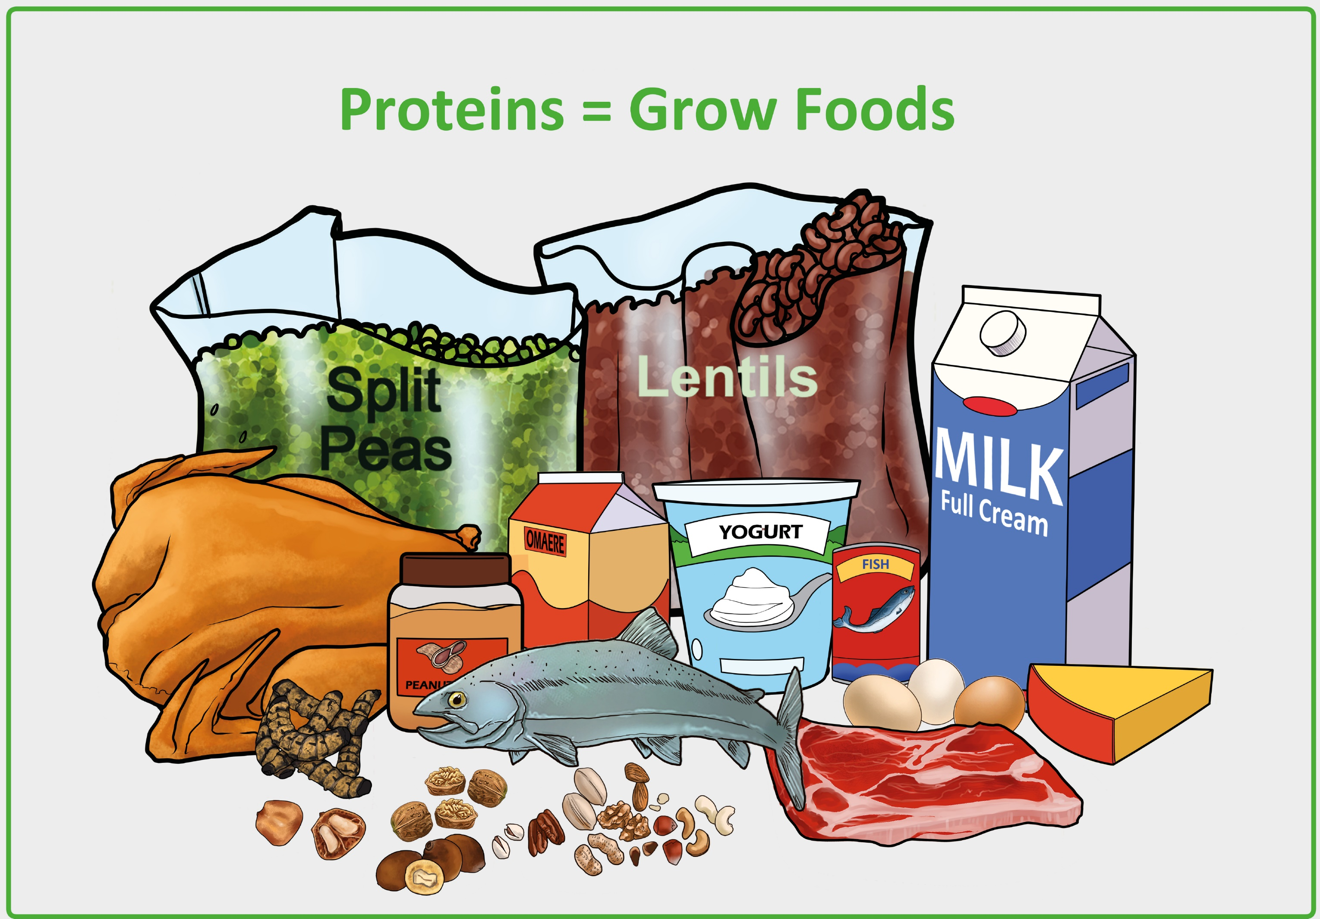
Notes:
Proteins help maintain life and build and repair damaged cells and tissues = “GROW-food” Sources = animals: beef, chicken, lamb, game, donkey, worms, frogs, eggs, milk, yogurt, omaere, … + In plants: beans (fresh or dried, incl. oshingali), Bambara groundnut (eefukwa), lentils, split peas, nuts, sesame seeds, peanuts, … Peanut butter is the healthier/better option on bread, instead of margarine, especially for children. Consuming more plant-based protein is recommended, as red (beef, game, pork) and processed meat increase health risks, e.g. inflammations, heart disease, cancer, Diabetes, and premature death.

Slide 16
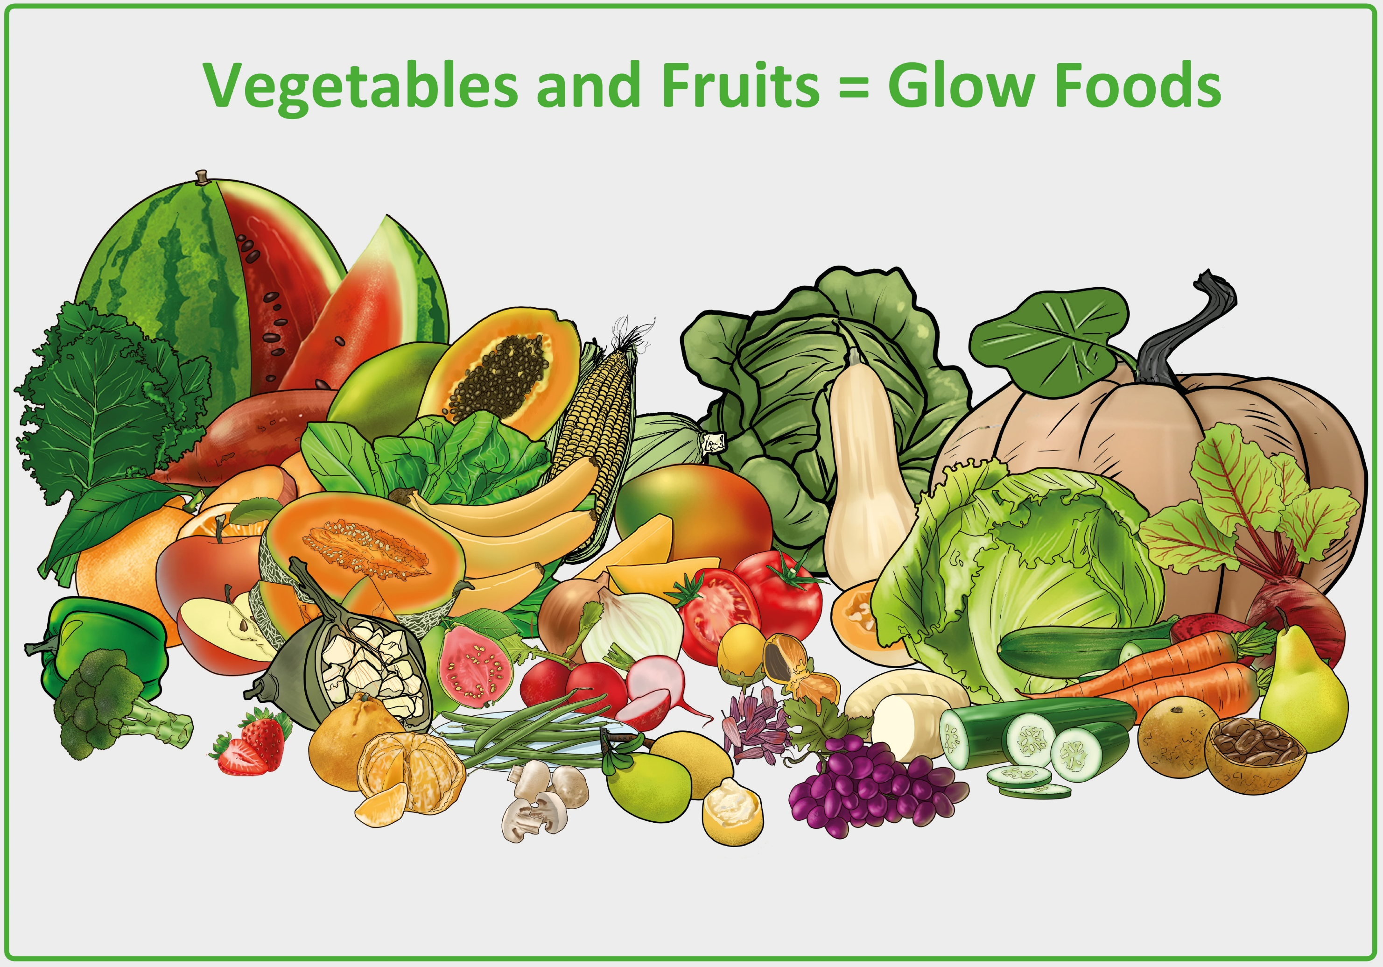
Notes:
Importance of vegetables and fruits: provide us with important micro-nutrients (= minerals + vitamins) to strengthen our immune system and to maintain healthy hair, eyes and skin = “GLOW-food” Examples of local vegetables: ombidi, ombowa, mutete, cabbage, pumpkin, lettuce, peppers, tomatoes. Dark leafy vegetables such as kale, spinach (ombidi/mutate/ombowa) and lettuce = good sources of iron, calcium, and Vitamins A, C, and K. They strengthen the immune system, slow down signs of aging, and help to prevent heart diseases, high blood pressure, and cancer.
Examples of local fruits: eembe, monkey orange, grapes, oranges, lemons, mango, pawpaw, guava, …

Slide 17
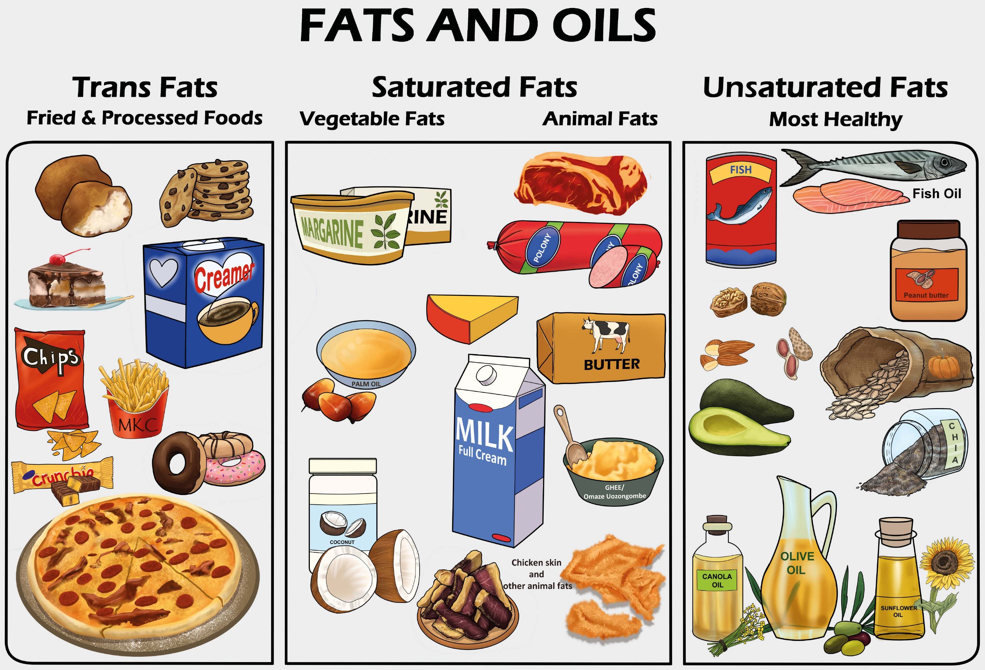
Notes:
Importance of fats: help the body take in Vitamins A, D and E, and provides the body with energy. Ideal sources of fats: nuts, avocado, natural local oils, fish and also in natural butter. Limit consumption: oils (especially canola oil mixes), margarine, baked goods, fatty meat, cheese etc. Caution = unhealthy hidden fats: fat cakes and warm chips (fries) and fried foods (e.g. sausages, ‘russians)

Slide 18
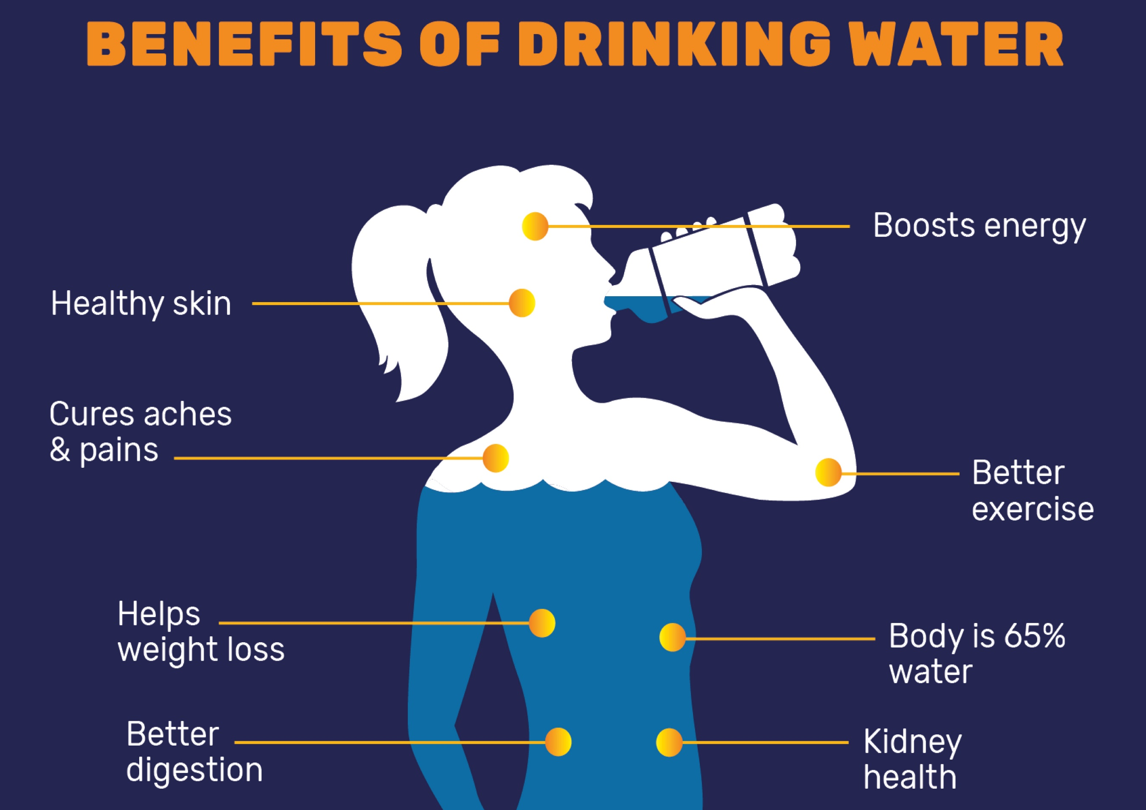
Notes:
Importance of water = prevents dehydration, allows us to have enough blood, saliva, sweat and tears; ensures healthy body functions, such as digestion and helps keep our body at a normal temperature. Drink 2-3 liters of water a day (8-10 glasses/cups), most of it in the morning, because our body needs about 3-4 liters of water a day, including water intake through other liquids.

Slide 19
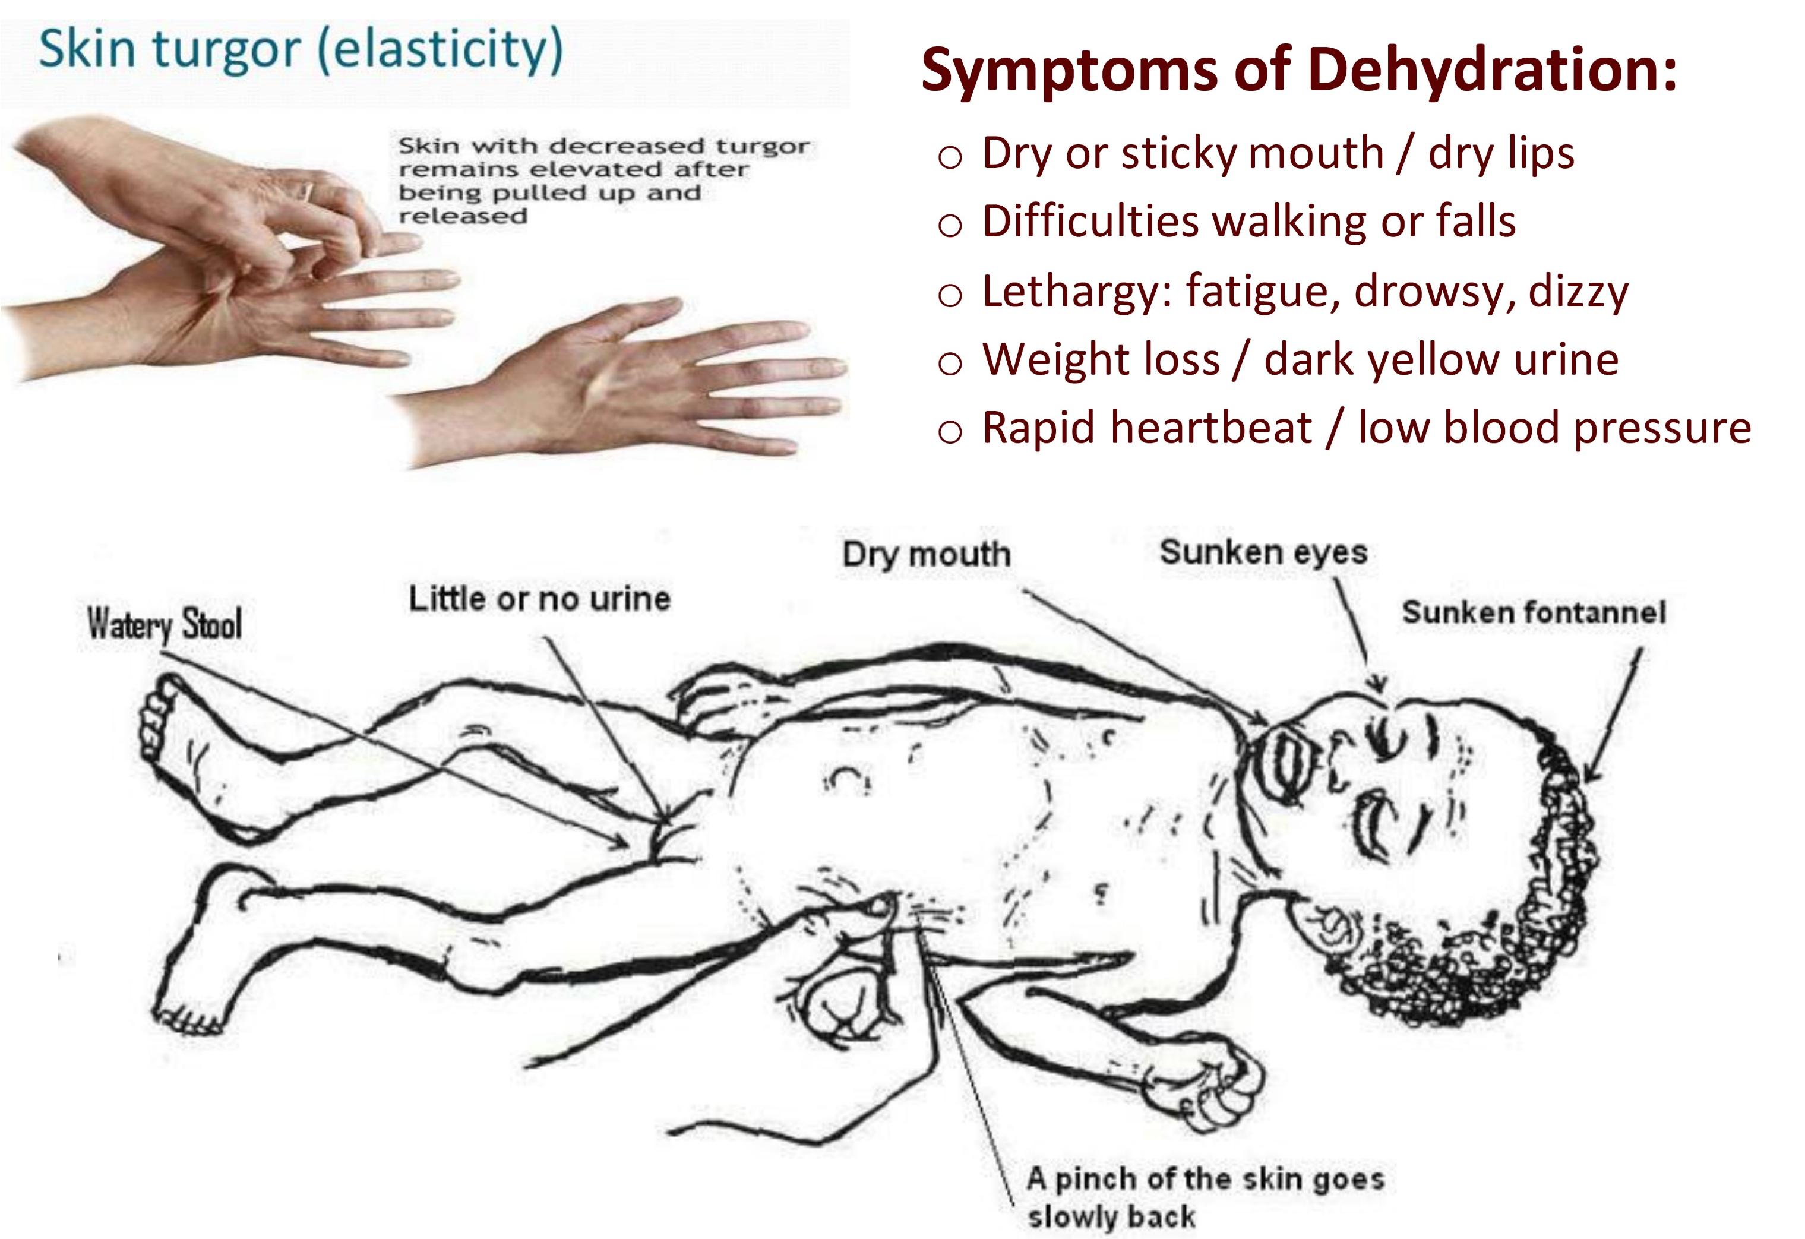
Notes:
Water must be clean and safe, otherwise it makes us sick, and we won’t be able to make use of it. Define dehydration as a lack of water and other fluid in the body as a result of not drinking enough water. Show how dehydration can be detected through the skin-test and other symptoms. Urge people to take dehydration seriously, especially for babies, young children, mothers and the elderly.

Slide 20
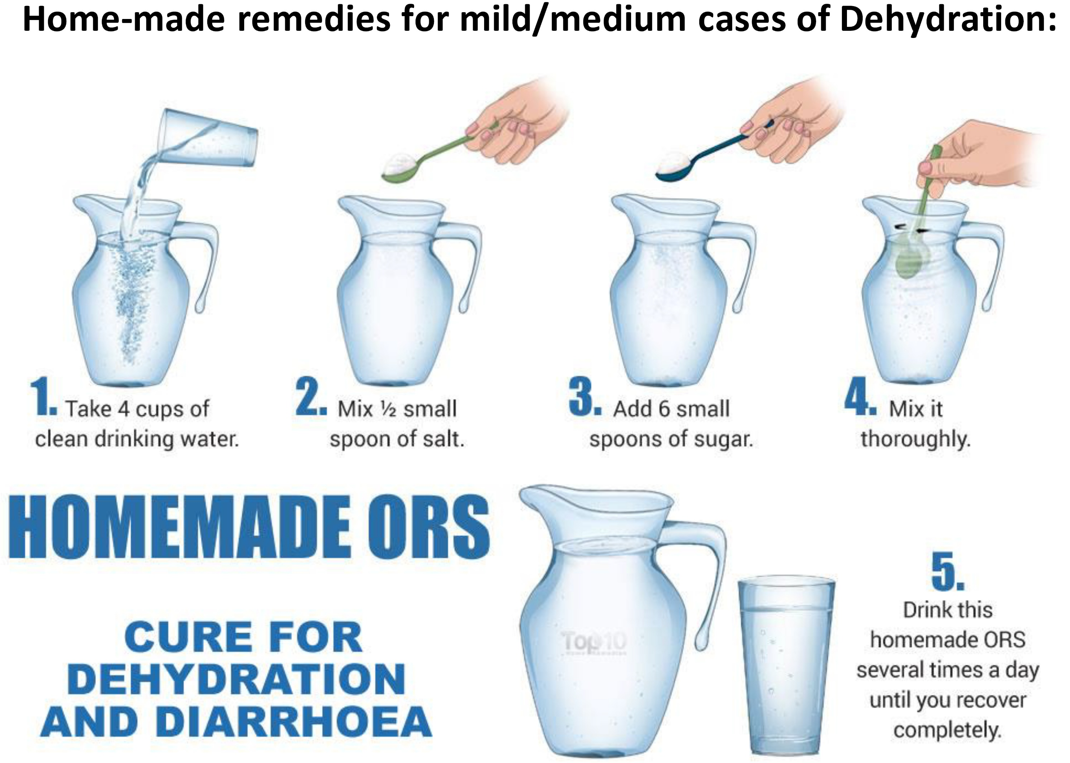
Notes:
Dehydration - First Aid: Move to a cool and shaded place, consider lying down and raising legs, Drink plenty of water (no drinks with alcohol or caffeine!), Prepare home-made ORS - use the slide to explain how to prepare the solution. Cases of severe dehydration must be treated with intravenous fluids at clinics or hospitals!

Slide 21
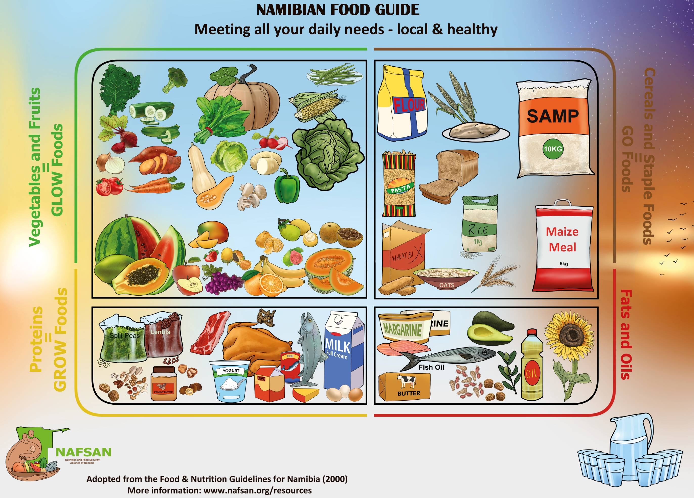
Notes:
Have a variety of foods from different food groups (various colours = “eat a rainbow”) throughout your day. Sweet or salty snacks should only be consumed in small amounts and on rare occasions. Oils, spreads and sauces should also be used sparingly – don’t reuse oil more than 3 times. Always read your food labels! Note that Namibia has so far very limited food label regulations, so we don’t know all ingredients and additives that are in our foods and beverages. Drink lots of water and reduce the number of sugary drinks, including fruit juices. Dilute fruit juices or other sugary drinks with water (50/50).

Slide 22
Nutrition Challenges
in our Lives:
Exercise 4
Notes:
Exercise instructions: p. 31 in the Manual, and Worksheet, p. 82

Slide 23
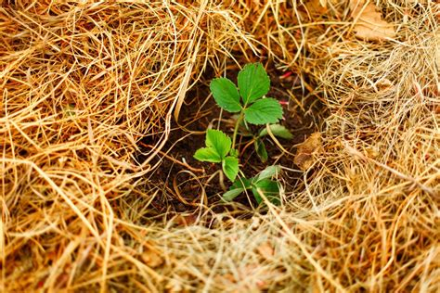
Thank you!
More information:
www.nafsan.org/N4H

