Slide 1

Nutrition for Health Embracing our Namibian Food Systems
Slide-Set
1 of 4

Slide 2
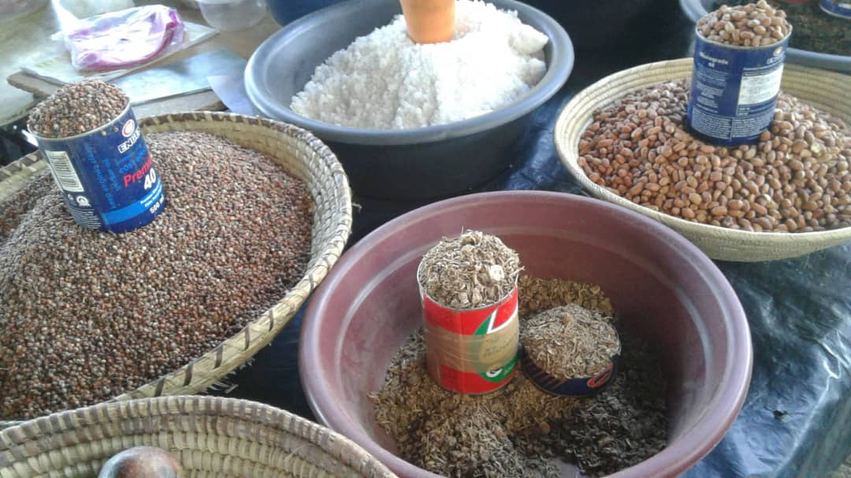

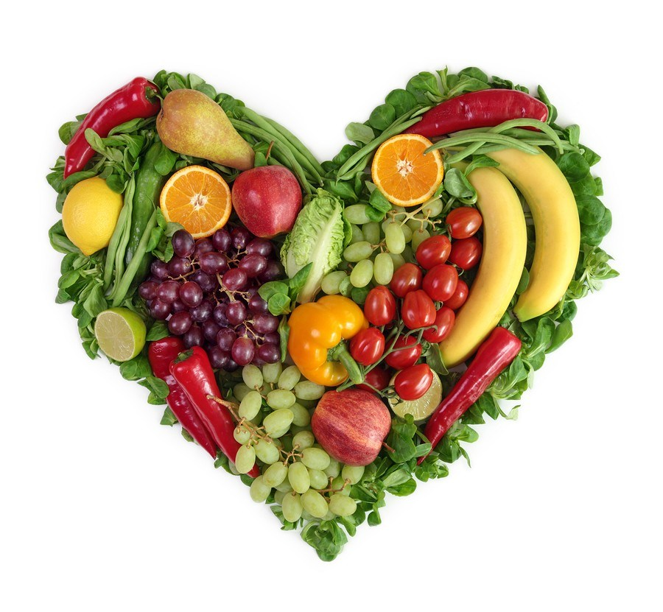




Nutrition for Health
Embracing our Namibian Food Systems

Slide 3
Understanding Malnutrition:
Under-Nutrition

Slide 4
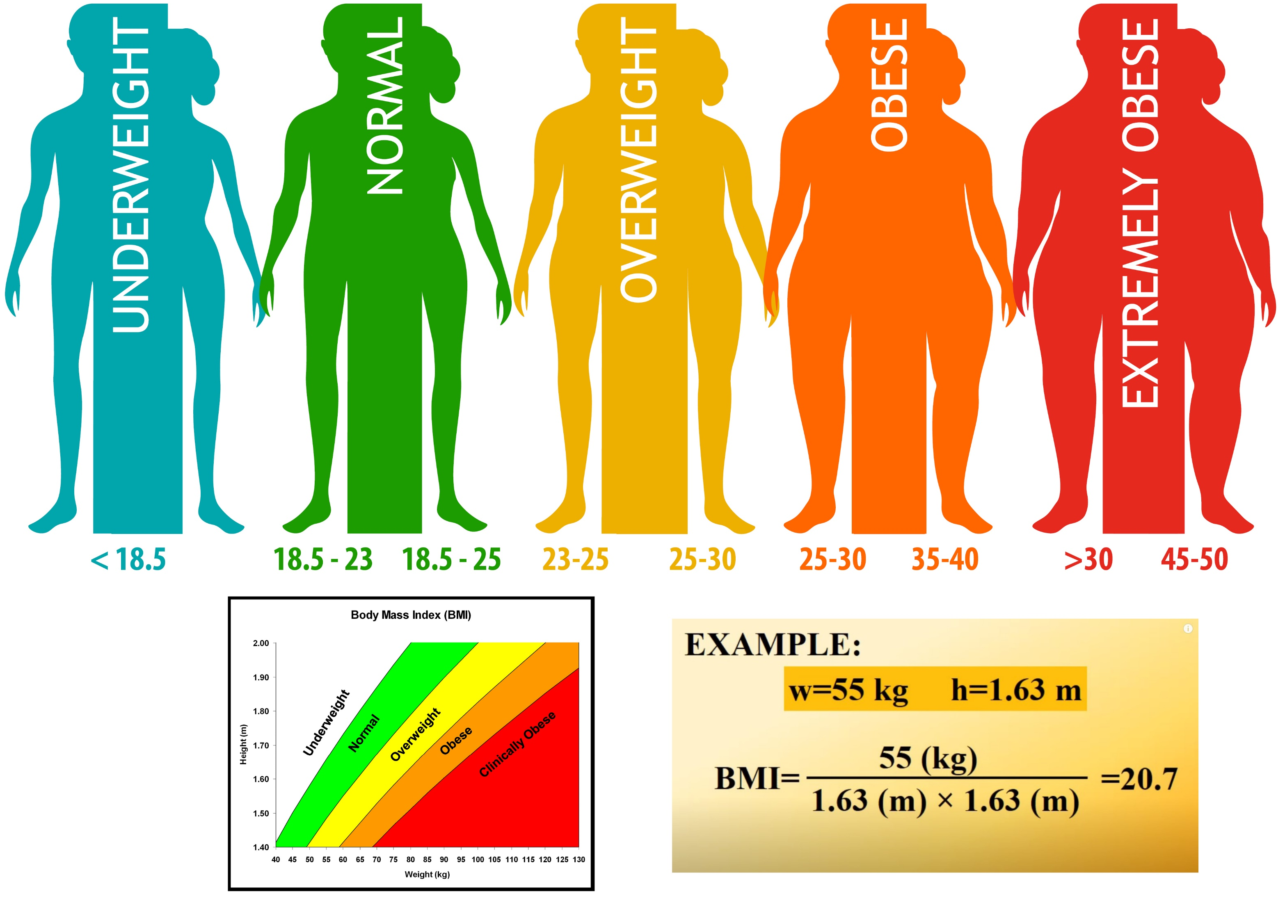
Notes:
Body Mass Index (BMI) is a simple calculation using a person’s height in metres and weight in kilograms. The formula is BMI = kg/m2 . For example, 55kg divided by 1.63 x 1.63 (height x 2) = BMI of 20.7 (kg/m2) Highlight the 5 categories (= underweight, normal, overweight, obese, extremely/clinically obese) using the BMI scale

Slide 5
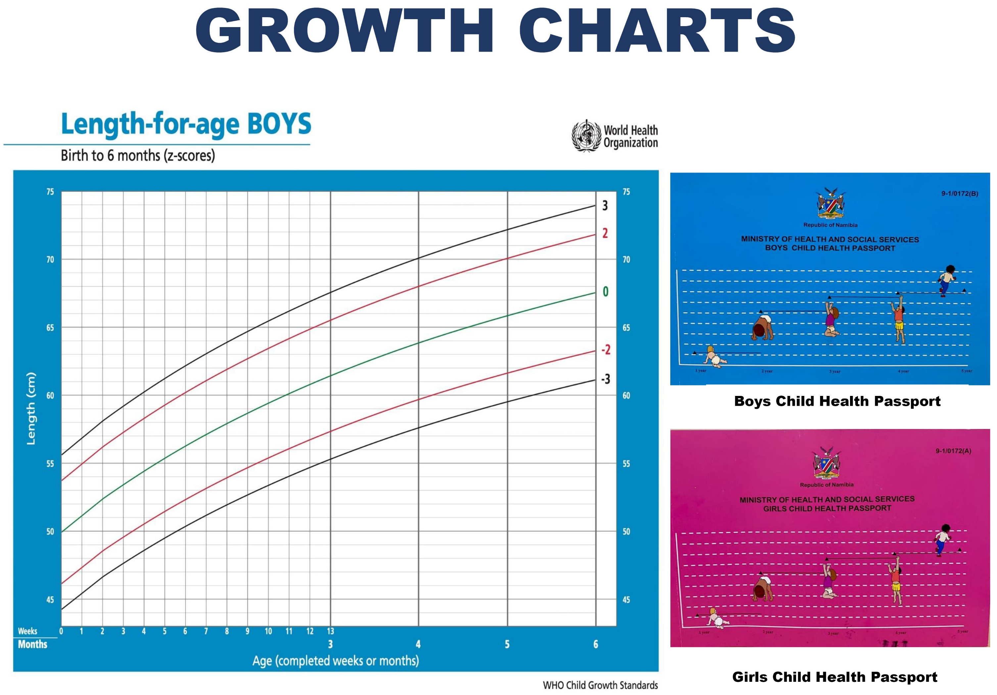
Notes:
Body Mass Index (BMI) is a simple calculation using a person’s height in metres and weight in kilograms. The formula is BMI = kg/m2 . For example, 55kg divided by 1.63 x 1.63 (height x 2) = BMI of 20.7 (kg/m2) Highlight the 5 categories (= underweight, normal, overweight, obese, extremely/clinically obese) using the BMI scale

Slide 6
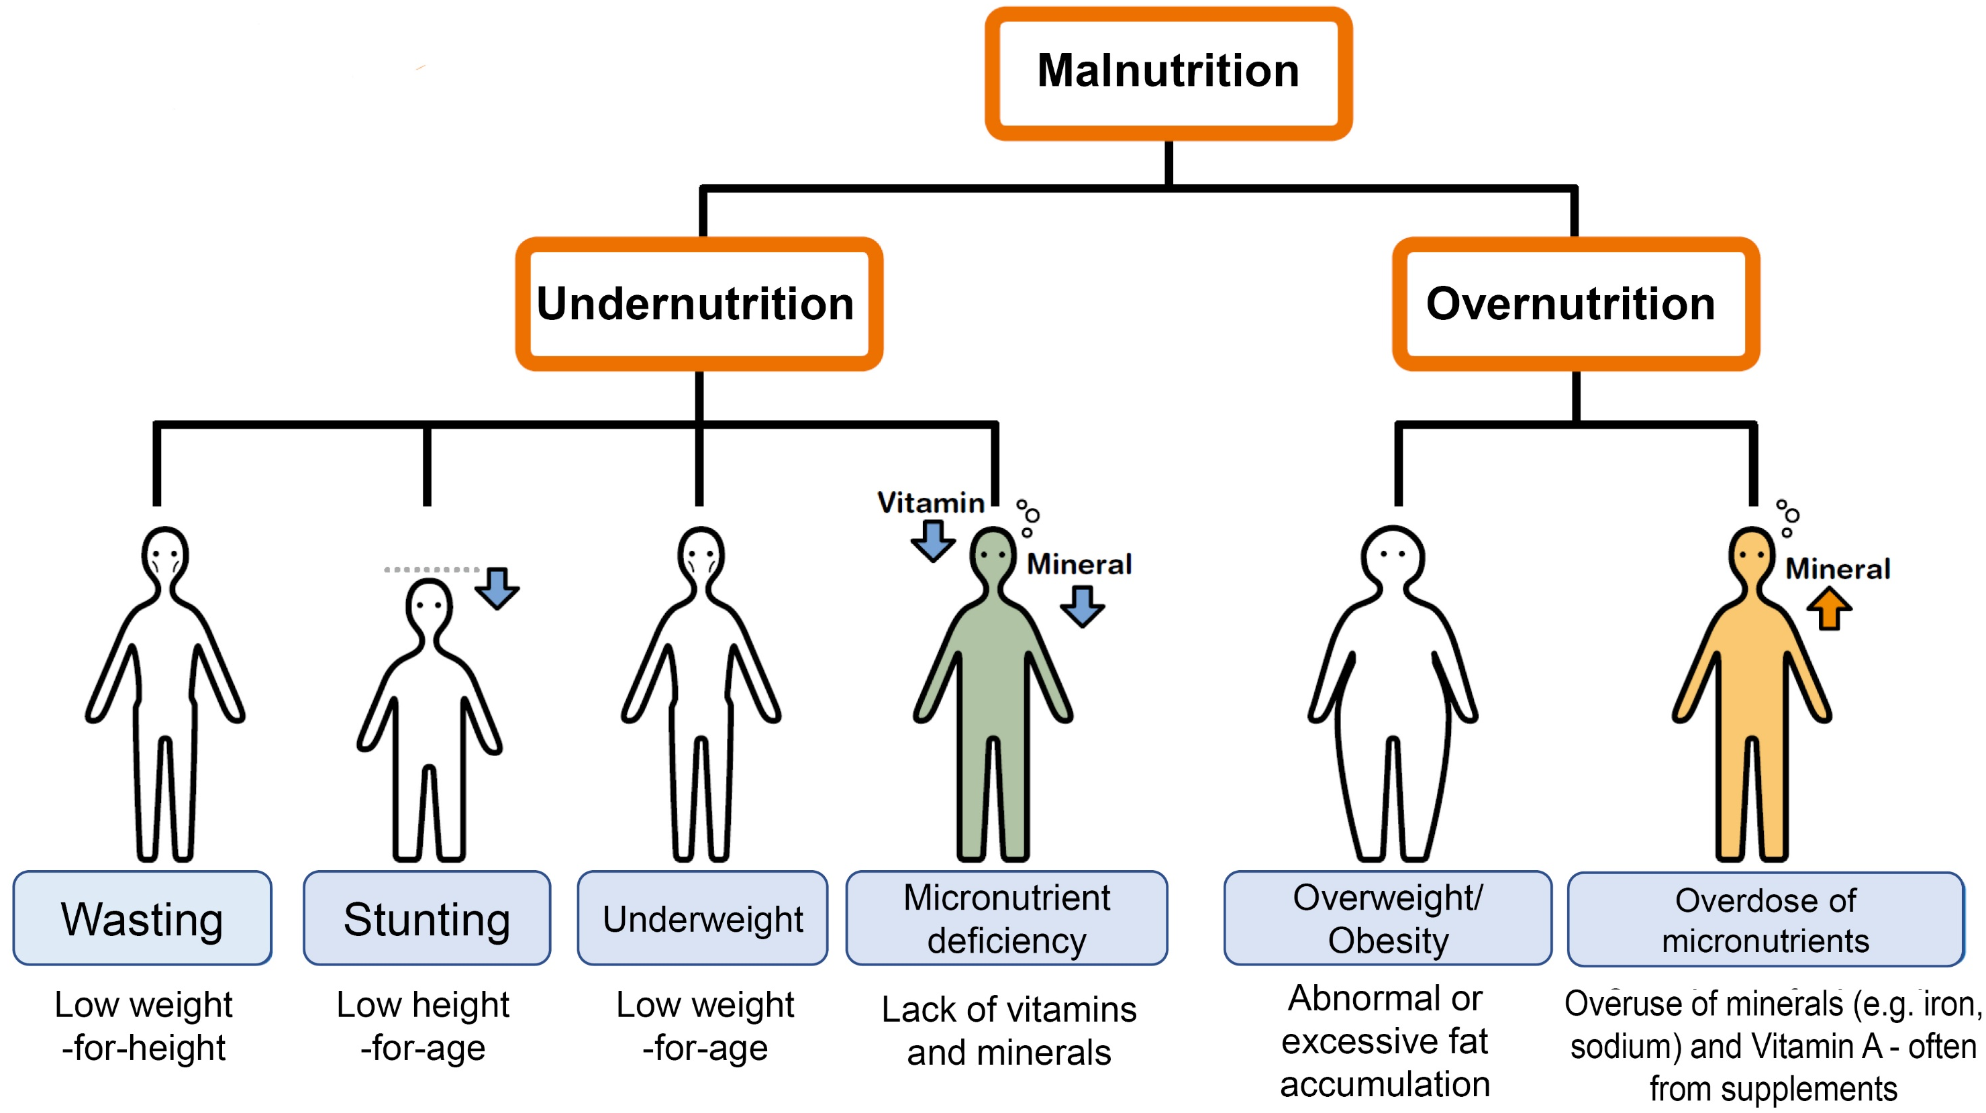
Notes:
There are 2 different types of malnutrition: over- and under-nutrition We now focus on forms of under-nutrition: wasting, stunting, underweight, micro-nutrient deficiency

Slide 7
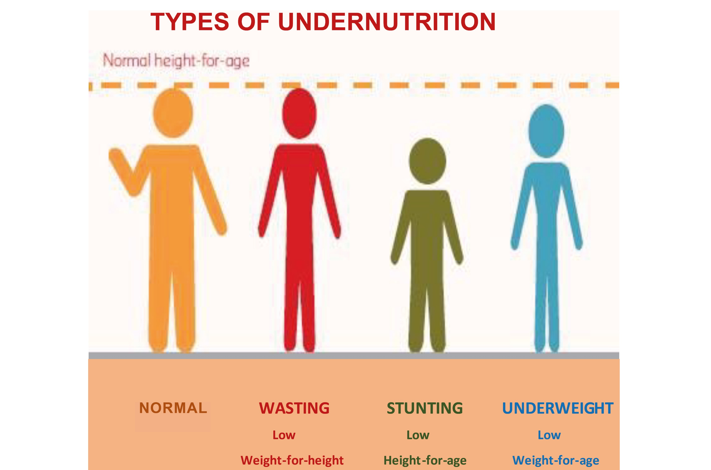
Notes:
Underweight = Weight is too low for their age Wasting = Weight is too low for their height Stunting = Height is too short for their age

Slide 8
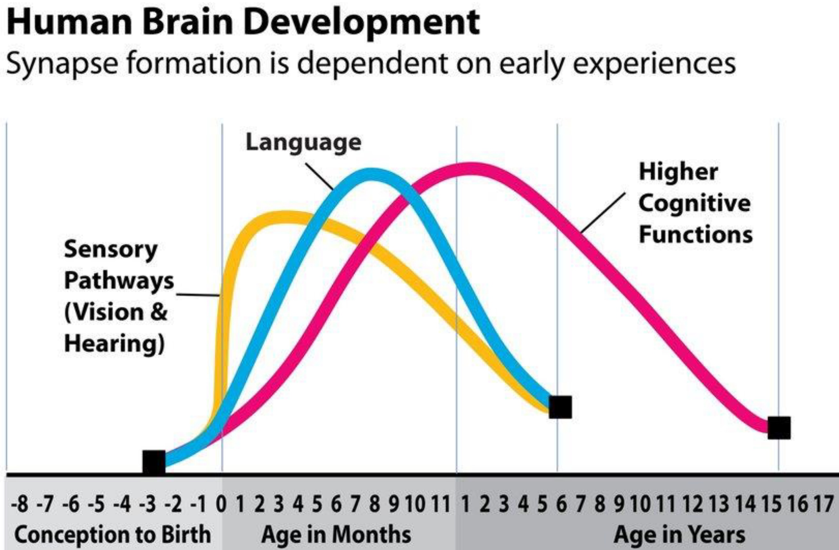
Notes:
Most neural connections (synapses) in the brain are build/developed before the age of 3 years, with up to 700 - 1,000 neural connections being established per second in the first 1-2 years. These are responsible for seeing, hearing, language, and ‘higher cognitive functions’, such as thinking, reasoning, concentrating, remembering, problem solving and our overall understanding of the world. 90% of brain development is completed by the age of 5 years

Slide 9
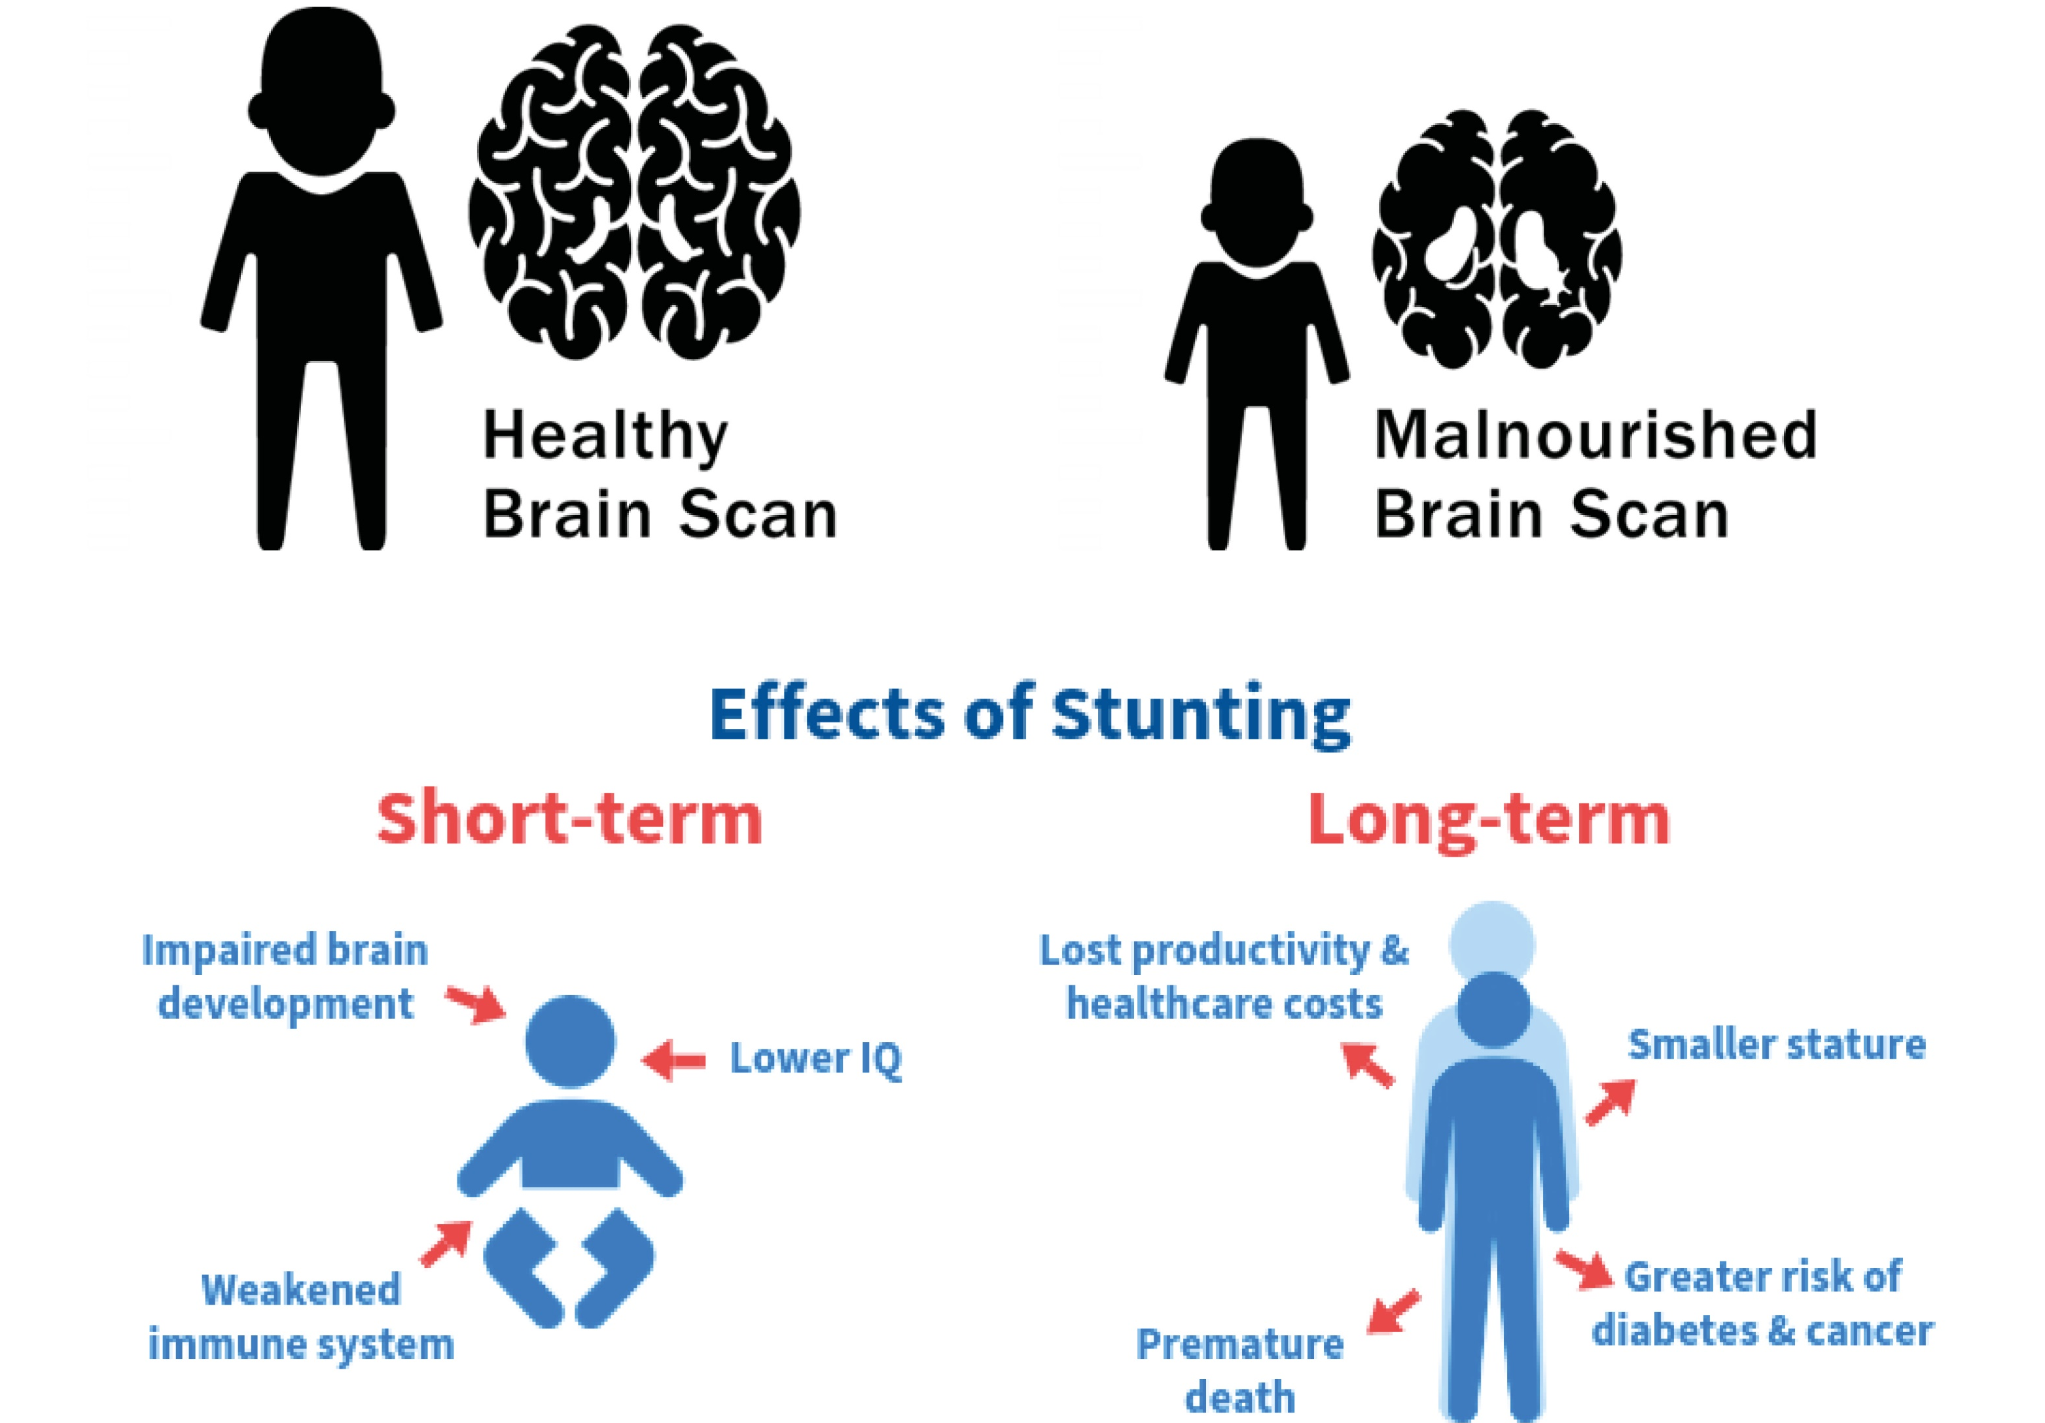
Notes:
Differentiate between a healthy brain of a normal child and the brain of stunted/malnourished child. If stunting is not addressed and treated within the first 2 years, its effects are irreversible! Short-term effects of stunting (weak immune system, slow brain development etc.) Long-term effects of stunting (stunted growth, low productivity, risk of Diabetes and cancer)

Slide 10
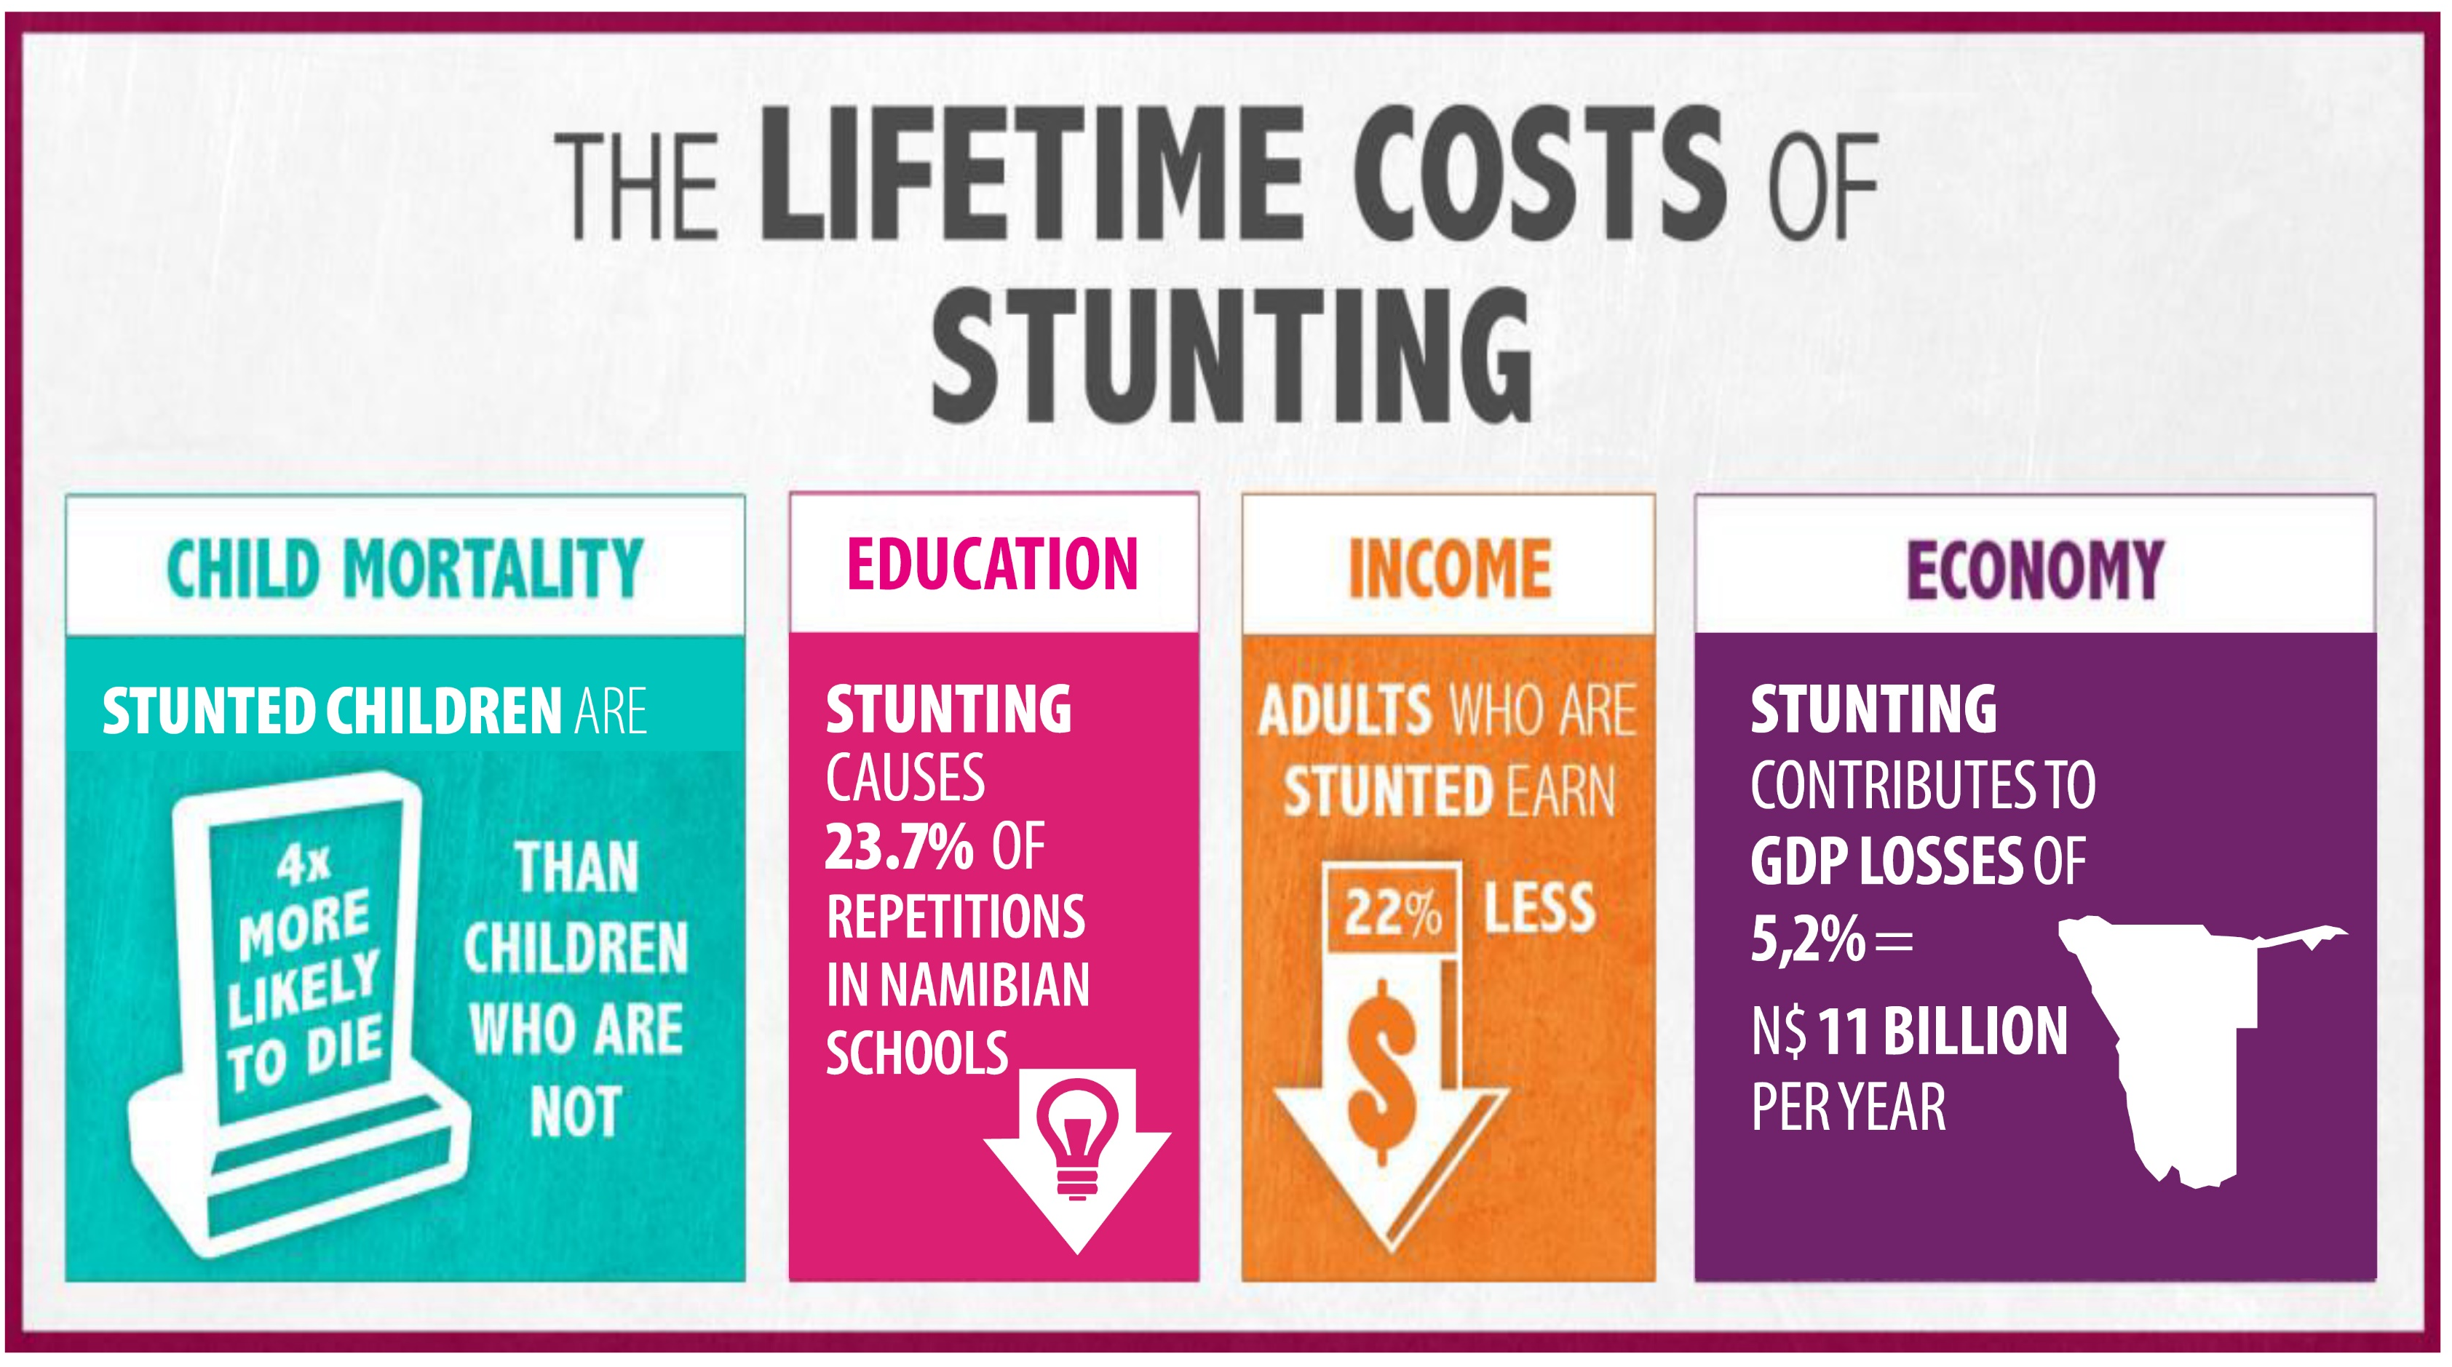
Notes:
Stunting increases child mortality (deaths), and it reduces average IQ scores and income opportunities. On a national level, it costs Namibia N$ 11,1 Billion or over 5,2% of our national GDP, every single year; according to the Namibian Cost of Hunger in Africa (COHA) Study in 2021 - www.nafsan.org/resources

Slide 11
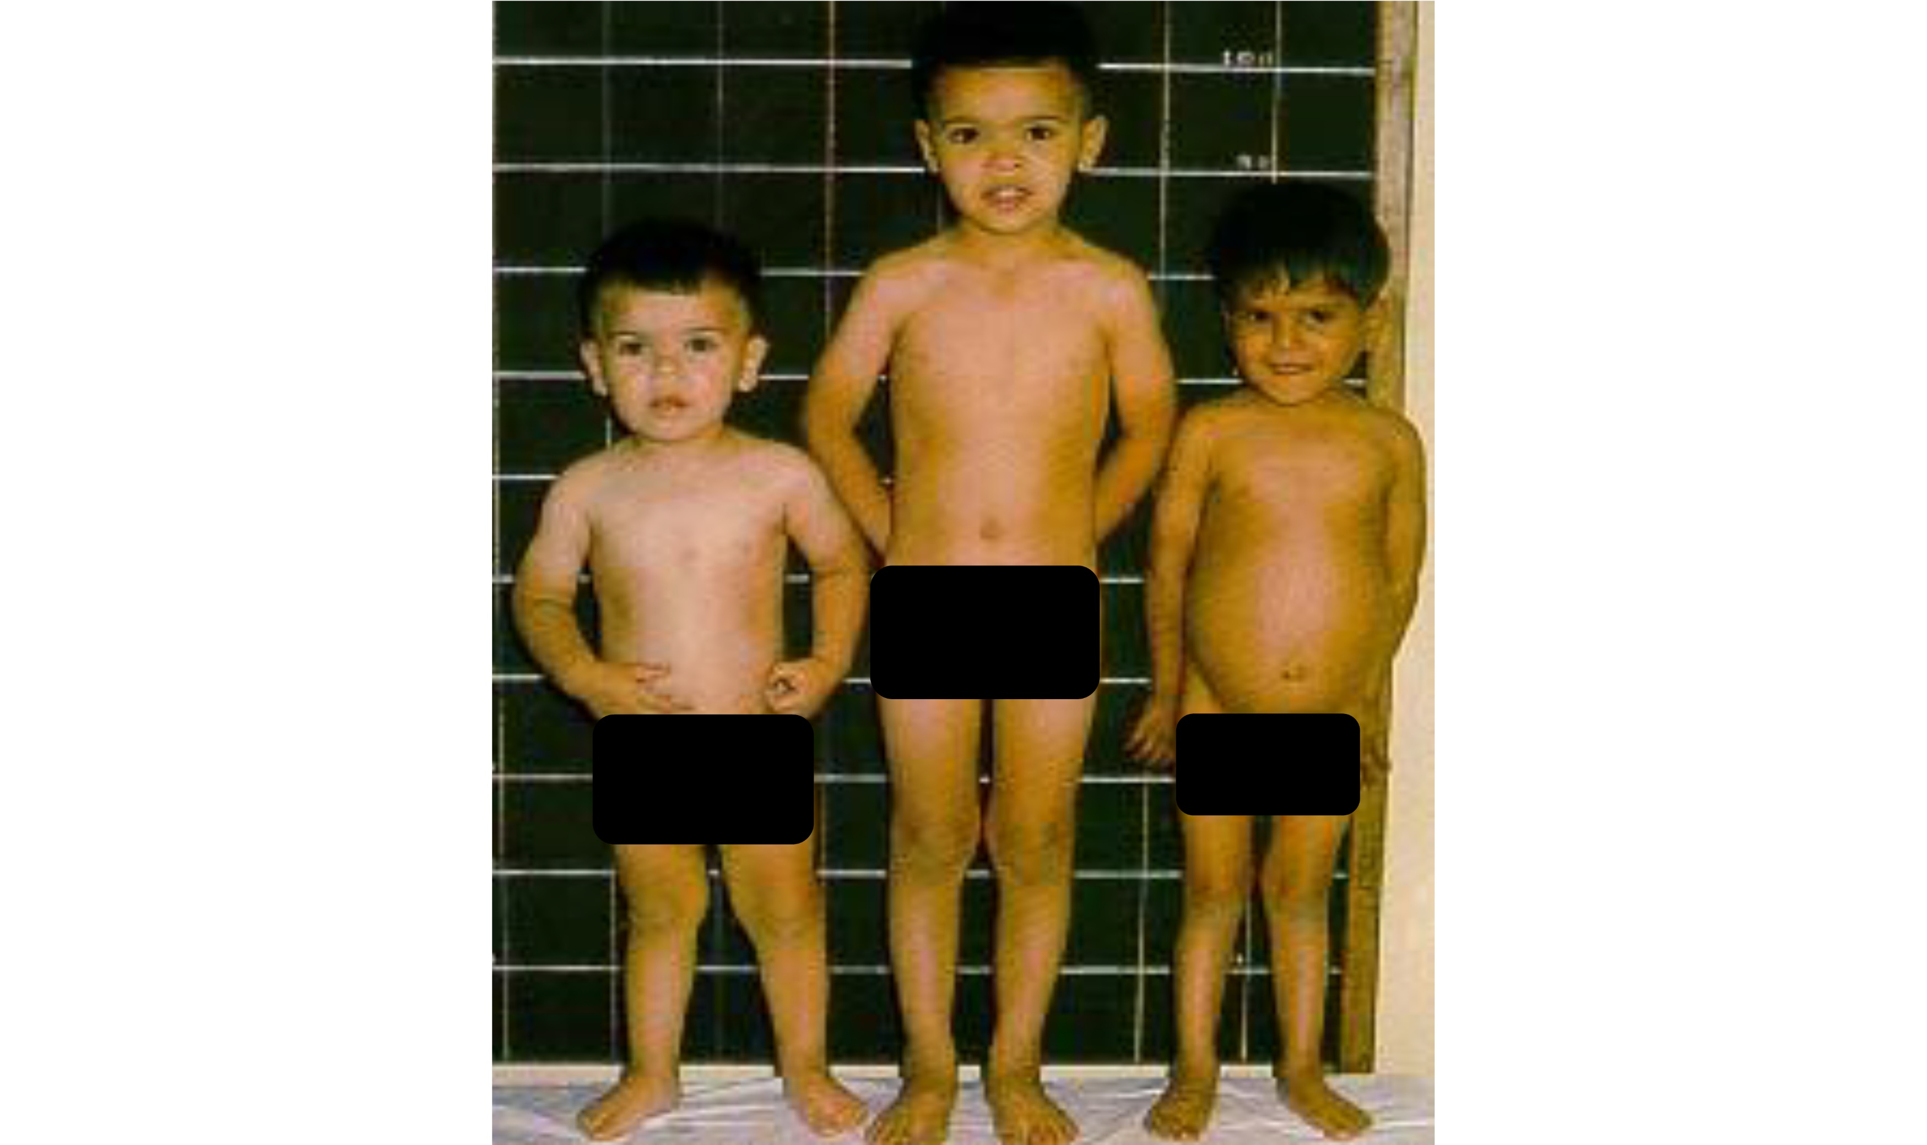
Notes:
Let them guess the children’s ages and thereafter reveal (FIRST = 2 years, SECOND = 4 years, THIRD = 5 years) Physical signs of stunting of the third child: ‘stunted growth’ (= short in height) and ‘pot belly’

Slide 12
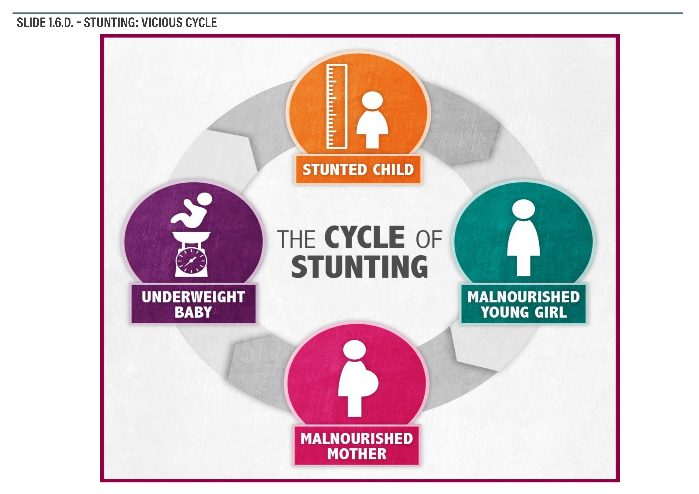
Notes:
The vicious cycle of stunting: Infant (small child) -> young girl -> pregnant woman -> underweight baby Stunting does not only effect girls, but also boys’/men’s sperm production and the DNA in it. Stunting is irreversible, but can be prevented through early nutrition interventions in the first 2 years (= first 1,000 days), or we can break the cycle of stunting/malnutrition over more than one generation

Slide 13
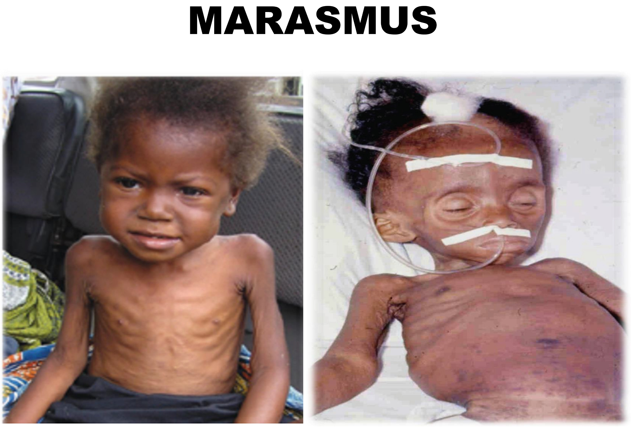
Notes:
Define Marasmus as a lack of energy intake through drinking and/or eating. Causes of Marasmus: infectious diseases, lack of food, not breastfeeding enough etc

Slide 14
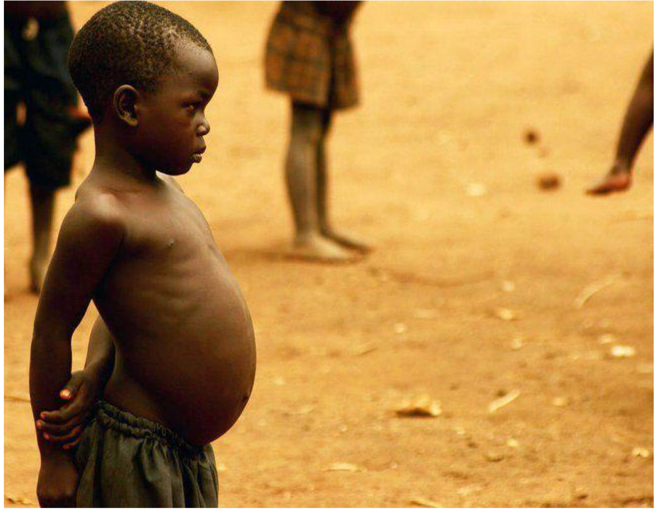
Notes:
Define Kwashiorkor as mostly a lack of protein (but also of other nutrients, with research still ongoing), e.g. children having access to carbohydrates (e.g. pap or bread) but little protein in their diet. Causes of Kwashiorkor: not eating enough diverse and protein-rich food from animal or plant sources (more information later, under “No. 2: Food Groups”), as well as poor hygiene, and infectious diseases.

Slide 15
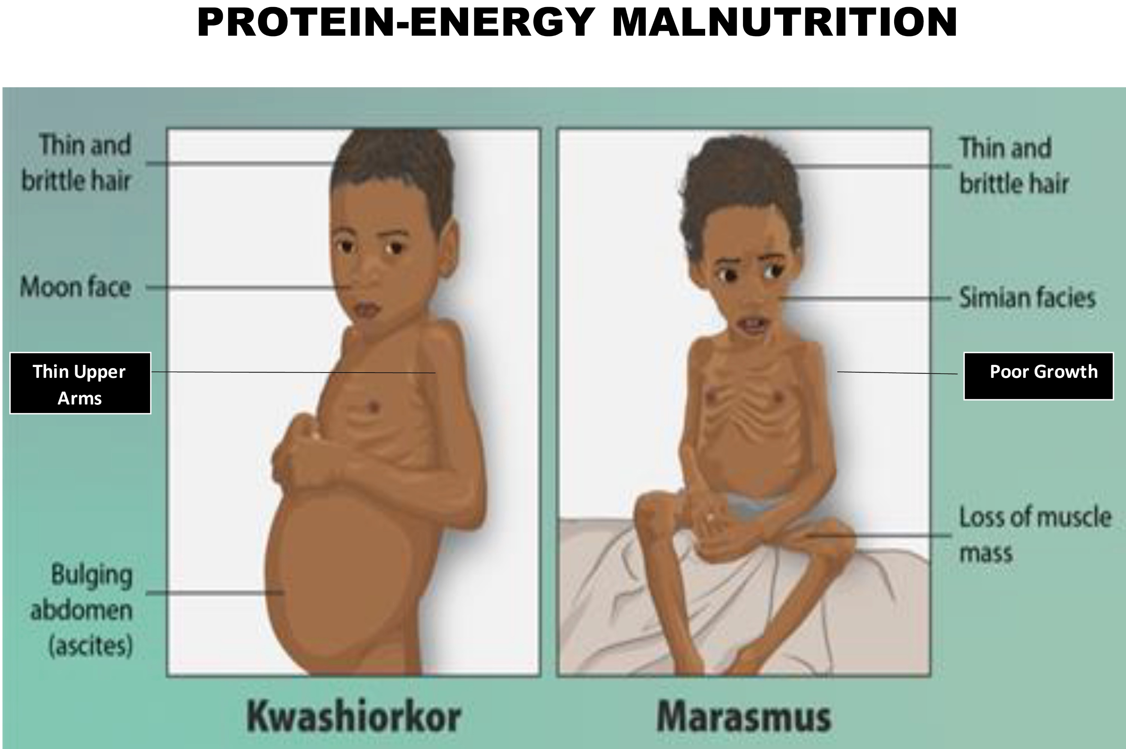
Notes:
Marasmus - Signs&Symptoms: old man/woman face, thin hair, dry skin, diarrhea, severe weight loss, loss of muscle mass and fat, poor growth, fatigue, reduced body functions and intellectual capacities. Kwashiorkor - Signs&Symptoms: enlarged tummy (pot belly), ribs visible, moon face, changes in skin color, dry hair, swelling (edema) of feet and ankles, failing to grow or gain weight, loss of muscles, flaky rash, diarrhea, fatigue, and irritability

Slide 16
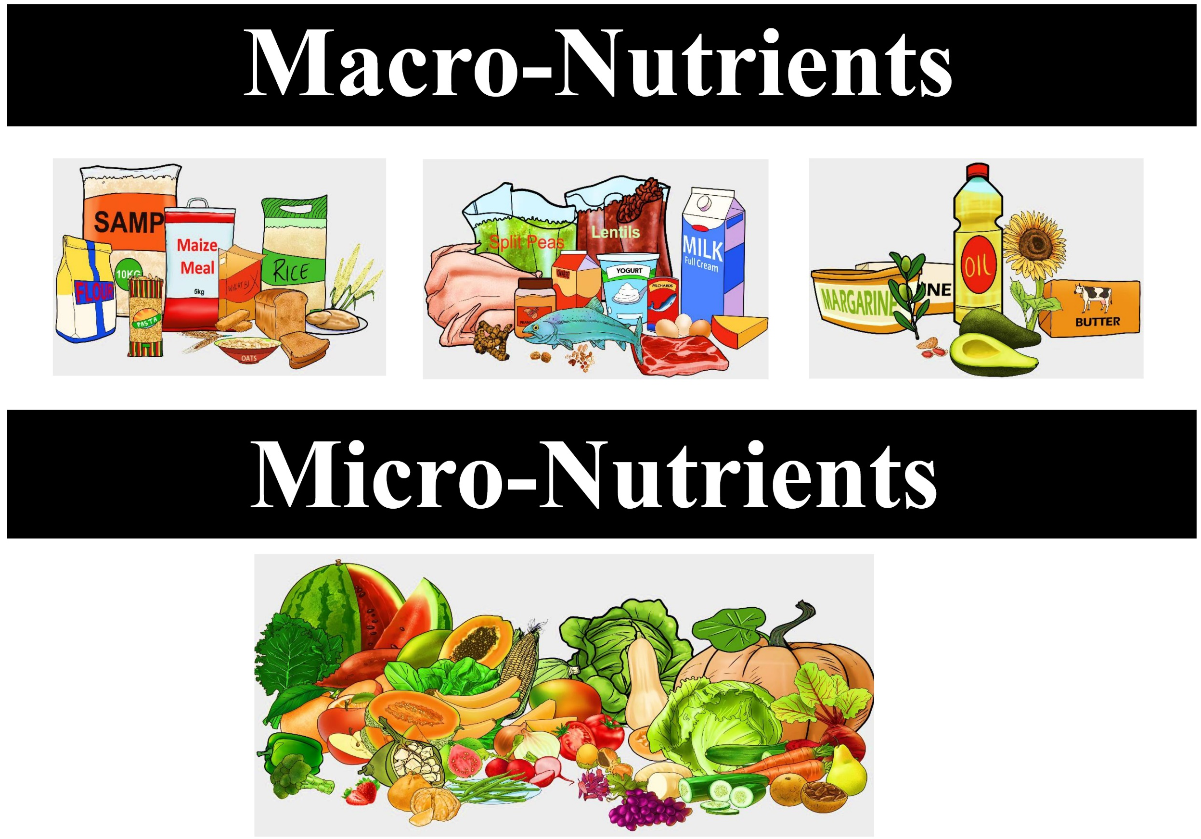
Notes:
‘Macro’ = nutrients that are needed in large amounts, such as carbohydrates, proteins, and fats ‘Micro’ = nutrients that are needed in small amounts but regularly(!), such vitamins and minerals

Slide 17
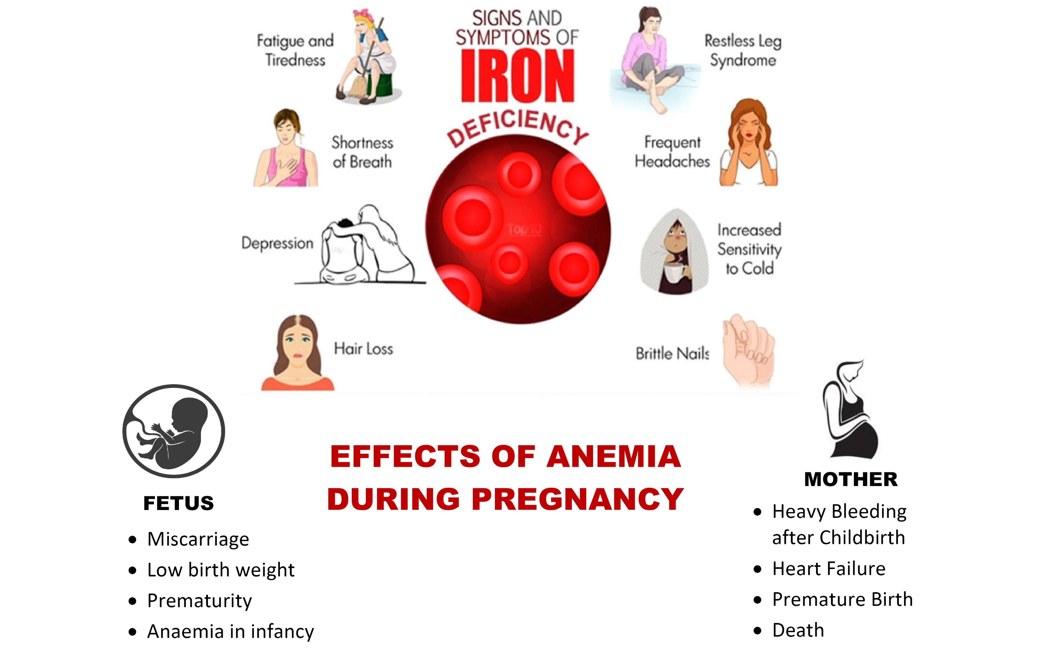
Notes:
Iron Deficiency Anemia (IDA) – Signs/Symptoms: tiredness, hair loss, dizziness, shortness of breath Anemia can be very dangerous during pregnancy, affecting the fetus: low birth weight, birth defects, etc. Effects on the mother: premature birth, heavy bleeding after giving birth, heart failure and even death.

Slide 18
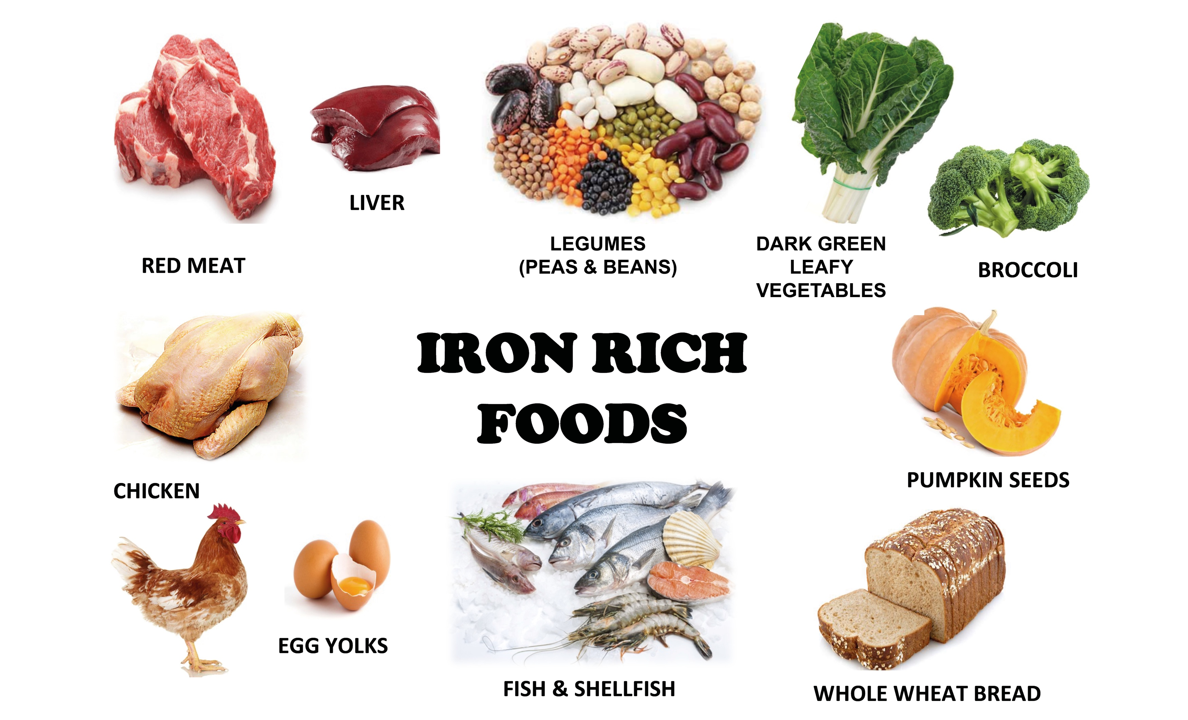
Notes:
Recommended supplements during pregnancy: iron and folic acids Food rich in iron (= natural sources of iron): spinach (mutete), legumes (chickpeas, beans etc.), pumpkin seeds, broccoli, liver, red meat, fish, dried fruits and nuts.

Slide 19
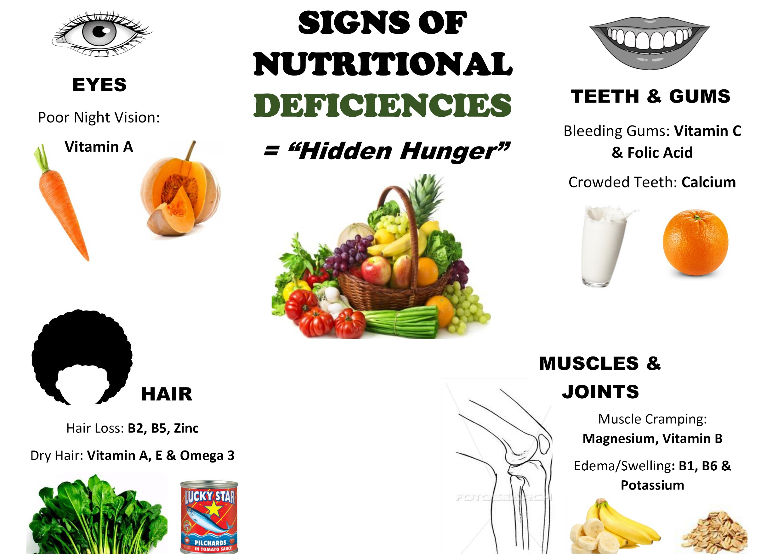
Notes:
Common micro-nutrient deficiencies in Namibia and foods that contains it: iron
(already mentioned), Vitamin A = carrots, butternut, sweet potato, kale, spinach,
mango, watermelon, orange, guava, liver and cheese
Iodine = iodized salt, seaweed, fish, dairy (milk, yogurt), eggs and prunes
Folic Acid (or: Folate/Vitamin B9; very important for pregnant women) = legumes
(beans, peas, lentils), eggs, asparagus, leafy greens (spinach and kale), citrus fruits
(lemons, oranges etc.), sprouts, broccoli, nuts and seeds.

Slide 20
Understanding Malnutrition:
Over-Nutrition

Slide 21
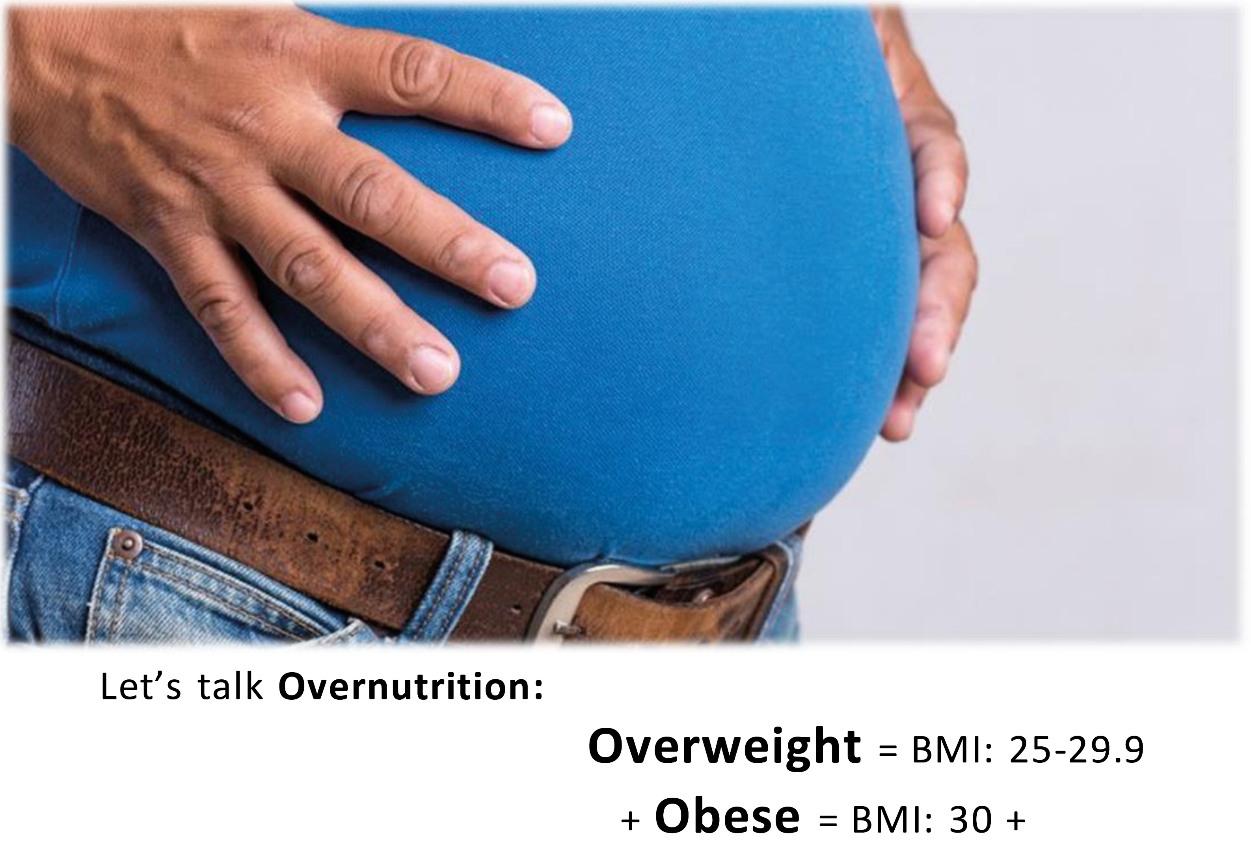
Notes:
In some cultures, weight-gain is seen as a sign of wealth and well-being, yet there are real health risks to it. Adults: Overweight = BMI: 25 – 29.9 kg/m2 and Obese = BMI: 30 kg/m2 . NOTE: BMI is a screening tool and not an indicator for overall health. Children: See Growth Chart if they are overweight, yet this is often visible to the eye. Changes to eating and behavior habits are to be made as early as possible in life to ensure a healthy future for individuals

Slide 22
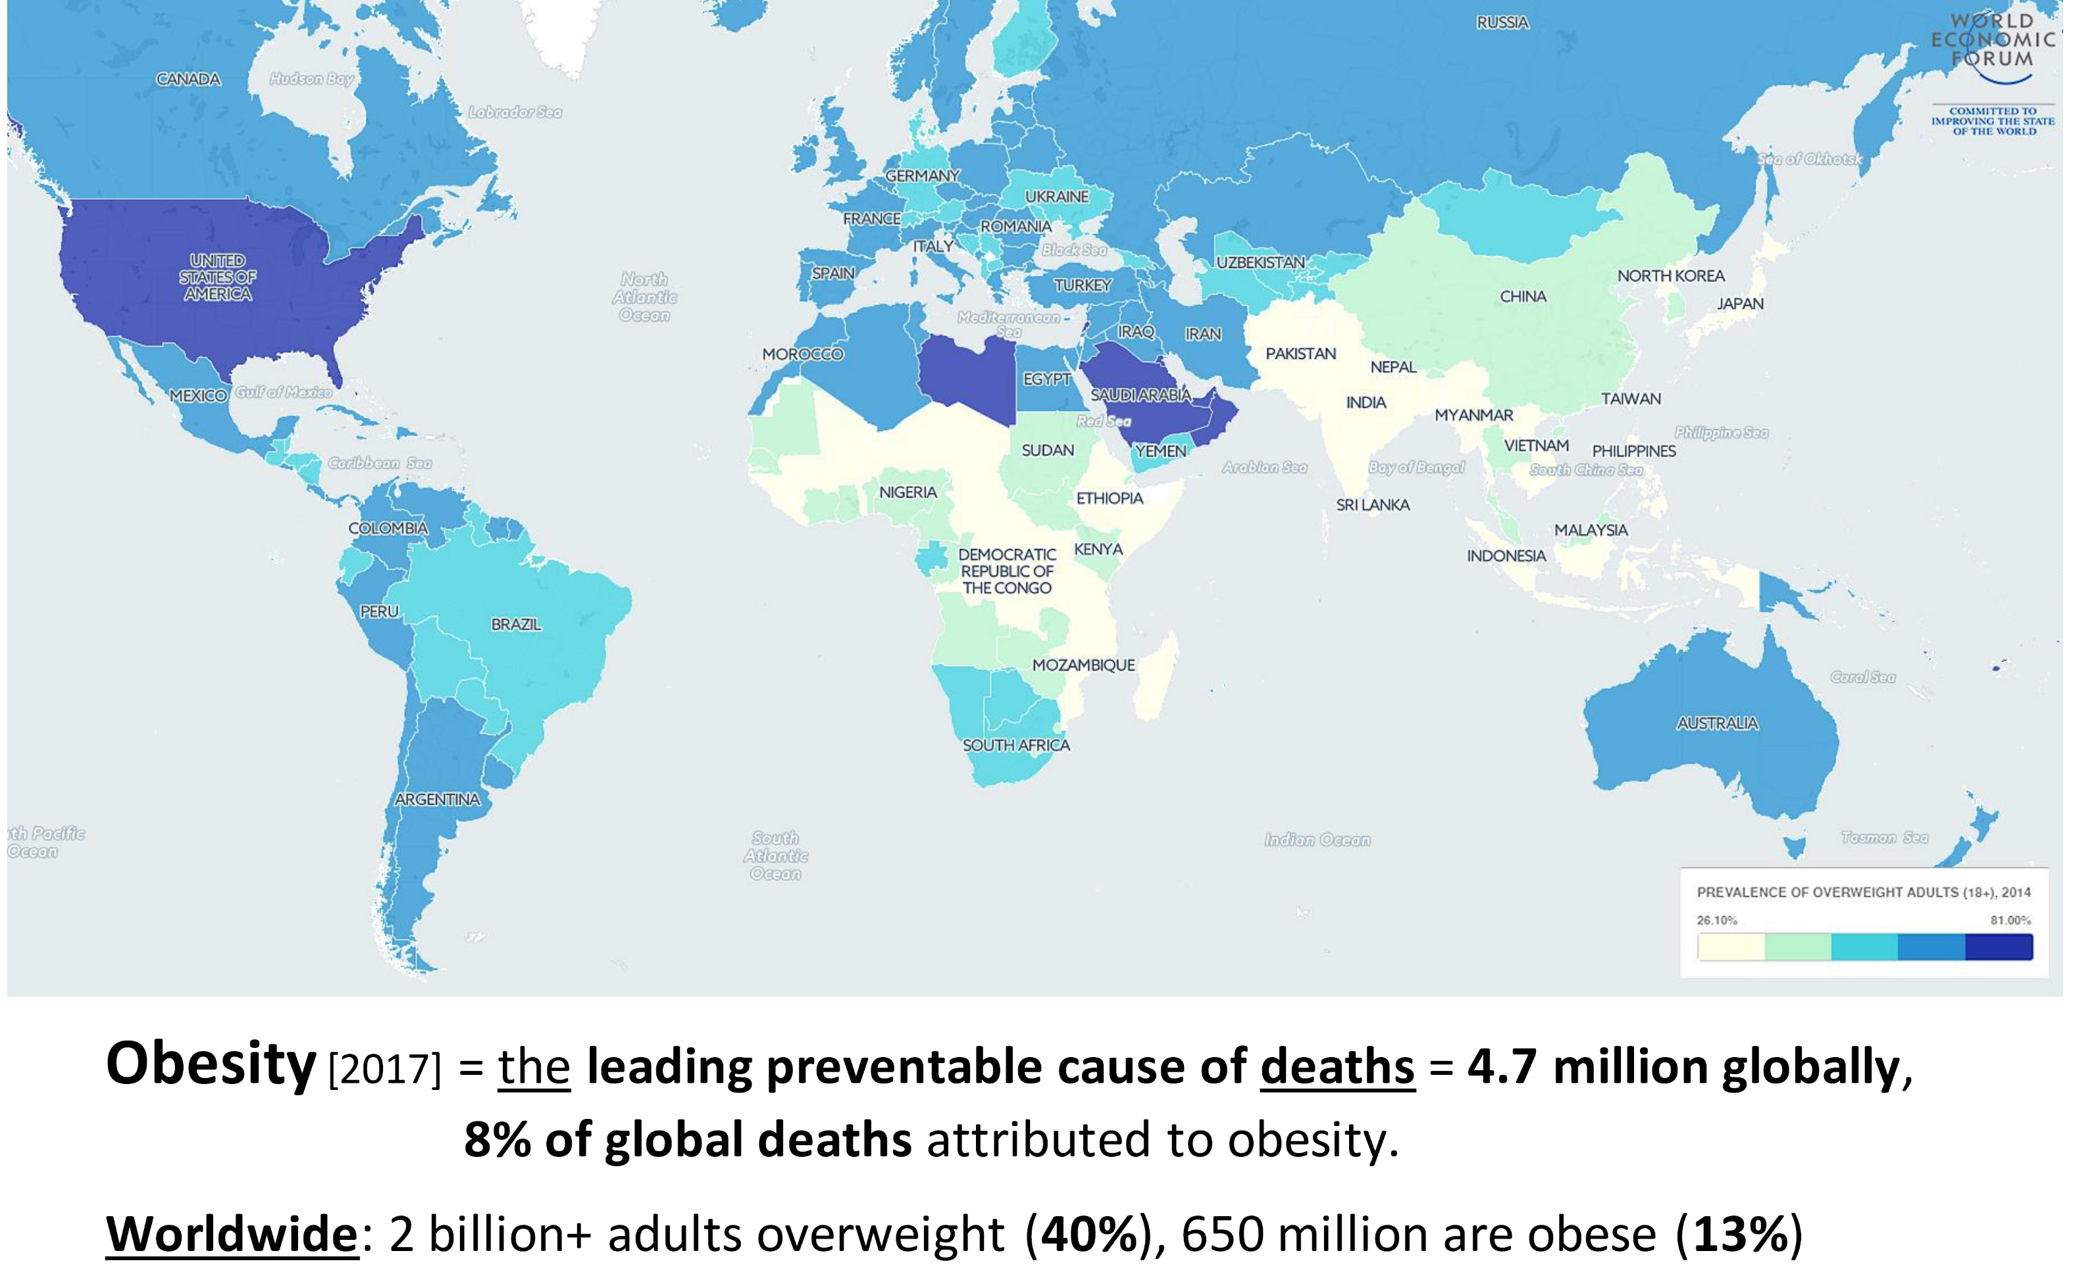
Notes:
Globally = Leading cause of preventable death (8% of the global population), with more than 2 billion people (40%) being overweight and more than 650 million even obese (13%) Namibia = Double burden of Malnutrition’ + over 40% overweight, almost 20% even obese – with more women being overweight/obese than men, and also young people being increasingly overweight.

Slide 23
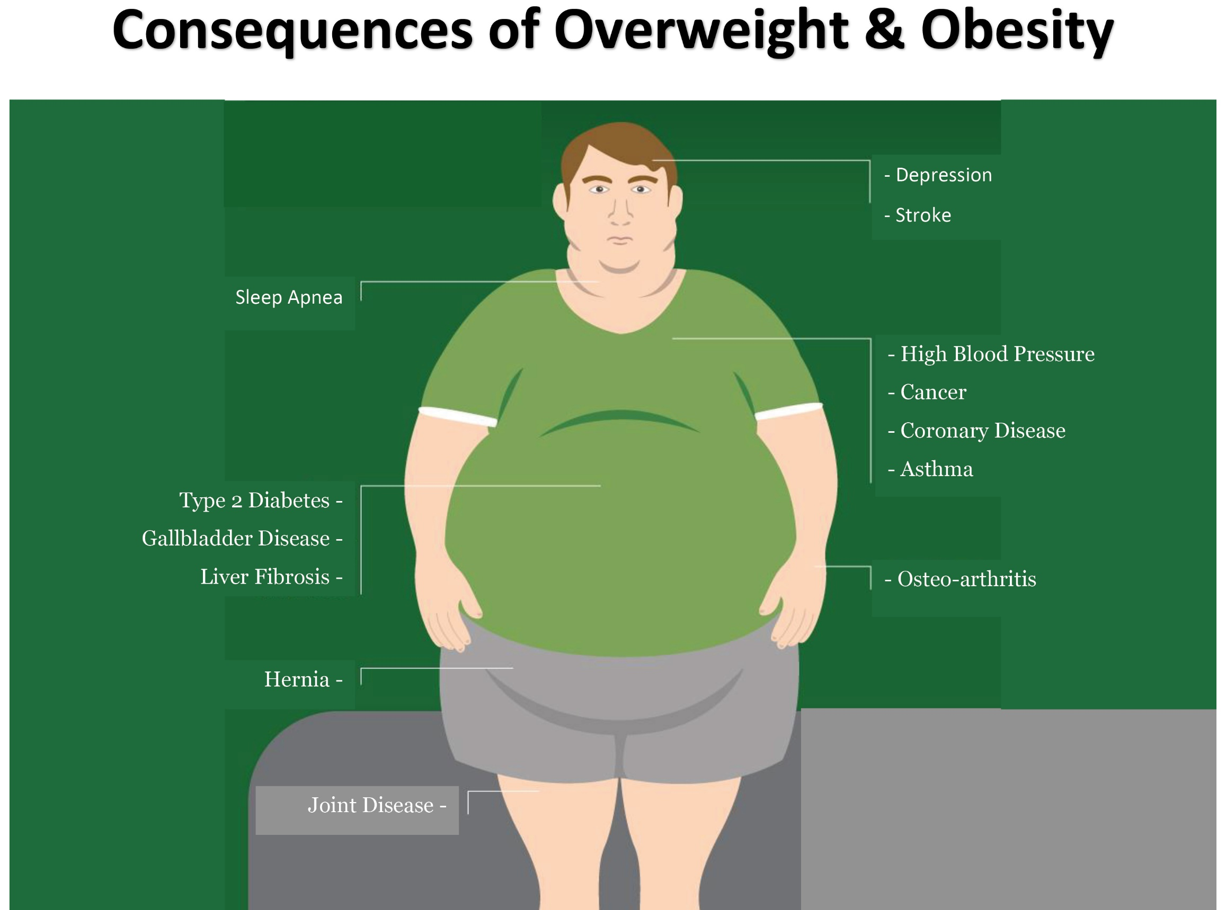
Notes:
Consequences of Obesity: High blood pressure, type-2 Diabetes, depression, stroke, cancer, and increased health costs while having a shorter life-span. Diabetes often comes with excessive thirst and urination, blindness, numbness in toes and fingers (gangrene), delayed wound healing, loss of limbs, kidney failure and need for dialyses Costs can also be high for family, colleagues, and society at large in terms of health system costs.

Slide 24
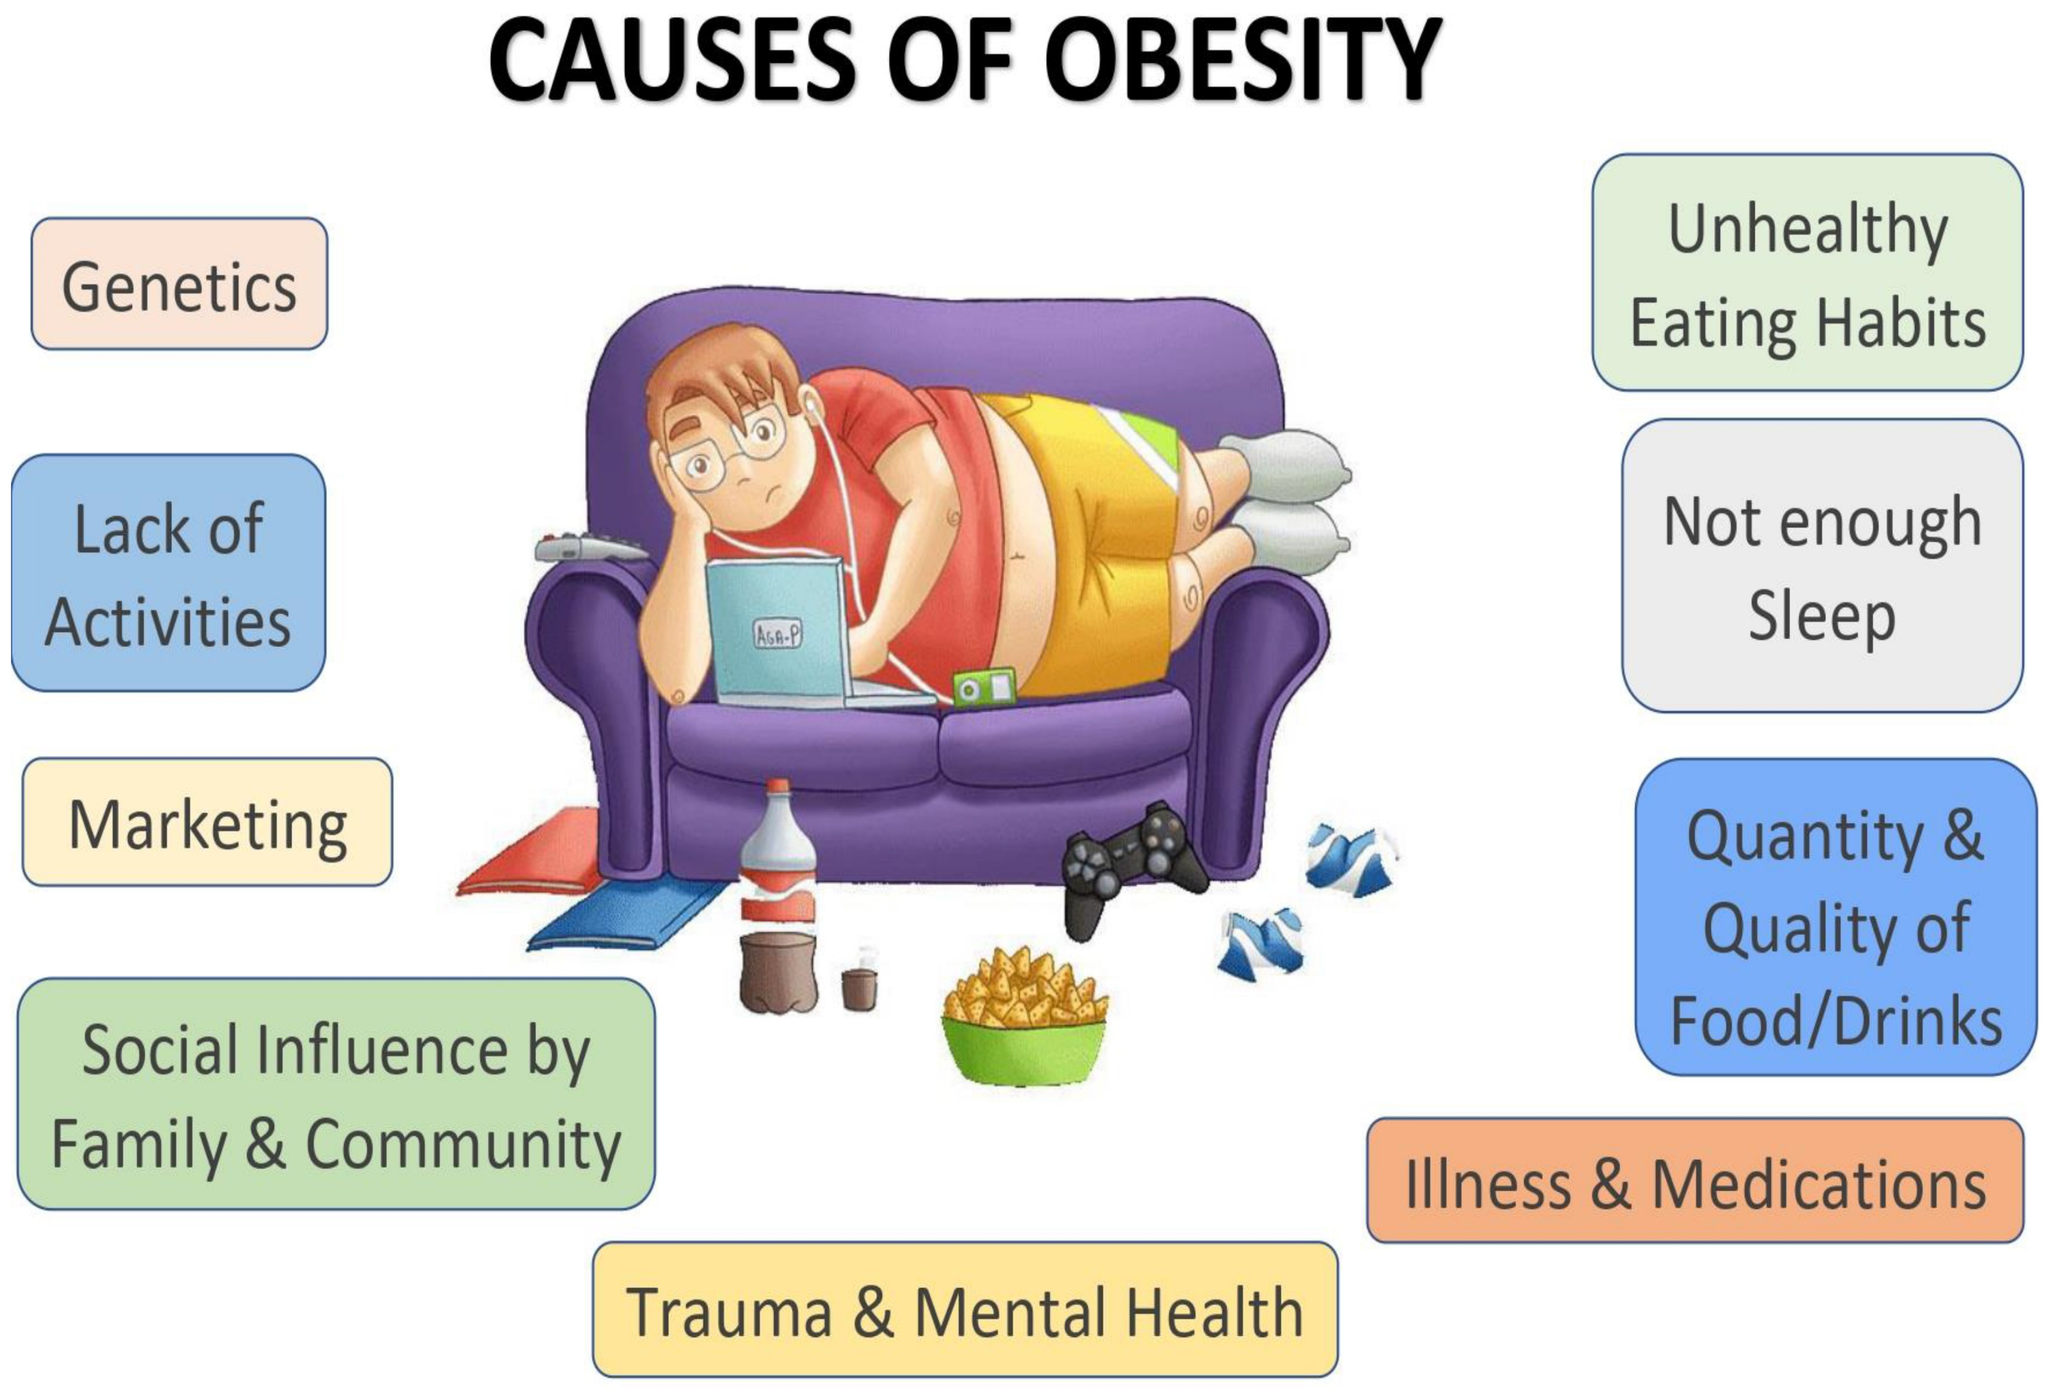
Notes:
Main Causes: eating too much junk food, lack of exercise, and not getting enough sleep Often Unknown Causes: genetics, stress, trauma, mental health, too much TV/electronics

Slide 25
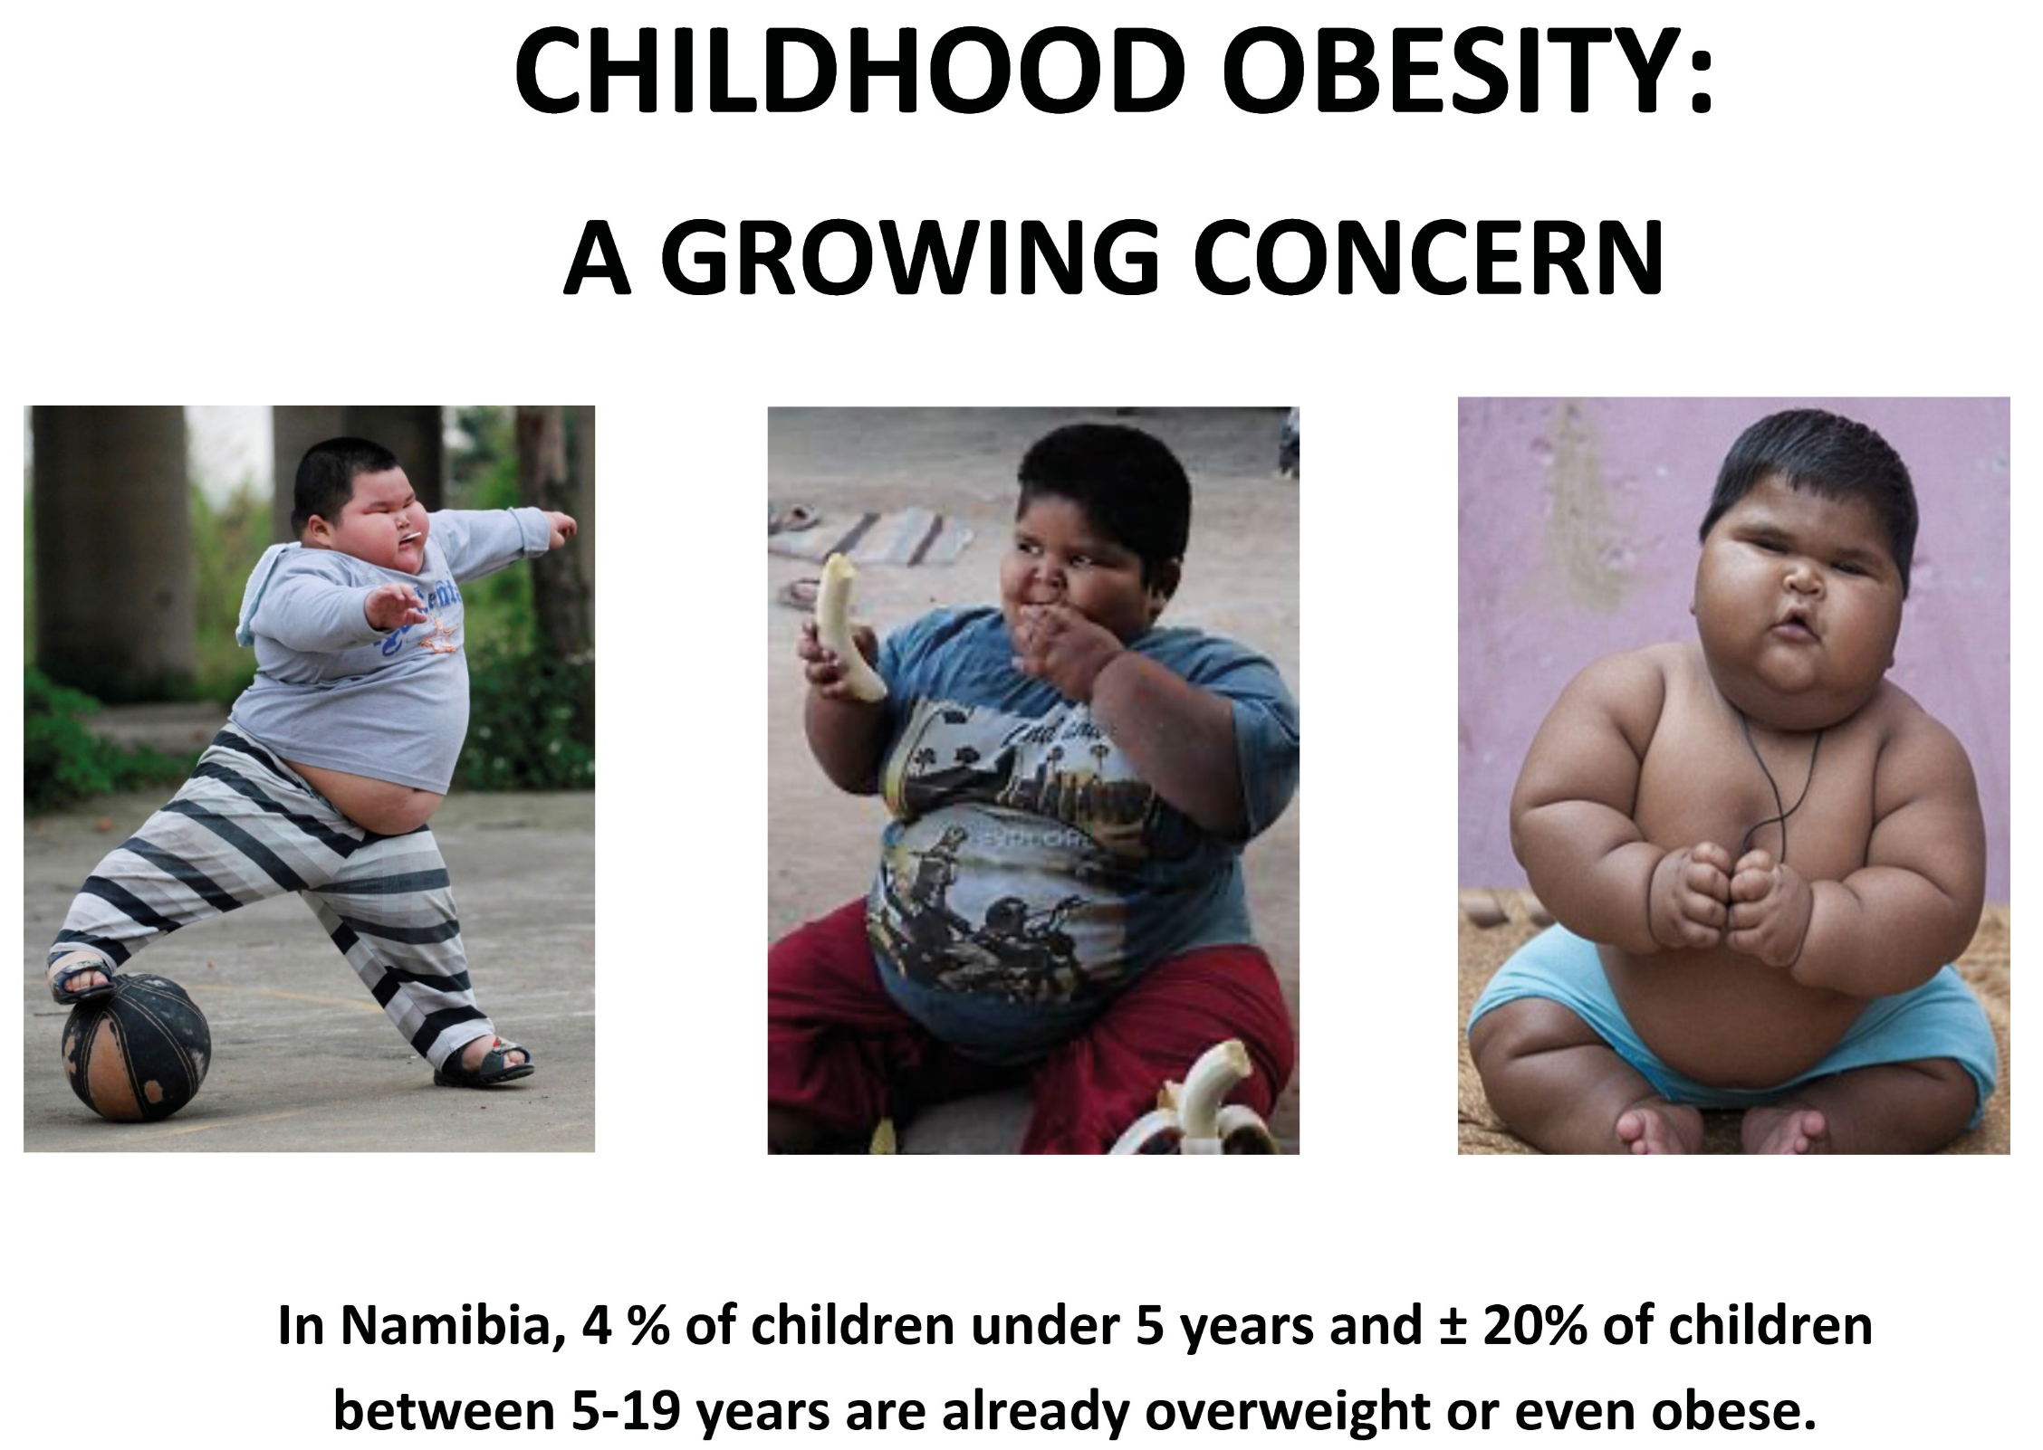
Notes:
Over 4% of children under 5 are overweight, as well as ± 9% teenage boys and ± 20% teenage girls. Emphasize the importance good eating habits at a young age, as this is when our tastebuds and habits are being formed. Therefore, no sugar and no electronics until 2 years, or at least as little as possible!

Slide 26
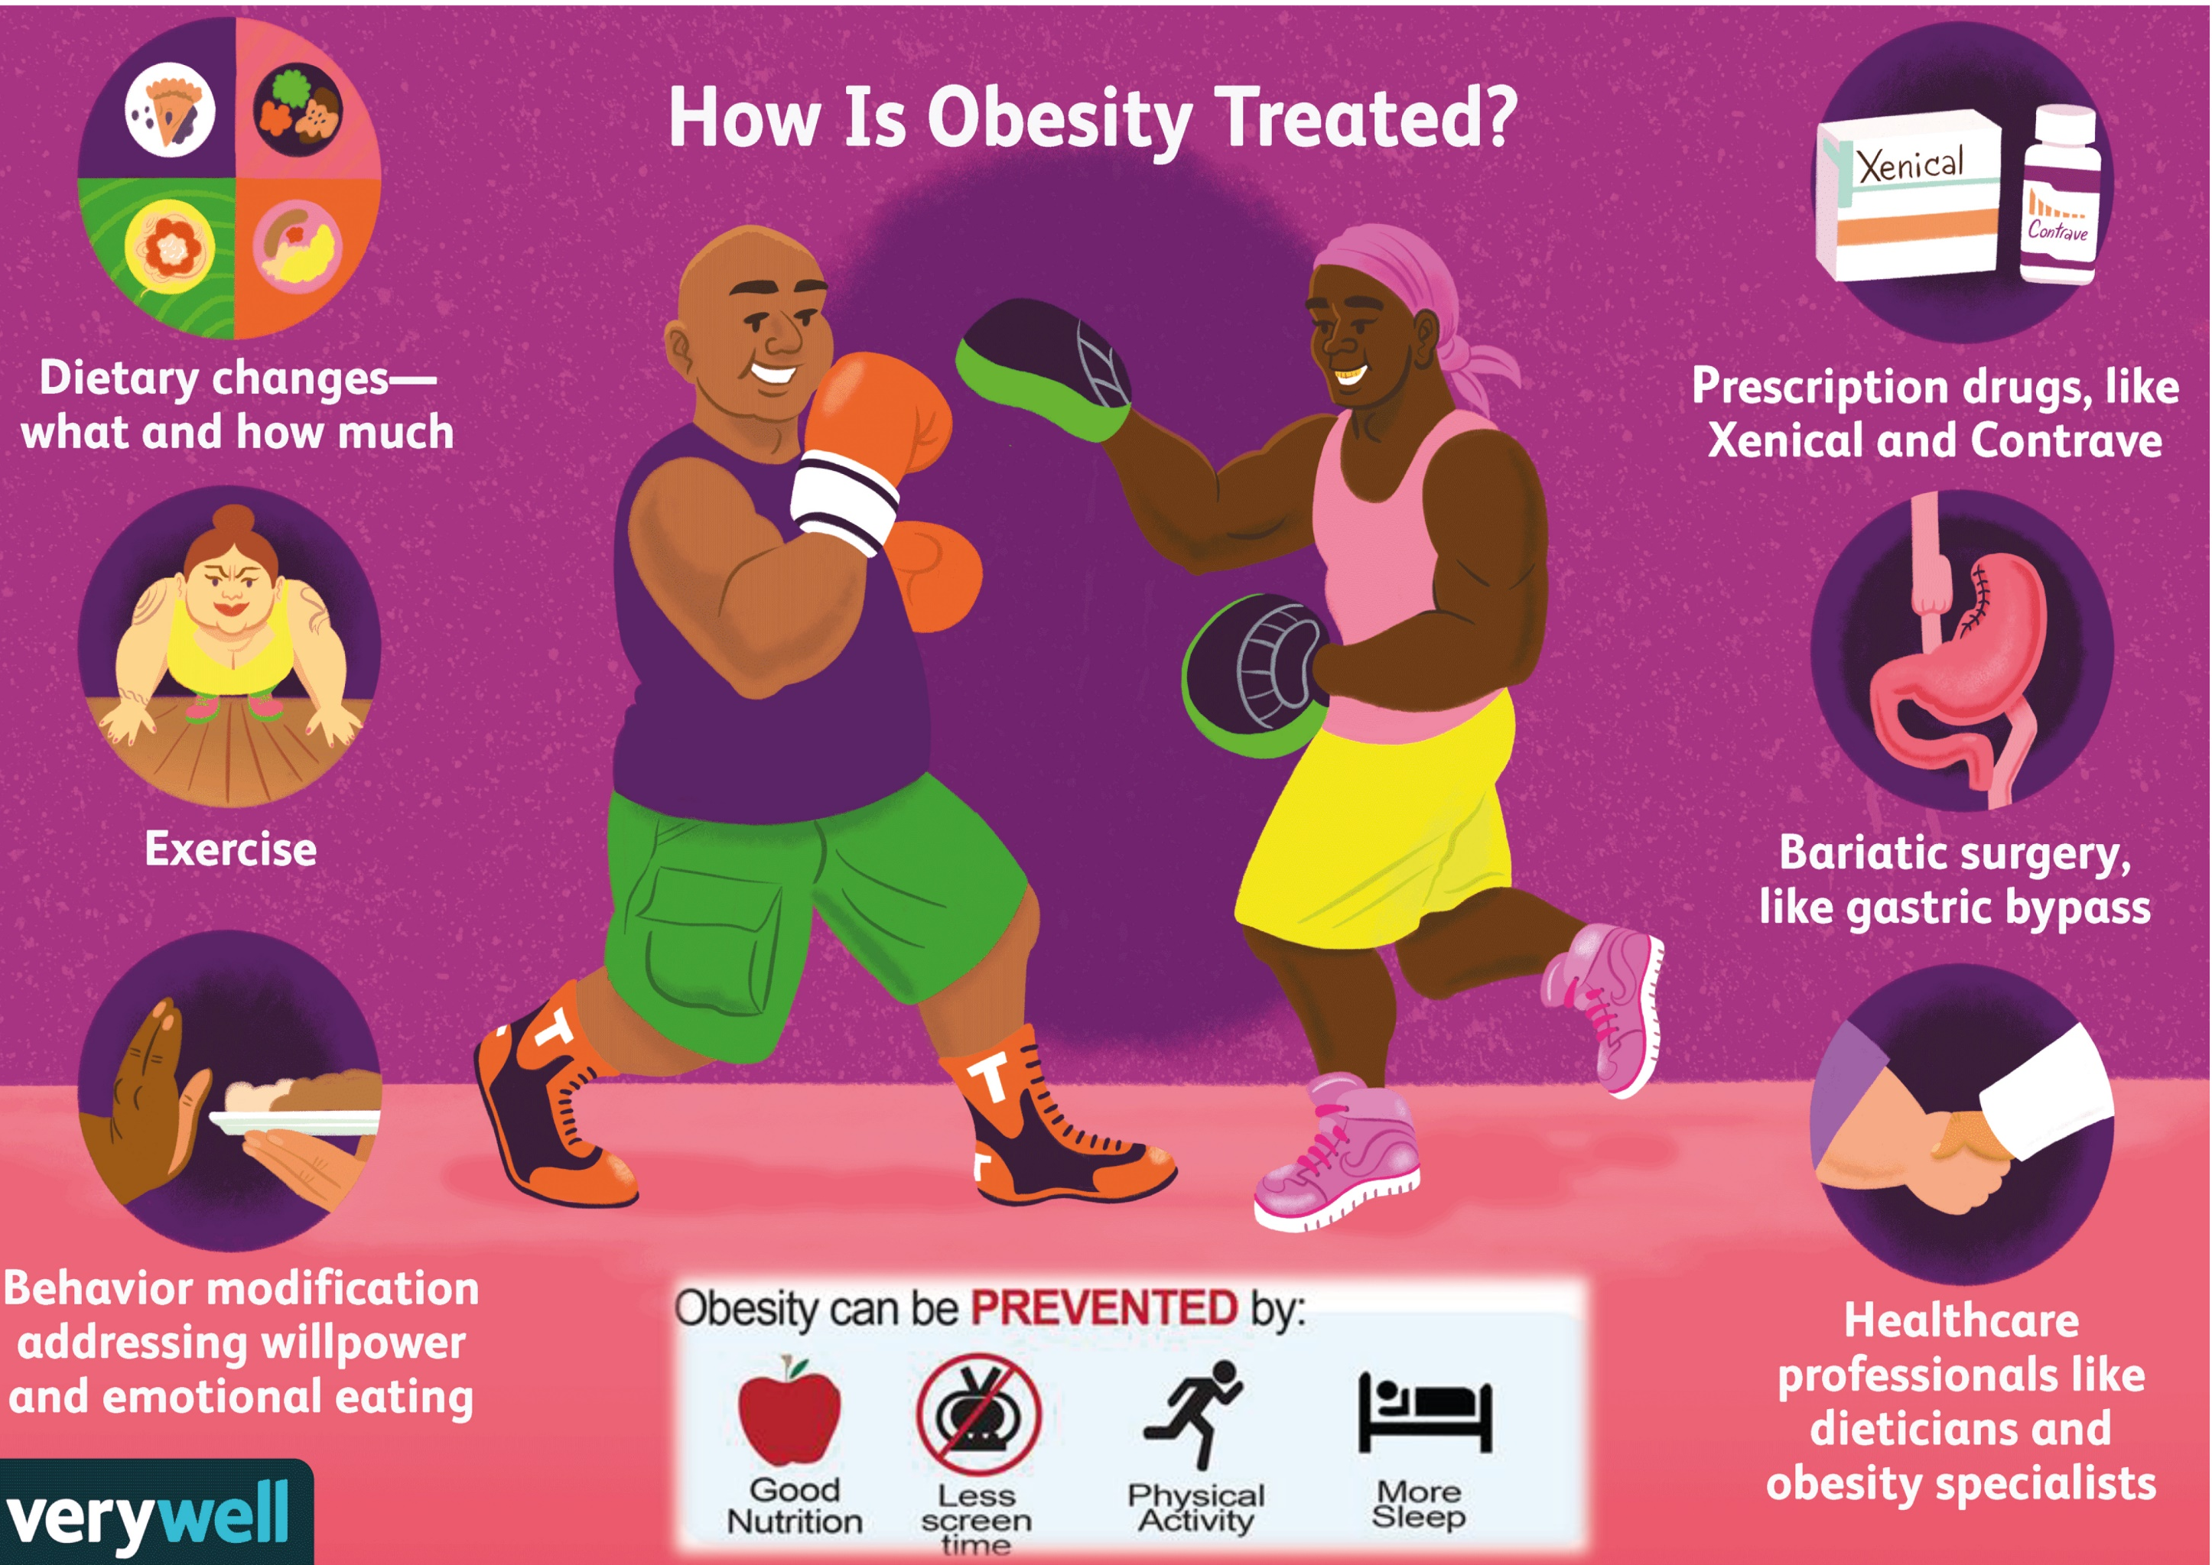
Notes:
Obesity can be prevented and treated. Different ways: regular physical exercise and less screen time, more sleep, healthier eating patterns, portion control and to eat more consciously (e.g. no sweets, alcohol, soft drinks or latenight snacks), while there are also medical interventions (like medication or surgery) for very serious cases

Slide 27
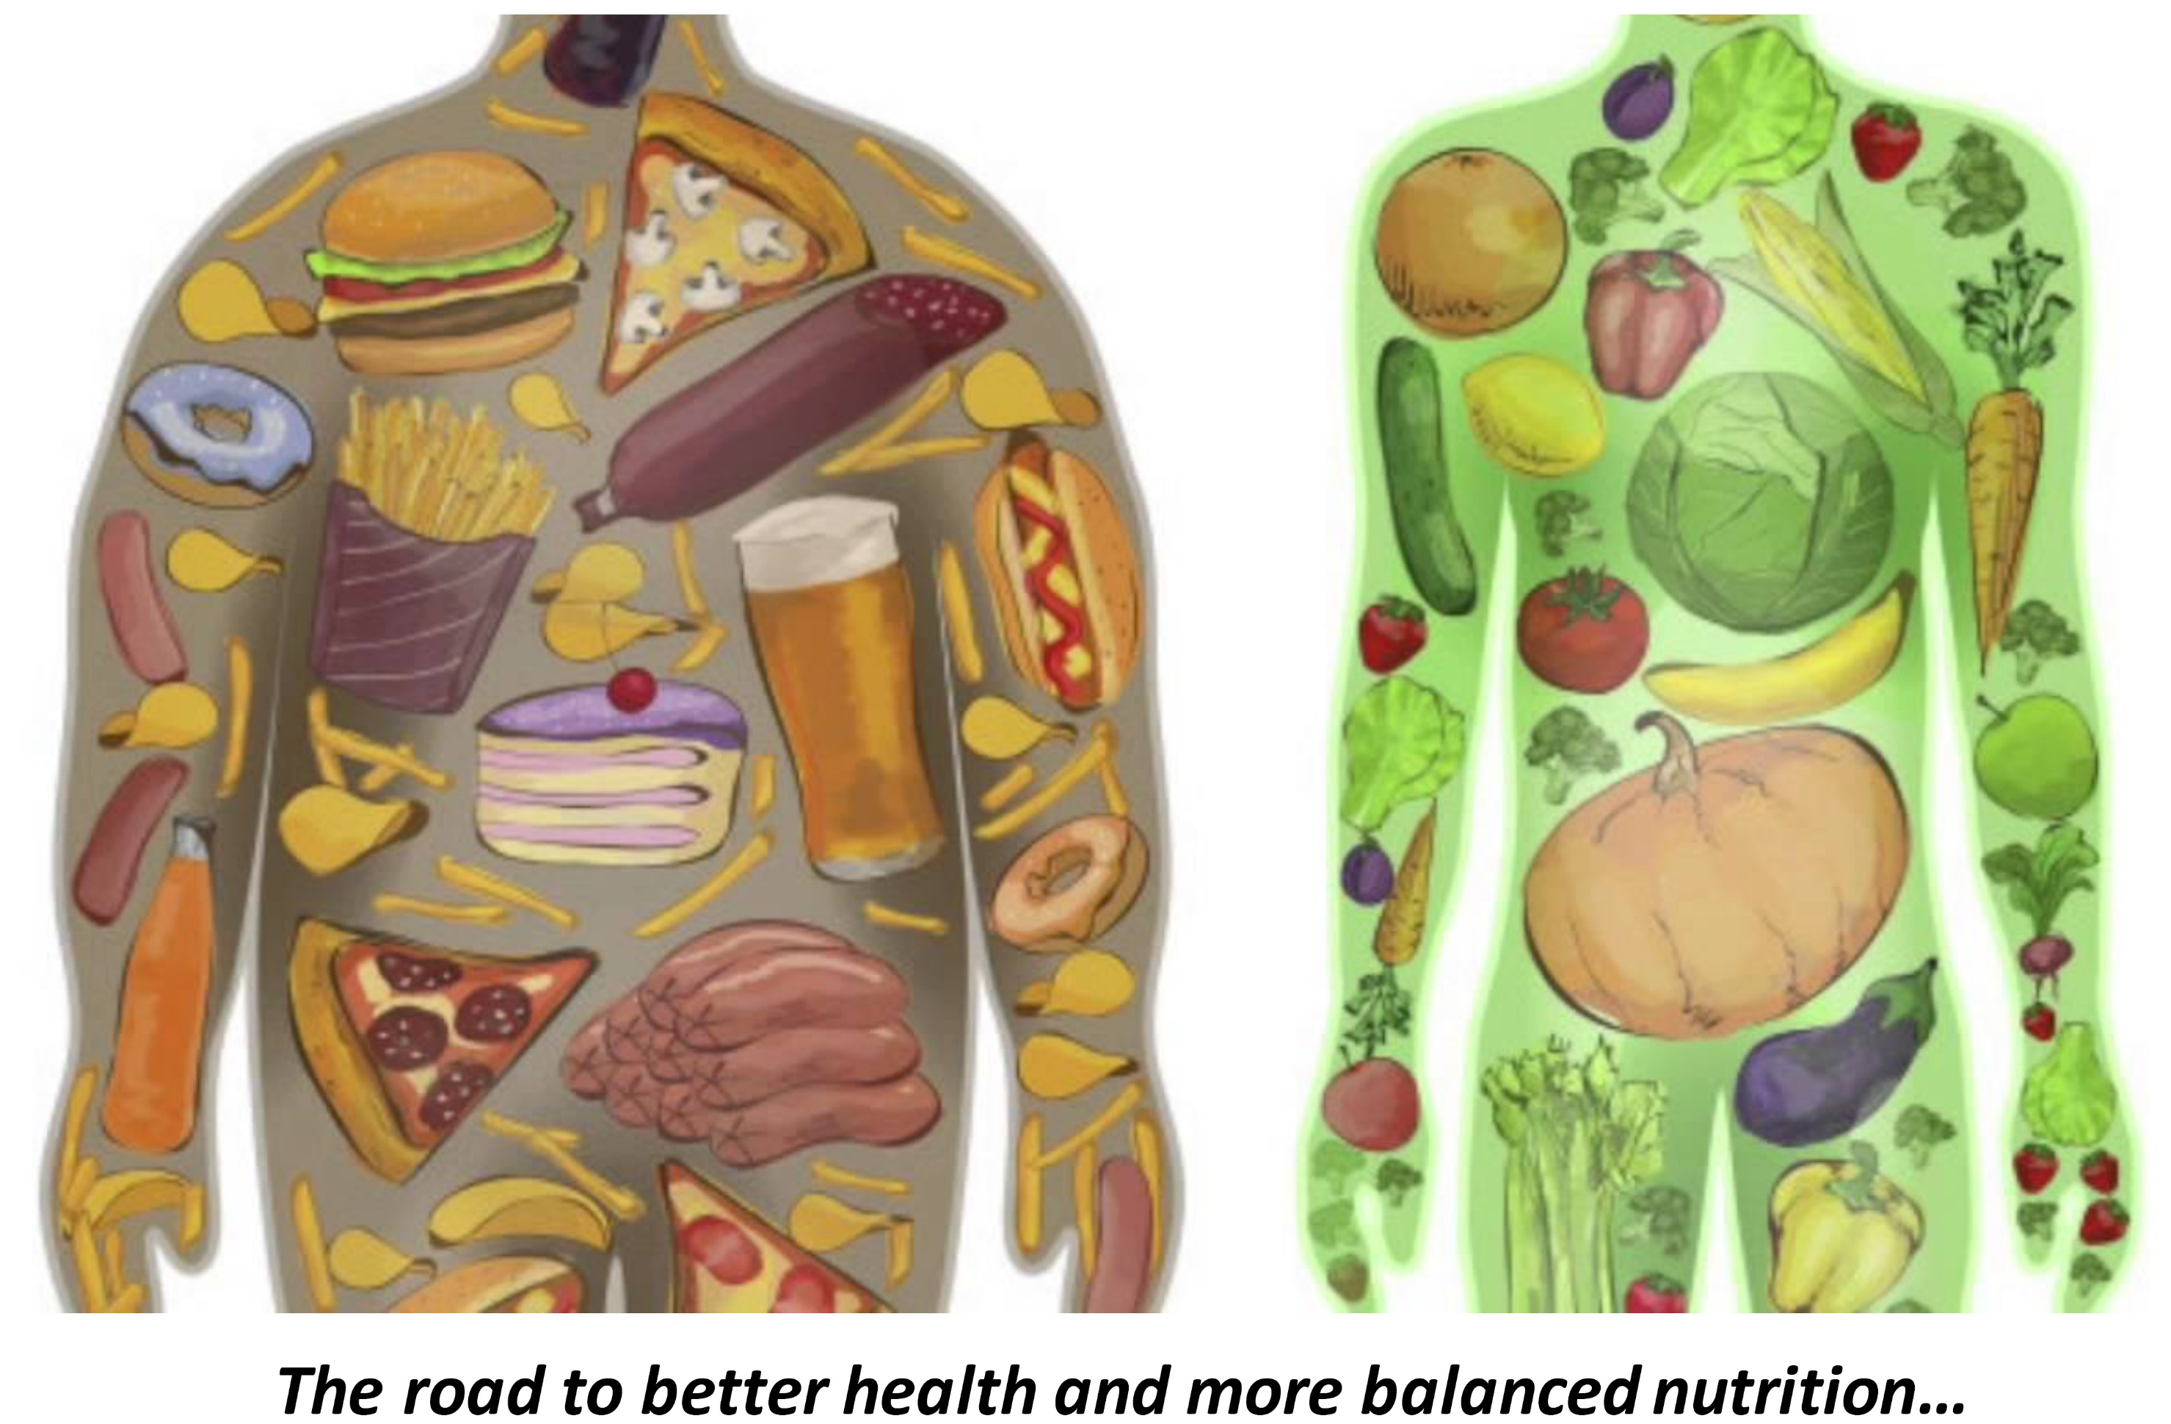
Notes:
Show the image: ‘You are what you eat’ and let the difference between the images sink in. Brainstorm on healthier eating habits for firstly ‘ourselves’ and secondly ‘our children’

Slide 28
Sugar & Me:
Exercise 2
Notes:
Exercise instructions: pp. 17-18 in the Manual.

Slide 29
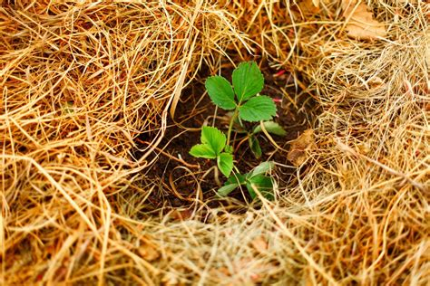
Thank you!
More information:
www.nafsan.org/N4H

