Slide 1
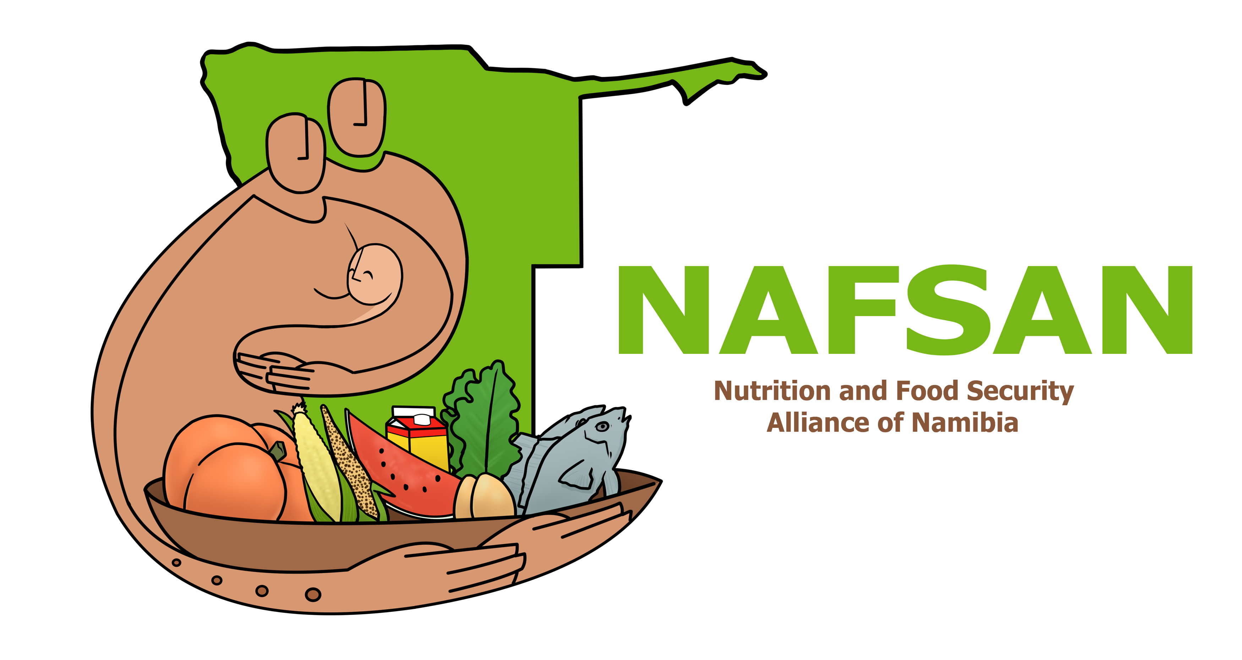
…and it’s Role within
Namibia’s Food and Nutrition Security Coordination Systems
Mr. Ben Schernick
Director of NAFSAN
Windhoek, April 2021

Slide 2
Key Aspects of
Food and Nutrition
Security
Maternal & Child Care
Health, Water & Hygiene
Social Protection
Food, Agriculture & Diets

Slide 3
Namibia: Historical Background
September 1994, Cabinet approved Food Security and Nutrition Council (FSNC)
Chaired by Permanent Secretary of Ministry of Health and Social Services (MoHSS)
Technical Committee chaired by Ministry of Agriculture, Water and Rural Development (MAWRD)
…after some time, as a result of institutional restructuring, the Technical Committee and the entire FNC became dormant
In 2010, the Namibian Alliance for Improved Nutrition (NAFIN) was established via Cabinet Resolution as a non-profit organization (Trust)
…however, around 2017, NAFIN also became dormant
+ did anyhow not have the proper 'convening power’.
Notes:
GRN structures existed at all levels but NGOs only existed at National level.

Slide 4
2017 = Cabinet Decision No: 1/14.02.17/004, resolved that
the Office of the Prime Minister (OPM):
Revive the National Food Security and Nutrition Council
chaired by the Office of the Prime Minister
2. Endorses NAFIN to serve as a technical partner
OPM established an inter-ministerial Technical Committee, incl. UN Agencies + NAFIN (later: NAFSAN)
→ to develop Namibia’s Food and Nutrition Security (FNS)
Policy (2021 - 2031)
Implementation Action Plan (2021-2026)
Coordination Structure (national/sub-national)
Notes:
GRN Structure moved to OPM
NAFIN reconstituted itself into NAFSAN

Slide 5
2018/19 = Participatory process leading to transition: ..from NAFIN to NAFSAN
Nutrition and Food Security Alliance of Namibia
Oct’19 = Constituting Meeting
Jan’20 = Official Letter to OPM: (NAFIN → NAFSAN)
Mar’20 = NAFSAN’s Constitution
Jun’20 = Start-up Funding from GIZ + SUN

Slide 6
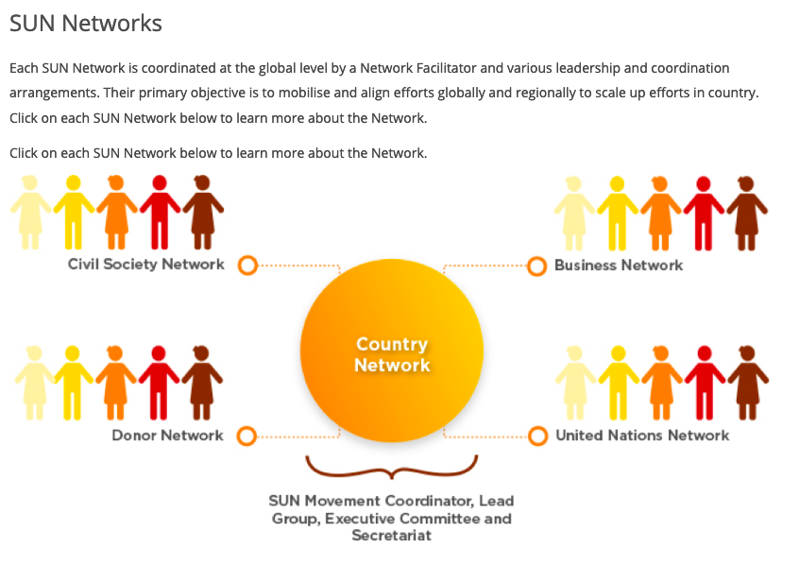
Background & Development
NAFSAN
Civil Society + Academia
+ Private Sector
+ Individuals
+ UN Agencies as Institutional Supporters
Government
Civil Society
Private Sector
Food and Nutrition Security Council (2021)
Technical Guidance & Regular Feedback
→
Academic Institutions
2010-19
UN/Global Partners
Food and Nutrition Security
INTER-AGENCY STEERING COMMITEE
Country Network
Members
Members
→
Members
Initiate & Support
Implementation
Members
Members
Members
Members
Members
Integrated into and aligned with
Regional Structures
Members
Sensitise & Empower Communities
Facilitating Dialogues, Networking, Advocacy, Sourcing of additional Funding
Integrated into and aligned with
Structures at Constituency Level

Slide 7
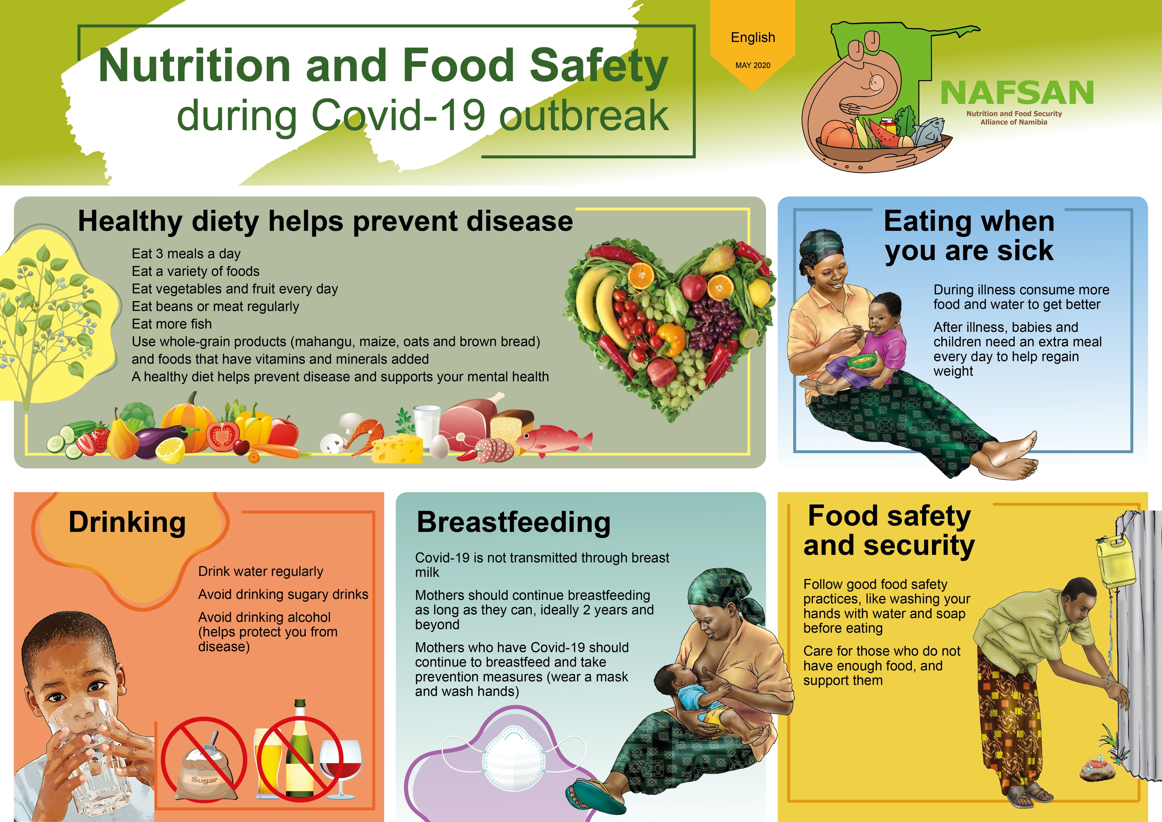
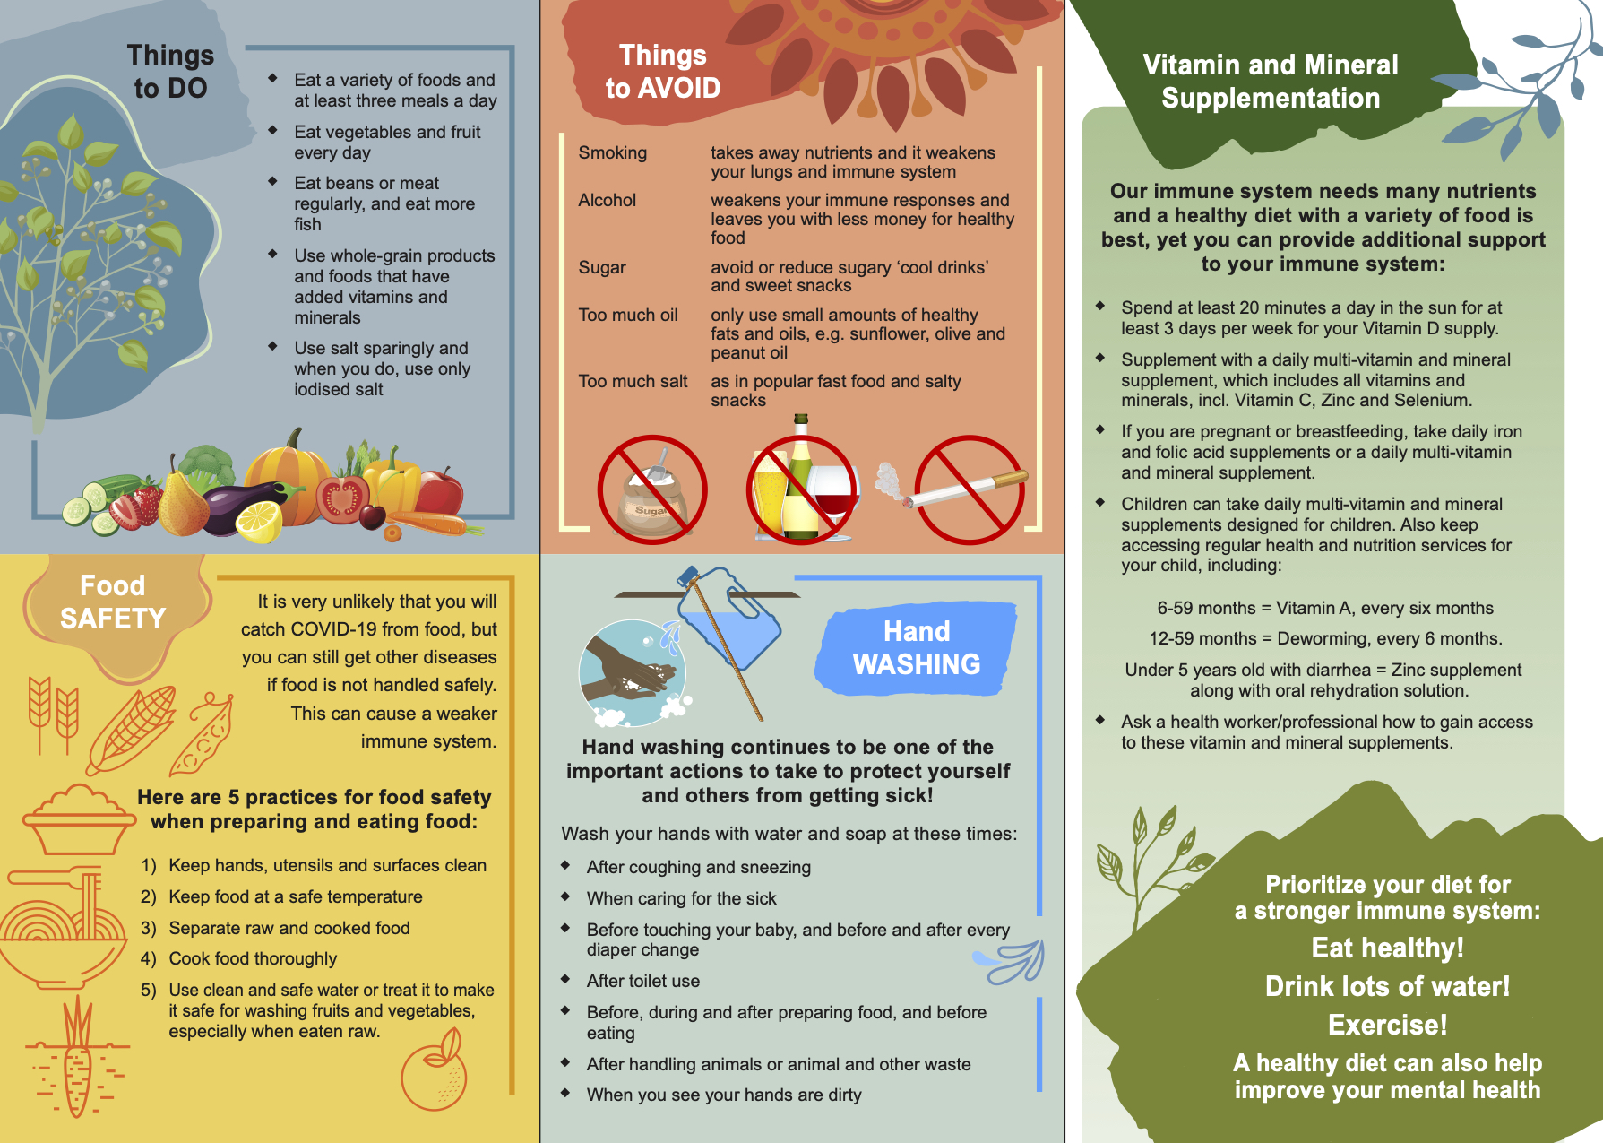

Slide 8
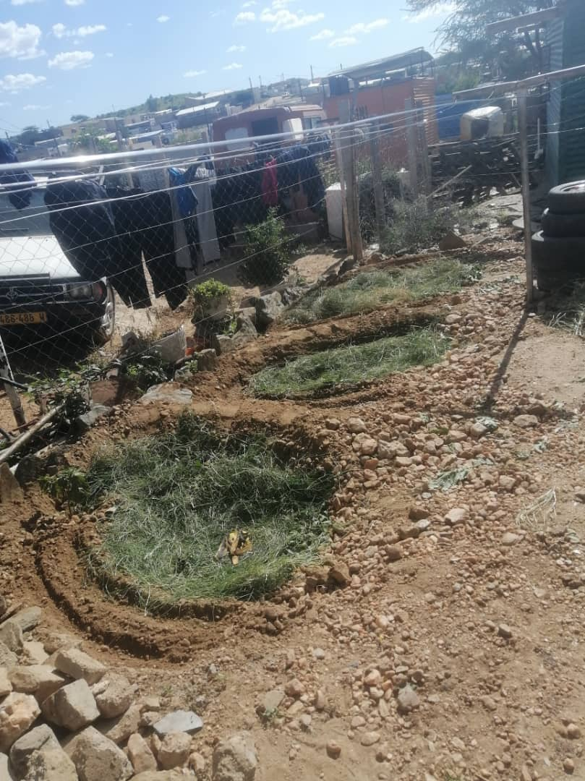
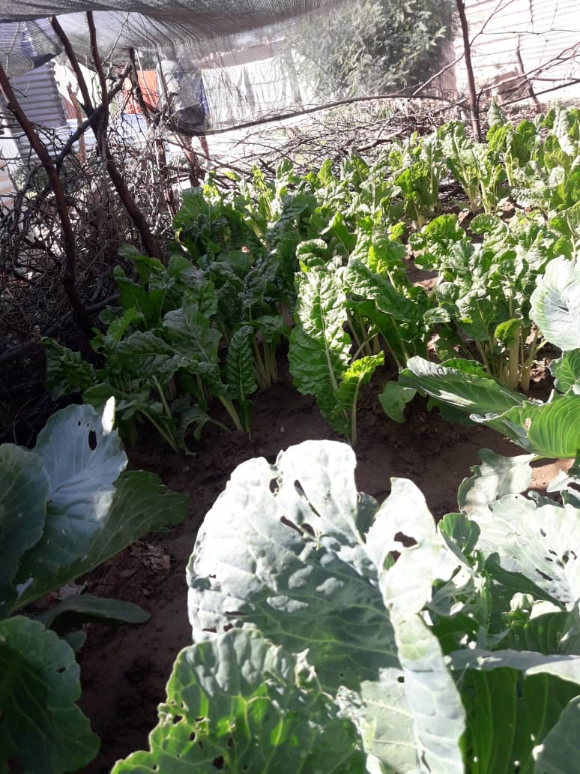
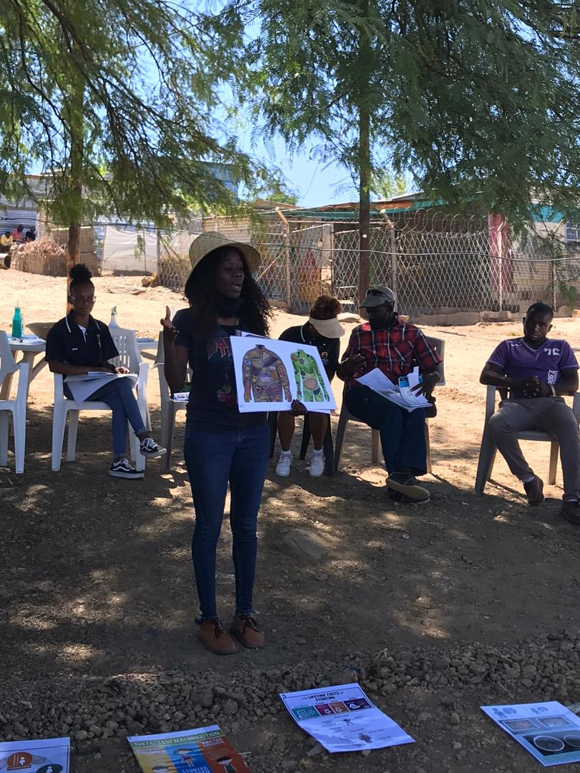
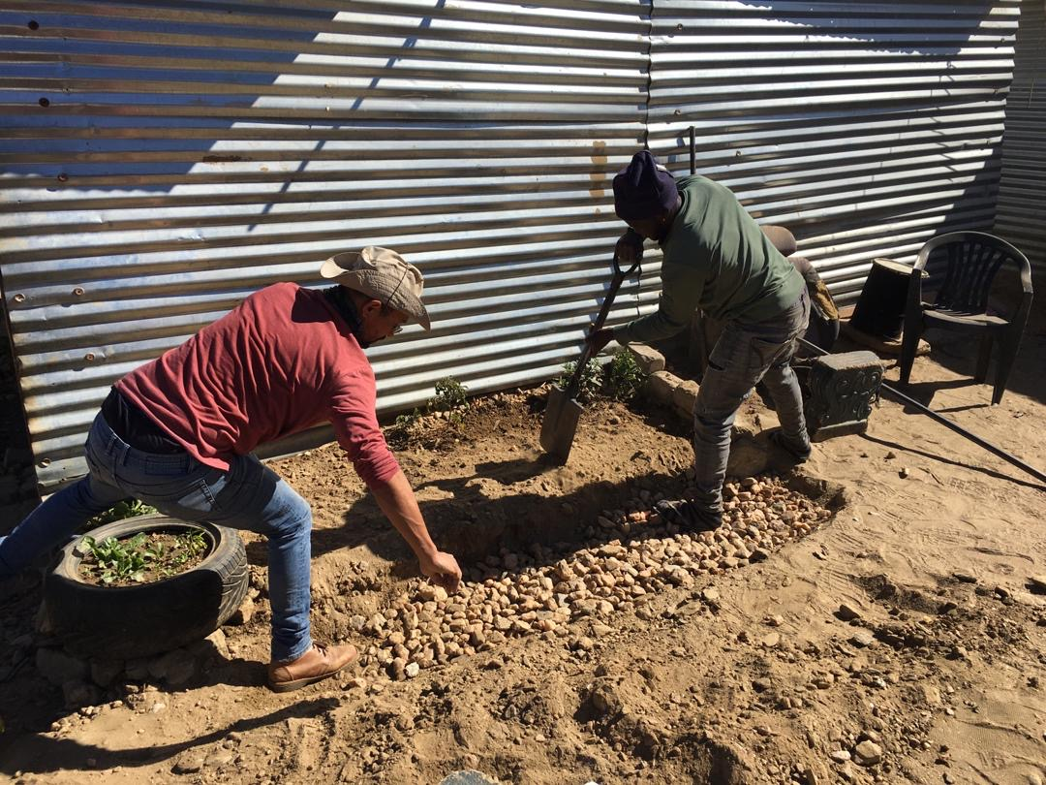
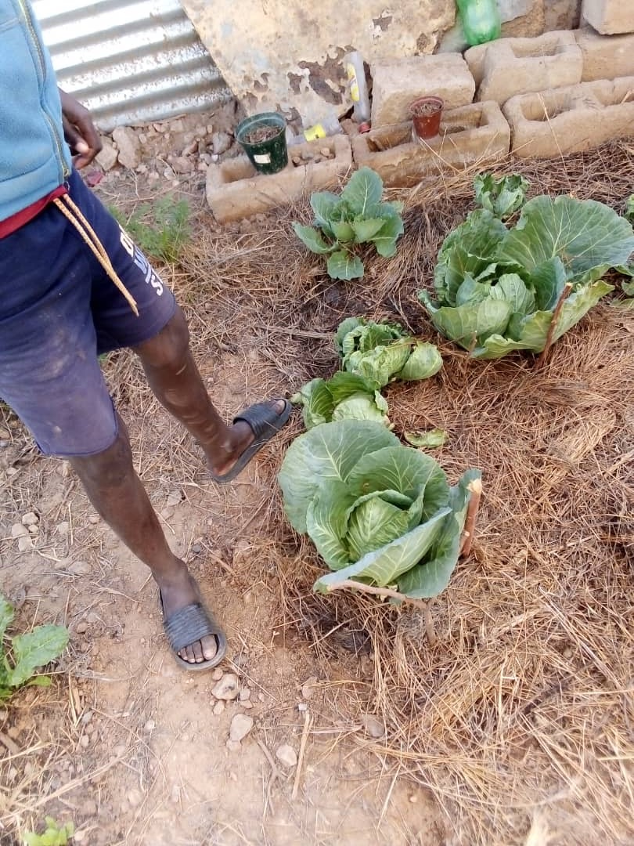
Focus Areas in 2020
Where are we now?
Organisational Development
& Membership Outreach
Collaboration with Government and UN Agencies to revive:
Food and Nutrition Security Council of Namibia
Food and Nutrition Security (FNS) Policy (2020)
FNS Implementation Action Plan (2020 – 2025)
Permaculture Gardens & Nutrition in Urban Communities

Slide 9
Q & A
Notes:
GRN Structure moved to OPM
NAFIN reconstituted itself into NAFSAN

