Slide 1
Nutrition in Namibia: Concepts and Controversies
Mrs. M. Charlotte Keyter
Faculty of Education: Department of Mathematics, Science and Sports Education

Slide 2
What to expect
10 Concept Pillars of Nutrition
Adequacy, Variety and Balance as
Key Characteristics of Healthful Diets
There is no ’good’ food and no ‘bad’ food
What constitutes a nutritious diet?
The Namibian Food and Nutrition Guidelines

Slide 3
Ten Concept Pillars of Nutrition
1
2
3
4
5
Food = Basic Need of Humans
Food = Energy (kJ), Nutrients + Other Substances → Growth & Development
Health Problems originate within Cells
Poor Nutrition can result from both Inadequate and Excessive Nutrient Intake
Humans can Adapt to Manage Fluctuations in Nutrient Intake

Slide 4
Ten Concept Pillars of Nutrition
6
7
9
10
There are no ‘good’ food and no ‘bad’ food
Adequacy, Variety and Balance are Key Characteristics of Healthful Diets
Some Groups/People are at Higher Risk of becoming Inadequately Nourished
Malnutrition = Poor Diets, Disease States, Genetic Factors …or Combinations
8
Poor Nutrition can Influence the Development of certain Chronic Diseases

Slide 5
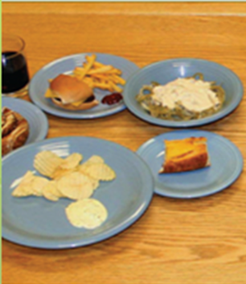
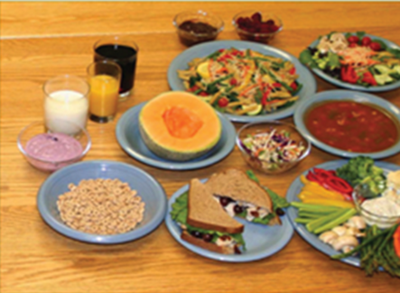
Pillar 9: Adequacy, Variety and Balance
= Key Characteristics of Healthful Diets
6615 kJ
High energy density and low nutrient density foods
6615 kJ
Lower energy density and high nutrient density
Solid fat, added sugar and alcohol reduce nutritional density
Include a Variety of Food from All Food Groups
Many Combinations of Food can supply Adequate Nutrients
High kilojoule diets or low nutrient density diets tend not to supply enough vitamins and minerals
No single food can supply all nutrients needed in meal / day

Slide 6
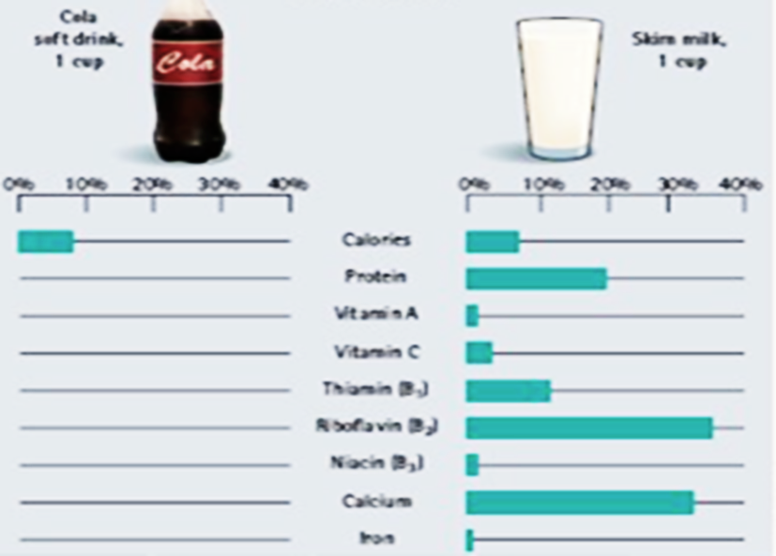
Pillar 9: Adequacy, Variety and Balance = Key Characteristics of Healthful Diets
Empty kilojoule food
Nutrient dense food
Energy dense food
Provides high levels of energy
Empty kilojoule foods (or low nutrient dense foods)
Provides high levels of energy and low levels of other nutrients
Nutrient dense foods
Food that contains high levels of nutrients compared to their weight and energy levels

Slide 7
Pillar 10: There are no ‘good’ food and no ‘bad’ food
People over-simplify the classification of food, typically:
‘Bad Foods’ | ‘Good Foods’
Warm Chips, Sweets, Cookies, Ice Cream, Pizza, Hotdogs, Hamburgers, … | Fruit, Vegetables, Whole Grain Products, …
Bad = only if food is spoiled by micro organisms or contaminants
Ice cream can be ‘good food’ for a healthy normal physical active person
Focusing only on vegetables and fruit, you may miss essential nutrients
All foods can be fit for a diet as long as:
energy needs are met + a healthy weight is maintained.
Best practise is a diet containing more nutrient dense food

Slide 8
What makes up a Nutritious Diet?
Nutritious Diet
Adequacy
Balance
Energy control
Moderation
Variety

Slide 9
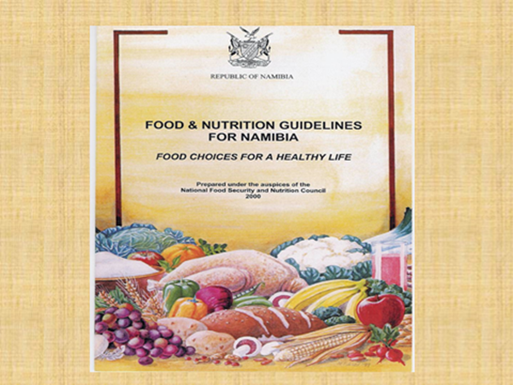
Eat a variety of foods
Eat vegetables and fruit every day
Eat more fish
Eat beans or meat regularly
Use whole-grain products
Use only iodised salt, but use less salt
Eat at least three meals a day
Avoid drinking alcohol
Consume clean and safe water and food
Achieve/maintain a healthy body weight

Slide 10
NAMIBIAN FOOD GROUPS
Cereal & Cereal Products
Vegetables
& Fruit
Animal Sources
& Beans
Fats, Oil
& Sugar

Slide 11
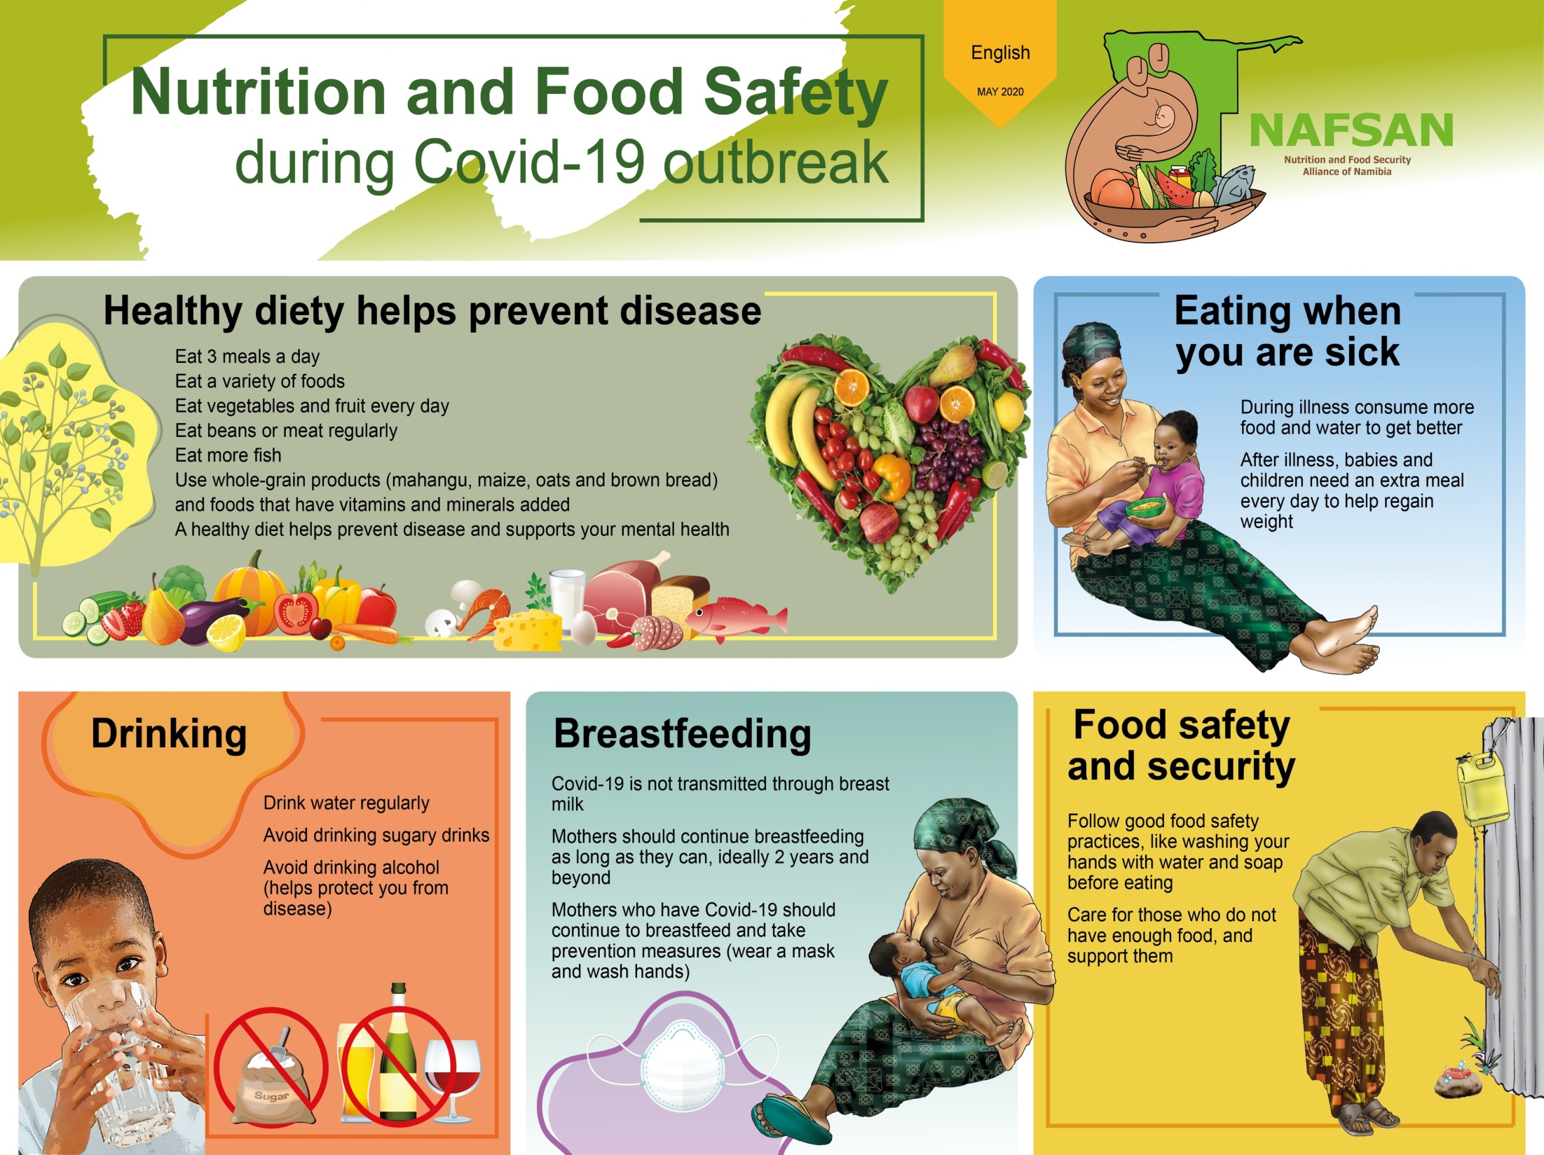
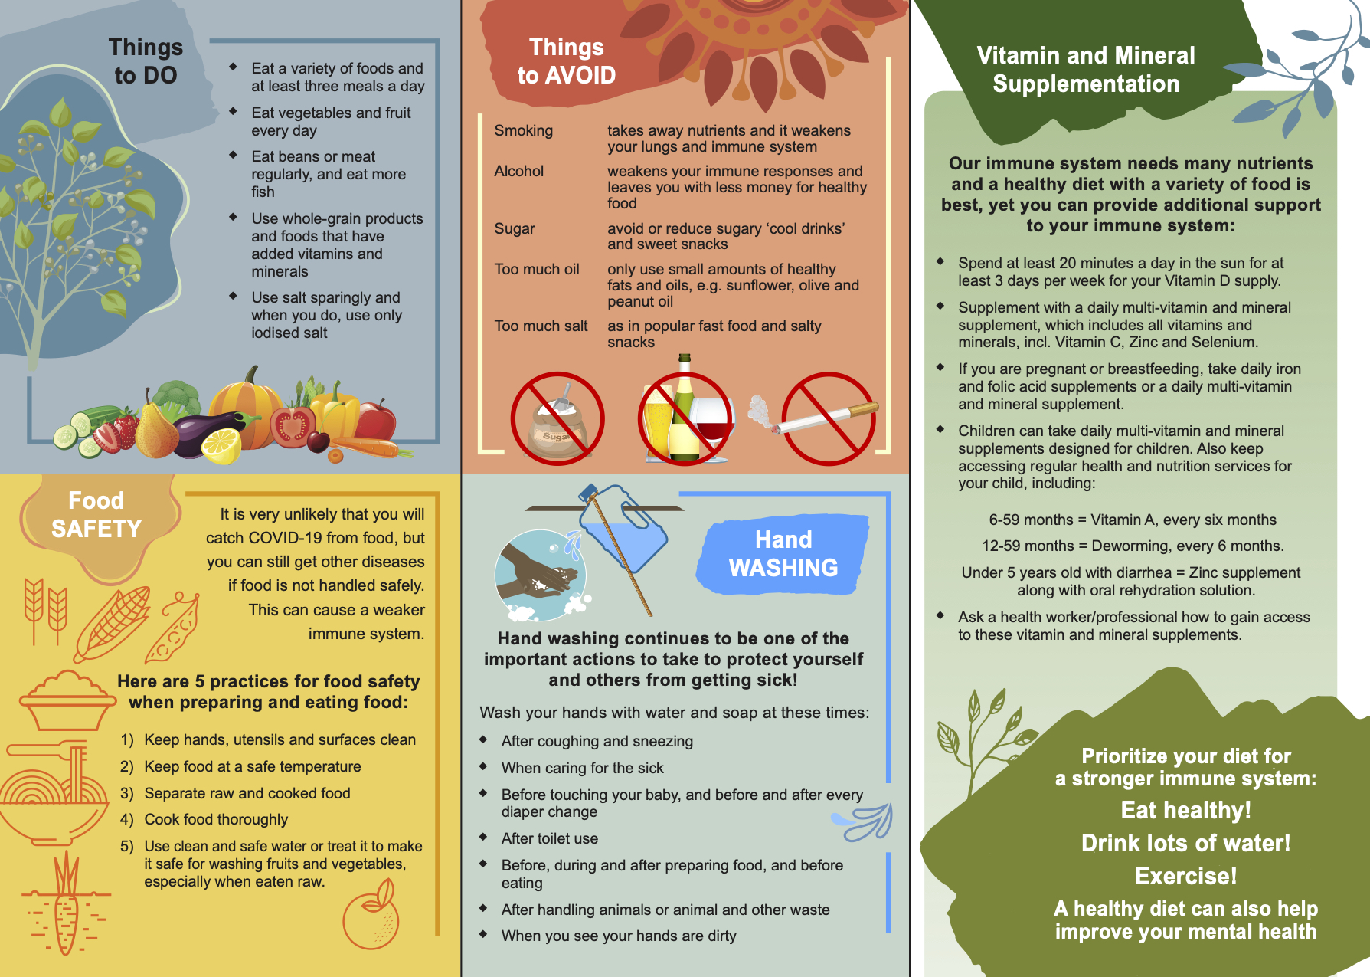

Slide 12
CONCLUSION
All food is fit!
Less processed food
All food is capable of giving nutrients.
Do not label food good or bad.
Variety in the diet
Reduce processed food from your diet.
Eat many types of food in a sensible amount.
Food is best!
Balanced diet
Nutrient dense food
Get nutrients from food before considering supplements
A diet that gives your body all the nutrients it needs to function correctly.
Include mainly nutrient dense food in your diet.

