Slide 1

Practical Insights
into Food & Nutrition Security
in Namibia
Ministry of Health and
Social Services
Marjorie van Wyk
Nutrition Officer: MHSS

Slide 2
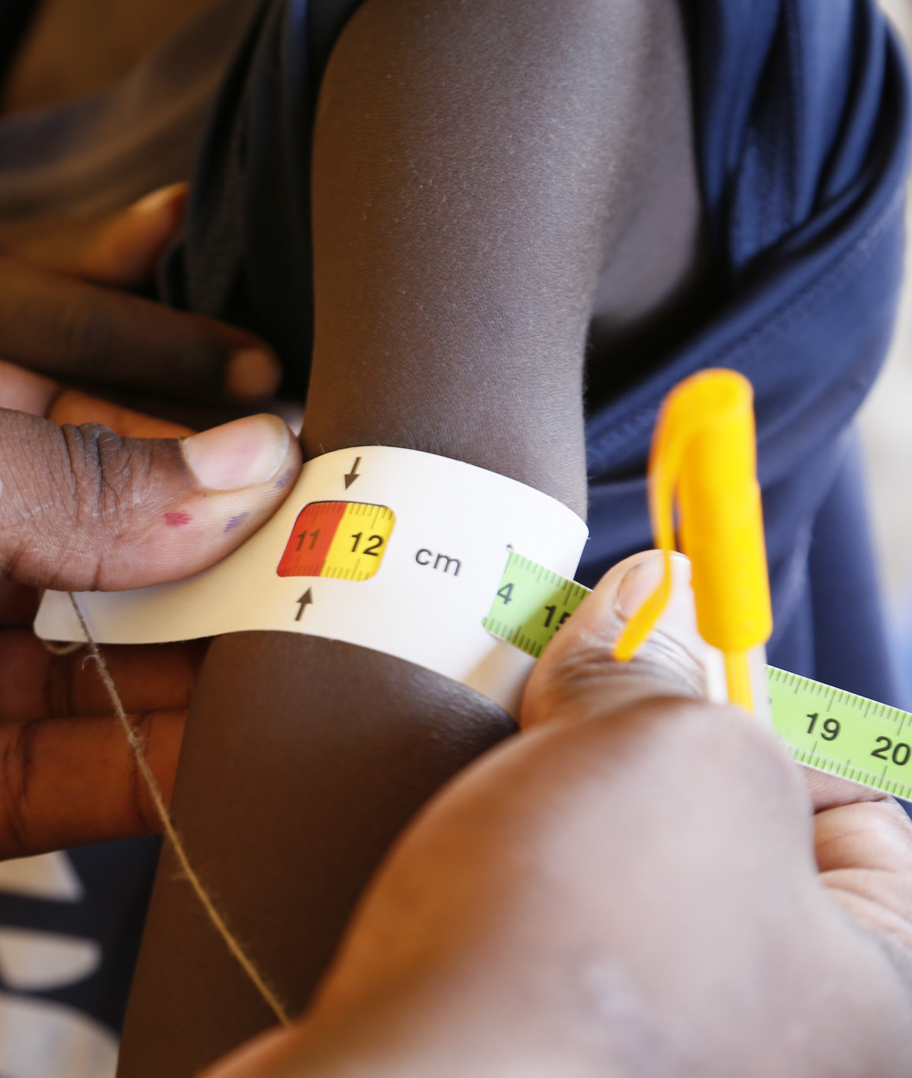
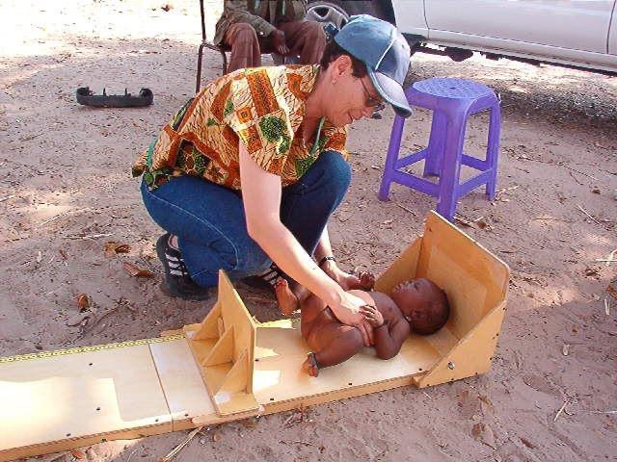
Food & Nutrition Security Policy (2021)
Objective 1: Reduce the Prevalence of Undernourishment

Slide 3
Introduction
Malnutrition is a major impediment to socioeconomic development of a country.
Malnourished children are more prone to diseases, poor cognitive and physical development and poor school performance.
  …this results in failure to achieve their full potential in life.
Therefore, the Goal of our Food and Nutrition Programme is:
  To improve the nutritional status of the Namibian population with special emphasis on children, women, and People Living with HIV/AIDS (PLWHA), resulting in the reduction of morbidity and mortality due to or associated with malnutrition.

Slide 4
Nambia’s Nutrition Situation: MALNUTRITION

Slide 5

Infant & Young Child Feeding
 | 1992 | 2000 | 2006 | 2013
Median duration of Breastfeeding (BF) | 17.3 months | 18.6 months | 16.8 months | 14.8 months
% Exclusively BF from birth to 6 months | 3% | 4.1 | 23.9% | 48.5%
% who started BF within 1 hour of birth | 52.3% | 80.9% | 71.3% | 71.2%
Children ever breastfed | 94.9% | 95.1% | 94% | 95.7%
Children breastfed at 1 year | 73% | 75.2% | 69% | 64%
Children breastfed at 2 years | 13.4% | 22.3% | 28% | 21%
“Breast is Best”

Slide 6
Overview: Micronutrient Deficiency Situation

Slide 7

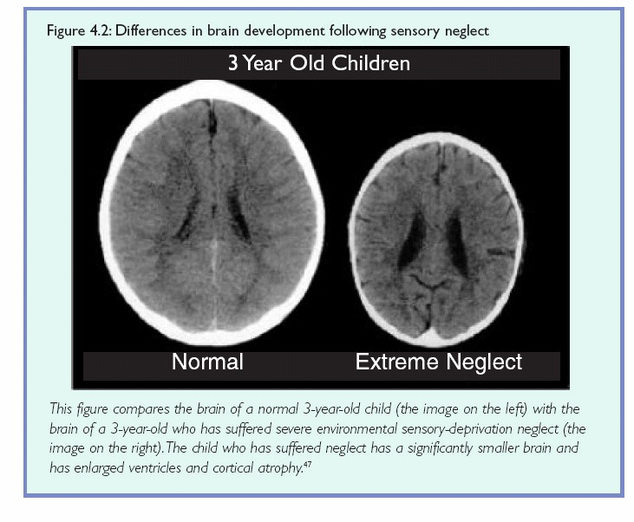
Food & Nutrition Security Policy (2021)
Objective 3: Reduce the Prevalence of Stunting
Effects of STUNTING
In Namibia,
¼ of all Children
are stunted!

Slide 8
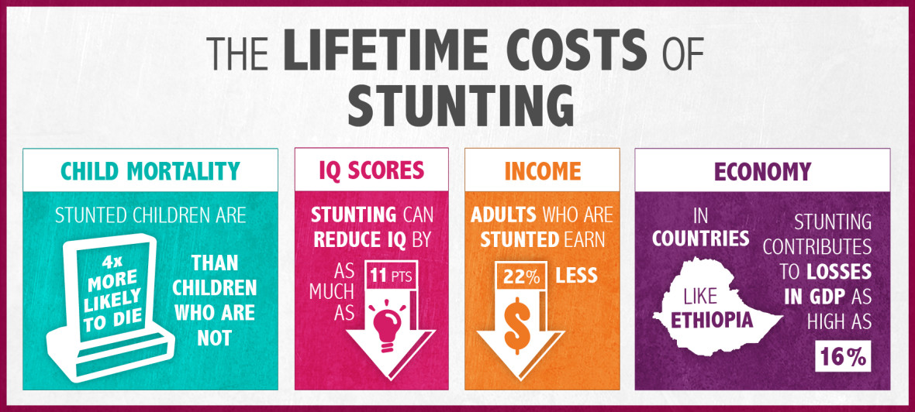

Slide 12
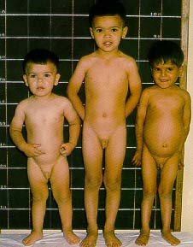
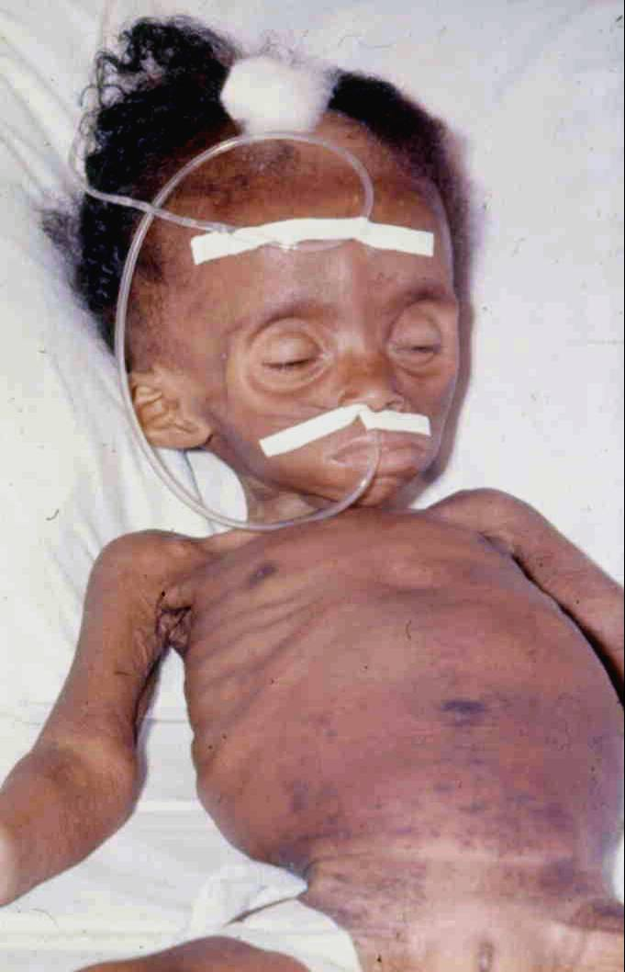
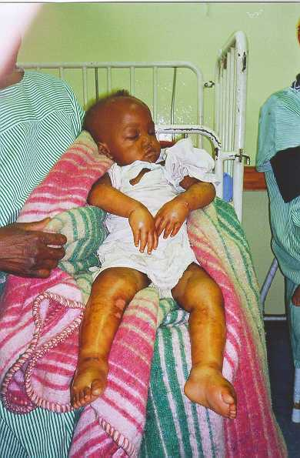
Impact of poor infant and young child feeding practices

Slide 13
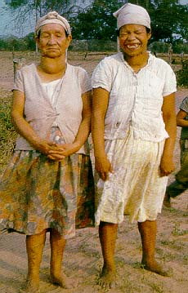

Micronutrient Deficiencies

Slide 14
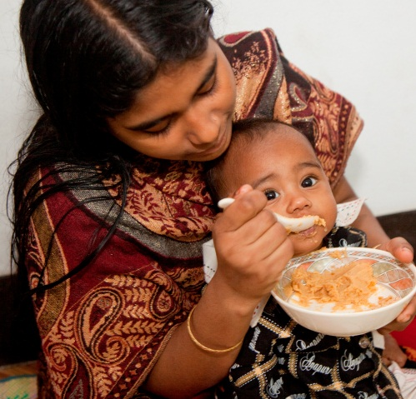

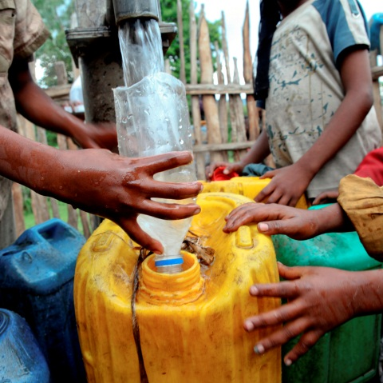

The causes of malnutrition are interconnected
Insufficient access to affordable, nutritious FOOD
throughout the year
Lack of good
CARE
for mothers & children & support for mothers on appropriate child feeding practices
Inadequate access to HEALTH sanitation & clean water services
ROOTED IN
Political & Cultural Environment
Poverty
Disempowerment of women

Slide 15
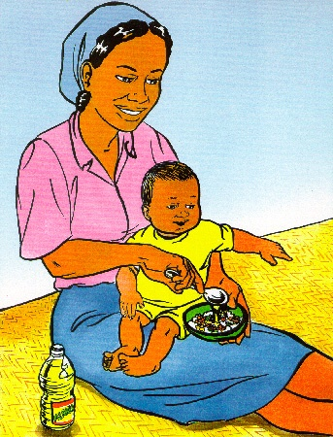
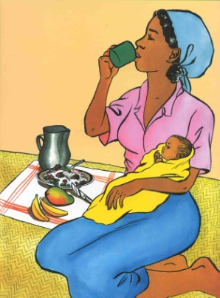
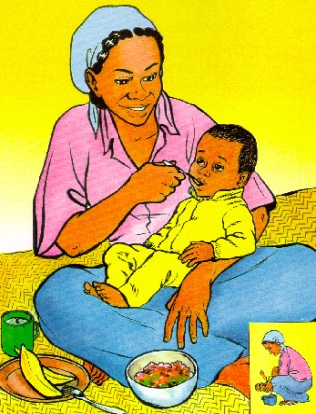




7 Essential Nutrition Actions
Complementary
feeding
Woman
Nutrition
Feeding of the
sick child
Breastfeeding
Iodine
Vitamin A
Iron

Slide 16
C o n c l u s i o n
Notes:
Nutrition Specific Interventions or programmes are those that address the immediate determinants of fetal and child nutrition and development—such as adequate food and nutrient intake, feeding, caregiving and parenting practices, and low burden of infectious diseases
Nutrition Sensitive interventions address the underlying determinants of fetal and child nutrition and development— food security; adequate caregiving resources at the maternal, household and community levels; and access to health services and a safe and hygienic environment—and incorporate specific nutrition goals and actions
Nutrition-sensitive programmes can serve as delivery platforms for nutrition specific interventions, increasing their scale, coverage and effectiveness

Slide 17
Nutrition-Sensitive Strategies increase
the Impact of Specific Actions for Nutrition
Specific Actions for Nutrition
Nutrition-Sensitive Strategies
Agriculture: Making nutritious food more accessible to everyone, and supporting small farms as a source of income for women and families
Clean Water & Sanitation: Improving access to reduce infection and disease
Education & Employment: Making sure children have the nutrition needed to learn and earn a decent income as adults
Health Care: Access to services that enable women & children to be healthy
Support for Resilience: Establishing a stronger, healthier population and sustained prosperity to better endure emergencies and conflicts
Feeding Practices & Behaviors: Encouraging exclusive breastfeeding up to 6 months of age and continued breastfeeding together with appropriate and nutritious food up to 2 years of age and beyond
Fortification of foods: Enabling access to nutrients through incorporating them into foods
Micronutrient supplementation:
Direct provision of extra nutrients
Treatment of acute malnutrition:
Enabling persons with moderate and severe malnutrition to access effective treatment
Notes:
Nutrition Specific Interventions or programmes are those that address the immediate determinants of fetal and child nutrition and development—such as adequate food and nutrient intake, feeding, caregiving and parenting practices, and low burden of infectious diseases
Nutrition Sensitive interventions address the underlying determinants of fetal and child nutrition and development— food security; adequate caregiving resources at the maternal, household and community levels; and access to health services and a safe and hygienic environment—and incorporate specific nutrition goals and actions
Nutrition-sensitive programmes can serve as delivery platforms for nutrition specific interventions, increasing their scale, coverage and effectiveness

Slide 18

Thank you

