Slide 1
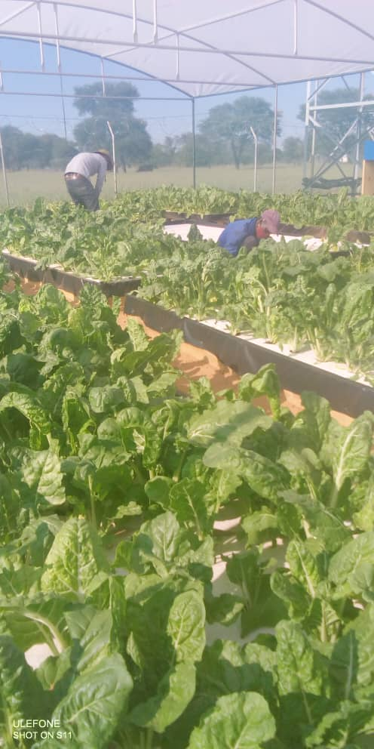
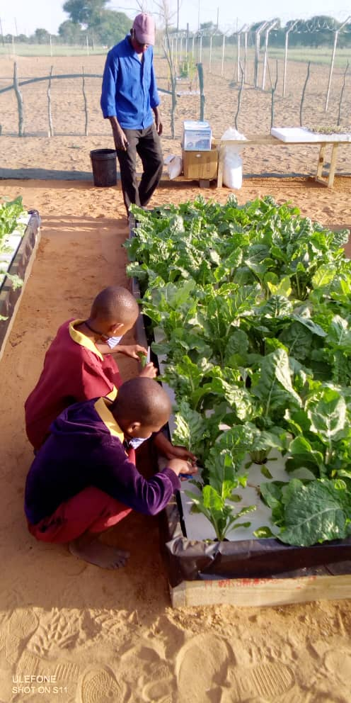
Supporting Namibia’s journey towards Food and Nutrition Security
United Nations World Food Programme (WFP)
SAVING LIVES. CHANGING LIVES.
Elvis Odeke
(Head of Programmes)
&
Rachael Mhango
(Nutritionist)
both WFP Namibia

Slide 2
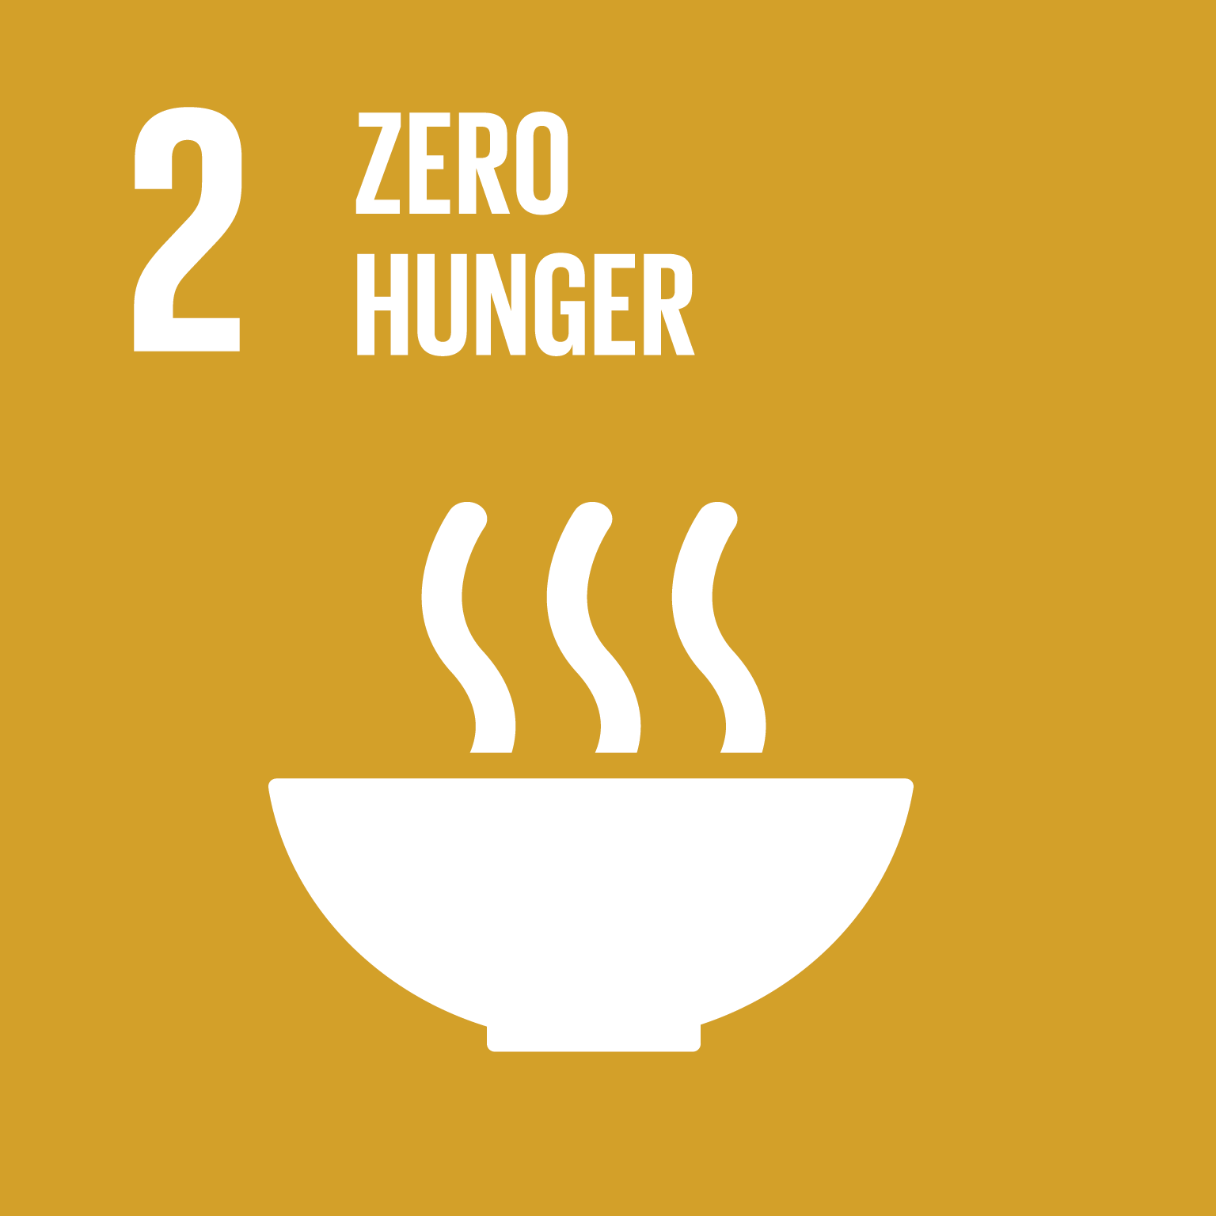
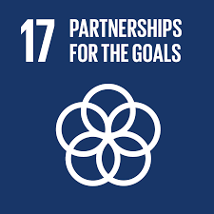
WFP PRIORITIES
WFP prioritize SDG 2, on achieving Zero Hunger;
AND
SDG 17, on Partnering to support implementation of the SDGs.

Slide 3
ABOUT WORLD FOOD PROGRAMME
Worlds Largest humanitarian agency fighting hunger worldwide
Reaches over 80 million people with food assistance in the world each year
Vision: Every man, woman and child should always have access to food needed for an active and healthy life, zero hunger in the world

Slide 4
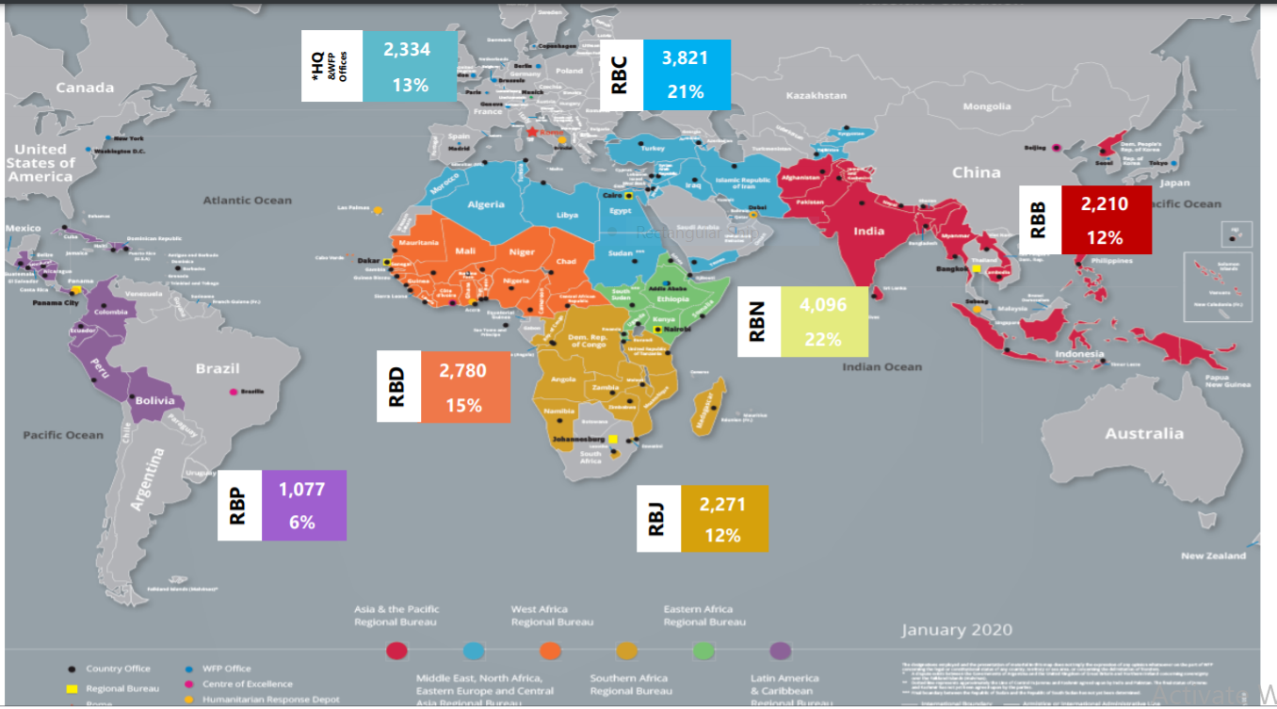
Our workforce is diverse and distributed….

Slide 5
World Food Programme Mission Statement
WFP’s mandate is to:
Design and implement strategies, policies and activities related to food assistance, with the aim to: Save lives in emergency situations.
Improve the nutrition and quality of life of the most vulnerable people when they are unable to produce enough food or do not have the resources to obtain food for active and healthy lives.

Slide 6
ABOUT WORLD FOOD PROGRAMME in Namibia
Programmes guided by the National Development plan, Harambee Properity Plan and other government priorities, and strategies.
WFP works within the framework of the United Nations Partnerships Framework – (UNPAF): Pillars – 1) Economic Growth; 2) Social Transformation; 3) Environmental Sustainability; 4) Good Governance
Broad Aims
- Provide technical assistance to government to strengthen programmes that address food and nutrition security.
- Support the Government accelerate the journey towards the achievement of zero hunger

Slide 7
What's WFPs Focus on?
Improving household access to food
Individual dietary intake of sufficient food and nutrients.

Slide 8
Namibia’s Country Strategic Plan (CSP) “line of sight”
Access to adequate food. Poverty, income inequality, high unemployment – high food prices HIV and COVID-19 are major factors limiting access to food
Ending all forms of malnutrition. Child stunting is at 24%, wasting 6% and underweight 13%

Slide 9
The three pillars of food security
  Food availability: The amount of food physically available to a household or at national level;
  Access to food: The physical and economical ability of a household to acquire adequate amounts of food;
  Food utilization: The intra-household use of the food accessible and the individual’s ability to absorb and use those nutrients.
AVAILABILITY
ACCESS
UTILIZATION
STABILITY

Slide 10
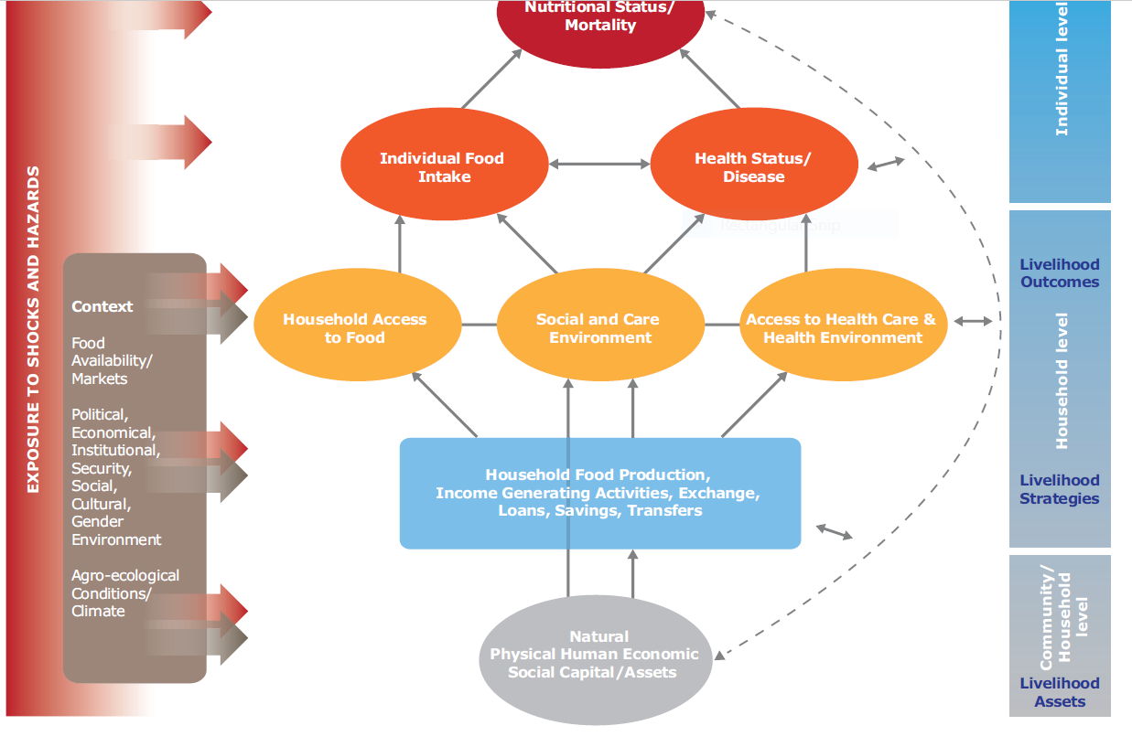
Conceptual framework of malnutrition

Slide 11
World Food Programme Mission Statement
Help build assets and promote the self-reliance of poor people and communities.
WFP food Aid is also directed to fight micronutrient deficiencies, reduce child mortality, Improve maternal health, and combat diseases such as HIV and AIDS

Slide 12
WFP’s Country Strategic Plan (CSP) “line of sight”
Smallholder Productivity and Income. Most smallholder and subsistence farmers live in communal areas where access to land and water is challenging. Most smallholder producers – 54 percent – are women
Sustainable food systems. Namibia’s climate is semi-arid and arid. Agricultural land accounts for 47 percent of the total area, of which only 34 percent supports economic crop and livestock production.

Slide 13
WFPs work in Namibia
WFPs Partnership with:
The Namibian government in support of national policy for reducing undernutrition in partnership with UN sister agencies, NGOs, FBOs, the private sector, and academia.

Slide 14
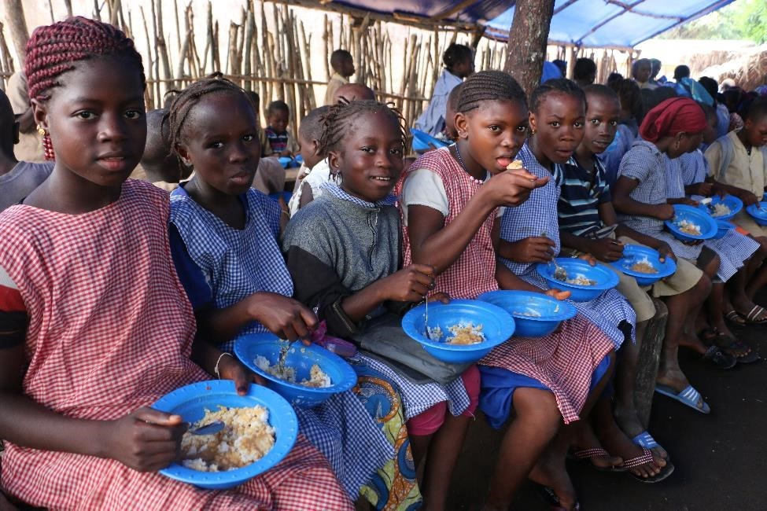
Interventions in Namibia: National School Feeding Programme
WFP supports the Ministry of Education in improving the efficiency and effectiveness of the school meals programme. This included the development of a school feeding policy,
Implementation guidelines and monitoring plan
Technical support on a web-based information system to capture monitoring information.

Slide 15
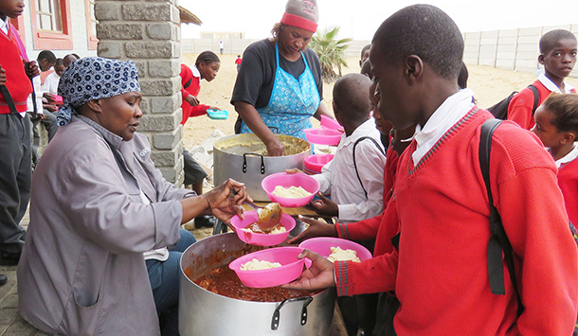
Interventions in Namibia: National School Feeding Programme
WFP is providing technical assistance to the government in the implementation of the National school feeding Programme, over 400,000 primary school learners are benefiting from the programme
WFP will provide financial and technical support in the piloting of the Home-Grown School Feeding Programme as a strategy to improve educational and nutrition outcomes

Slide 16
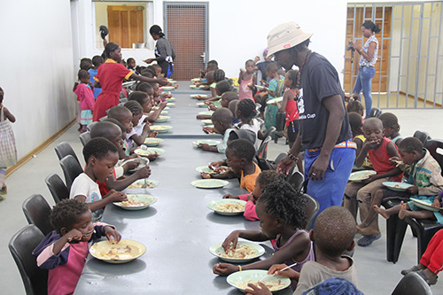
Interventions in Namibia: National School Feeding Programme
WFP is in the process of providing emergency school feeding to school learners in Kunene region most affected by severe drought condition, 3000 students from most affected households will be provided with a dry take home ration.

Slide 17
Interventions in Namibia: Nutrition
Provision of Ready to Use Supplementary Food (RUSF) to all health facilities across the country for treatment of Moderate Acute Malnutrition (MAM).
Fill the nutrient Gap Study: Analyses the nutrition situation in a country and identifies the barriers faced by the most vulnerable to accessing and consuming healthy and nutritious foods.
Technical and financial support on the development of the food and nutrition security policy for nutrition sensitive and nutrition specific interventions (2020-2025)

Slide 18
Interventions in Namibia: Emergency Response
Drought Response:
101,636 clients on ART (plus two family members each, totalling 304,908 beneficiaries) in eight out of 14 regions of the country and 44,900 severely drought affected beneficiaries in Kavango East and Kavango West regions
Cash Based Transfers (CBT) and Food Based Transfers

Slide 19
Interventions in Namibia
Zero Hunger Programme Implementation: OPM and other stakeholders
Food security and Vulnerability Assessment: OPM and other Stakeholders
Climate Adaptation: Ministry of Environment and other stakeholders
Livelihood strengthening projects
Cost of Hunger Study: NPC, NSA, OPM plus other Stakeholders
Food Systems: Production to Consumption

Slide 20
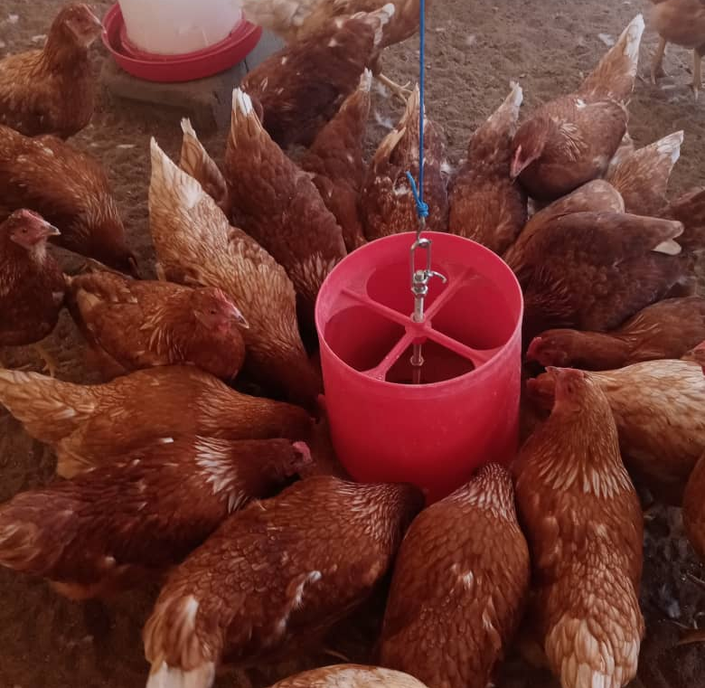
THANK YOU

