Slide 1


The Journey of Building Capacity around Health and Nutrition Security in Namibia
Professor Sylvester R Moyo.
Founding Dean:
Faculty of Health and Applied Sciences
Namibia University of Science and Technology (NUST)

Slide 2

Founding of the
Faculty of Health and Applied Sciences
Initial decision by the Council of the then Polytechnic of Namibia to establish the School of Health and Applied Sciences.
I was recruited end of 2009 and started 1st March 2010
April 2010: School (= now: Faculty) was born, started operating 1st May 2010
By then, only four Programmes existed:
Mathematics and Statistics
Biomedical Sciences
Environmental Health Sciences
Emergency Medical Care

Slide 3

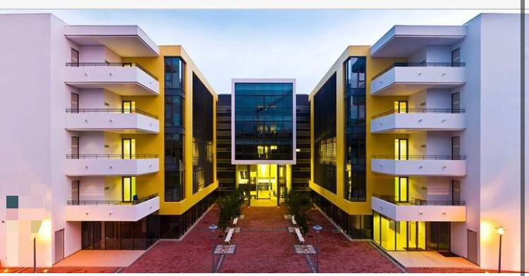
Road to Building Human Resource Capacity in Health and Applied Sciences for Namibia
1st Task: Inherited 4 Programmes, which needed much support
Key Issues:
Staffing
Facilities
Industry partnerships
International partnerships
Future programmes

Slide 4
Planning
Comprehensive Discussions: Ministry of Health and Social Services + other major Stakeholders
Needs Assessment
Programmes - in order of priority
i. Biomedical Sciences (Hons)
ii. Environmental Health Sciences (Hons)
iii. Emergency Medical Care (Diploma, BSc + Hons)
iv. Natural and Applied Sciences (BSc+ Hons)
v. Honours Programmes: Applied Mathematics and Statistics
vi. Health Information Systems and Management (Hons)
vii. Human Nutrition (Hons)

Slide 5

Post Graduate Programmes
Postgraduate Diploma in Radiation Science (Uranium Institute)
Postgraduate Diploma in Health Information Systems and Management
Master’s degrees in Applied Mathematics
Master’s degrees in Applied Statistics
Master’s in Health Sciences
Master’s in Natural and Applied Sciences
PhD in Applied Mathematics
PhD in Applied Statistics
PhD in Health Sciences

Slide 6
Human Nutrition
Started 4 years ago in 2017
1st Cohort now in final year = completing studies in 2021
Class of ± 30 students, to be deployed in the Namibian labor market
Similar number of Graduates expected, providing Namibia with sufficient Nutrition Experts
Programme is offered to Honours level + Graduates can hook into already existing Master and PhD Programmes at Faculty of Health and Applied Sciences

Slide 7
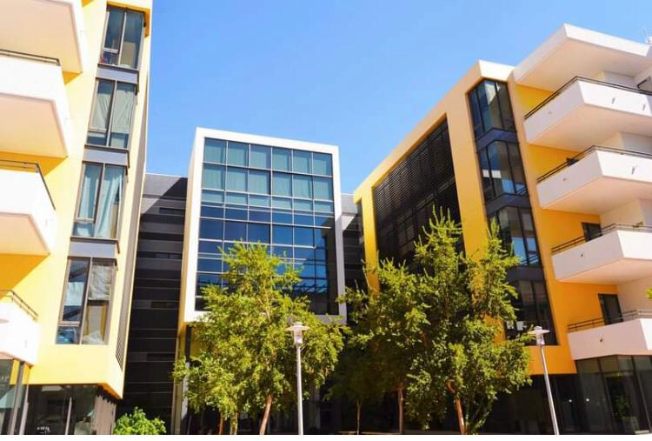
Future Plans
Currently NUST is working on coming up with a
Centre of Excellence in Human Nutrition
in the Faculty of Health and Applied Sciences
Major Functions:
Research and Development
Training
3. Hub of knowledge in Human Nutrition
4. Dissemination of knowledge in nutrition
5. Scaling Up Nutrition in the country

Slide 8
Thank you
&
Questions?

