Slide 1

Office of the Prime Minister
Regional Consultation Workshops
22 February – 8 March 2021
National Food Security and Nutrition Policy
Draft - 2021

Slide 2
Presentation Outline
Introduction
Background
Rationale & Alignment
Guiding Principles
Policy Content & Direction
Coordination Structure
Implementation Action Plan
Conclusion
Process of Reviewing

Slide 3
1. Introduction
Revision of Food and Nutrition Policy for Namibia (1995);
Informed by national progress and challenges, NDP5 and the Zero Hunger Strategy Review Report (2016).
Context for ending hunger, reduce malnutrition and guarantee nutritional well-being for the population of Namibia through sustainable food and nutrition security.
Contributes to continual economic growth through improved health, increased income, better education accomplishments and employment prospects.
Forms basis for food security and nutrition actions.

Slide 4
1. Introduction cont.
Changes in Policy Document
 | 1995: Food and Nutrition Policy for Namibia | 2021: Revised Food and Nutrition Security Policy (draft)
Goal | Improve nutritional status of the population | Ensure that the population has access to adequate, safe, quality food and water throughout their life cycle that always meets their nutrient requirements for optimal healthy and productive lives.
Objectives: 3 (1995) → 4 (2021) |  | Strategies: Each objective has various strategies outlining actions in support of each strategy and objective. Implementation Action Plan = separate document

Slide 5
2. Background
Malnutrition is a major impediment to socioeconomic development of a country.
Malnourished children are more prone to diseases, poor cognitive and physical development and poor school performance.
  …this results in failure to achieve their full potential in life and reduced physical and economic attainment in adulthood.
In 2016, a food and nutrition security assessment indicated that 34% of the Namibian population was food insecure.
In 2017, the Global Hunger Index Score declined from 30.9 (2008) to 25.7, depicting a serious hunger situation in Namibia.
Further findings of the food security and nutrition situation indicated 28.8% of Namibians were undernourished.

Slide 6
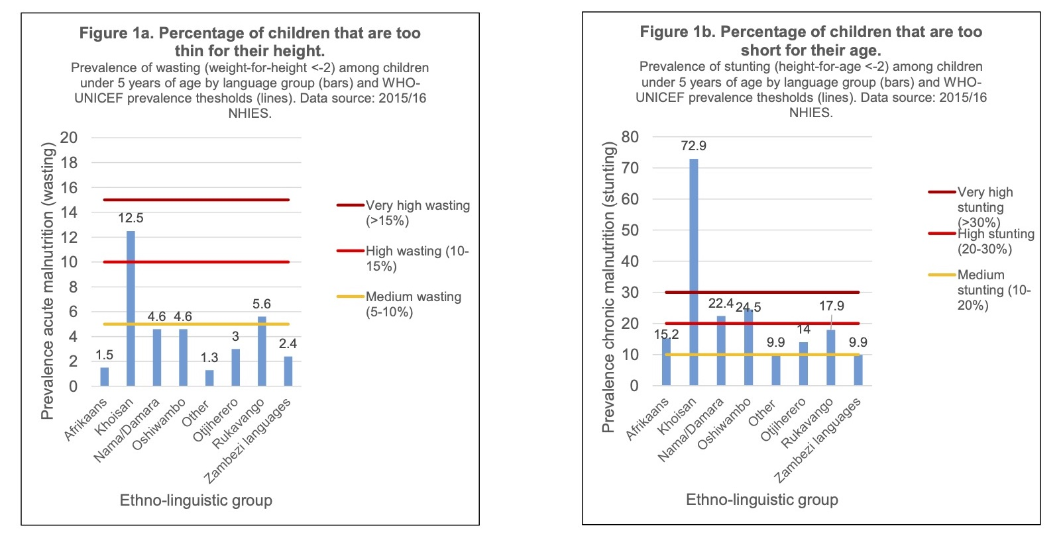
Food Insecurity Brief – June 2020

Slide 7
How is nutritional status measured?
Weight-for-Height (WFH) = Recent rapid weight loss or a failure to gain weight
ACUTE MALNUTRITION WASTING/THINNESS
Height-for-Age (HFA) = Inadequate nutrition over a long period of time
CHRONIC MALNUTRITION STUNTING/SHORTNESS
Weight-for-Age (WFA) = Composite index actually used in growth monitoring in Namibia
ACUTE + CHRONIC UNDERWEIGHT
Body Mass Index (BMI) = Recent weight loss (acute) or long term weight accumulation
ACUTE + CHRONIC UNDERWEIGHT

Slide 8
Overview of Nutrition Situation
Malnutrition

Slide 9
Overview of Regional Nutrition Situation

Slide 10
Overview of Breastfeeding Situation
 | 1992 | 2000 | 2006 | 2013
Median duration of BF | 17.3 months | 18.6 months | 16.8 months | 14.8 months
% EBF from birth to 6 months | 3% | 4.1 | 23.9% | 48.5%
% who started BF within 1 hour of birth | 52.3% | 80.9% | 71.3% | 71.2%
Children ever breastfed | 94.9% | 95.1% | 94% | 95.7%
Children breastfed at 1 year | 73% | 75.2% | 69% | 64%
Children breastfed at 2 years | 13.4% | 22.3% | 28% | 21%
Breastfeeding

Slide 11
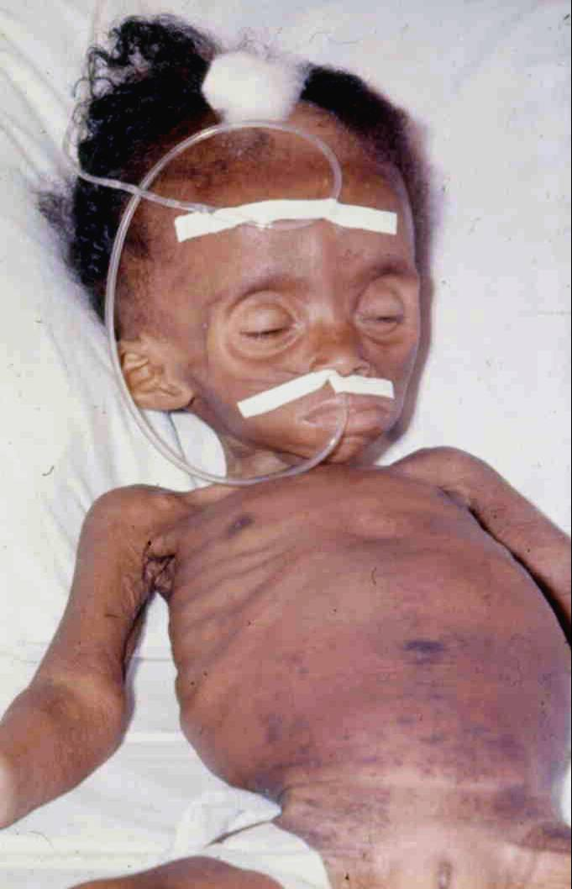
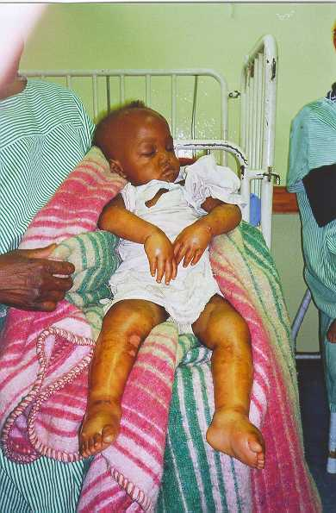
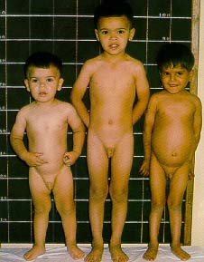
Impact of poor infant and young child feeding practices

Slide 12

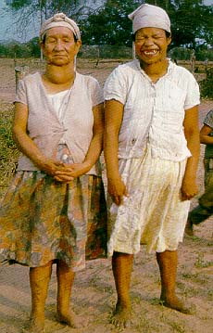
Micronutrient Deficiencies

Slide 13
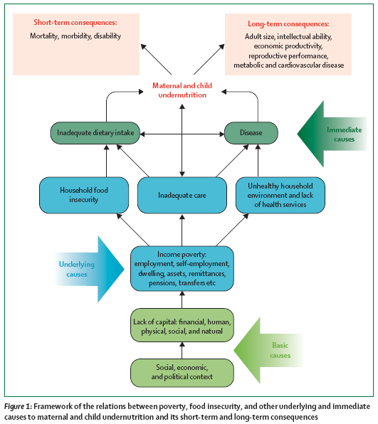
Causes of malnutrition framework
Notes:
The malnutrition framework illustrate the association of the vicious cycle of malnutrition (undernutrition - disease - inadequate dietary intake) with the underlying and basic causes. In order to fight against malnutrition and to prevent the short- and long-term consequences, these causes need to be addressed at different level (Individual, Community, Health District, Region and National).

Slide 14
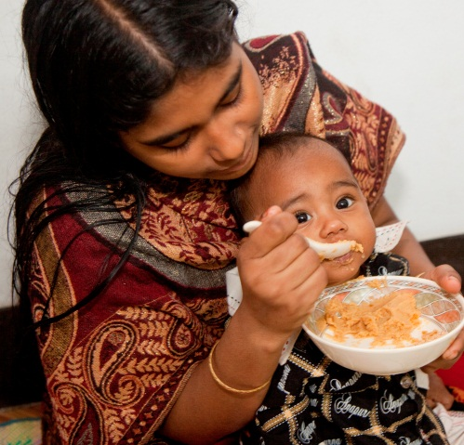

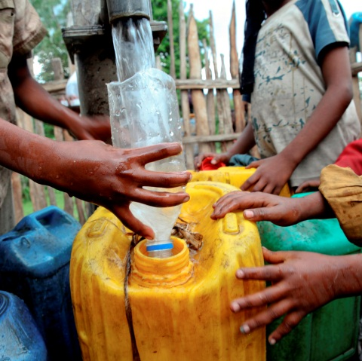

The causes of malnutrition are interconnected
Insufficient access to affordable, nutritious FOOD
throughout the year
Lack of good
CARE for mothers & children & support for mothers on appropriate child feeding practices
Inadequate access to HEALTH sanitation & clean water services
ROOTED IN
Political & Cultural Environment
Poverty
Disempowerment of women

Slide 15
Nutrition-sensitive strategies increase the impact of
specific actions for nutrition
Specific Actions for Nutrition
Nutrition-Sensitive Strategies
Feeding Practices & Behaviors: Encouraging exclusive breastfeeding up to 6 months of age and continued breastfeeding together with appropriate and nutritious food up to 2 years of age and beyond
Fortification of foods: Enabling access to nutrients through incorporating them into foods
Micronutrient supplementation:
Direct provision of extra nutrients
Treatment of acute malnutrition:
Enabling persons with moderate and severe malnutrition to access effective treatment
Agriculture: Making nutritious food more accessible to everyone, and supporting small farms as a source of income for women and families
Clean Water & Sanitation: Improving access to reduce infection and disease
Education & Employment: Making sure children have the nutrition needed to learn and earn a decent income as adults
Health Care: Access to services that enable women & children to be healthy
Support for Resilience: Establishing a stronger, healthier population and sustained prosperity to better endure emergencies and conflicts
Notes:
Nutrition Specific Interventions or programmes are those that address the immediate determinants of fetal and child nutrition and development—such as adequate food and nutrient intake, feeding, caregiving and parenting practices, and low burden of infectious diseases
Nutrition Sensitive interventions address the underlying determinants of fetal and child nutrition and development— food security; adequate caregiving resources at the maternal, household and community levels; and access to health services and a safe and hygienic environment—and incorporate specific nutrition goals and actions
Nutrition-sensitive programmes can serve as delivery platforms for nutrition specific interventions, increasing their scale, coverage and effectiveness

Slide 18
3. Rationale & Alignment
Need for revision due to:
Evolution of Food and Nutrition Security, and changes in global environment.
Namibia being a member of the regional and international community and signatory to several instruments, including:
  International Conference on Nutrition (ICN2) recommendations,
  Scaling Up Nutrition (SUN) movement,
  Sustainable Development Goals (SDGs)
  1000 Days’ movement, and the
  African Regional Nutrition Strategy.
..and to:
Align with scientific evidence and global recommendations
Address and improve inadequate coordination mechanisms
Create policy synergies and link long term perspective to short term planning.
Ensure a multi-sectoral approach to strengthen the implementation of nutrition and food security initiatives;
Reduce stunting,
Adhere to the provisions of Namibia’s Constitution: Article 95, paragraph (j):
‘consistent planning to raise and maintain an acceptable level of nutrition and standard of living for the Namibian people and to improve public health.’
Overall renew GRN commitment to Food Security and Nutrition.

Slide 19

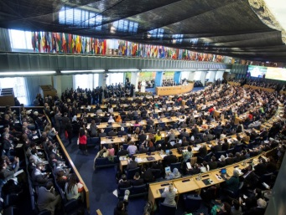
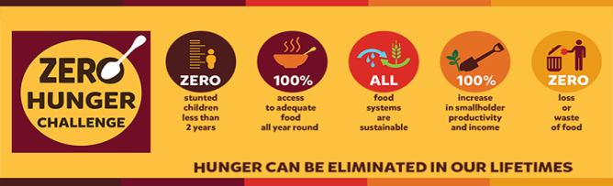


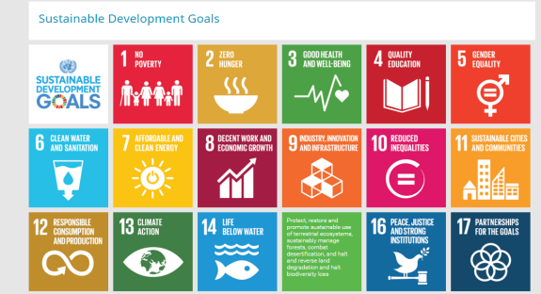

Alignment with existing Strategic Frameworks
National policies, instruments and frameworks
Regional and global frameworks
International protocols, conventions ratified by Namibia
Namibia Vision 2030
Namibia NDP 5
SUN movement
UN Zero Hunger Challenge
Second International Conference on Nutrition (ICN2) recommendations 2014 and FFA
African Regional Nutrition Strategy
The African Union – Malabou Declaration and CAADP
SADC Regional Agricultural Policy
WHO global targets
Sustainable Development Goals (SDGs)
1000 days
1990 World Summit for Children
World Nutrition Summit (1996)
Global Strategy for IYCF

Slide 20
Revised Food and Nutrition Security Policy
Legal Alignment
The Policy is well aligned to national sectoral policies, strategies and the constitution, and contributes to aspirations of NDP5, Harambee Prosperity Plan and the Zero Hunger Road Map, among others.
Legislative Framework
The Constitution of the Republic of Namibia
Namibia Vision 2030
National Development Plan 5
Namibia Zero Hunger Road Map (2016 – 2020)
Namibia Agriculture Policy of 2015
National Gender Policy 2010
Namibia Food Safety Policy 2014
National Health Policy Framework 2010 – 2020
National Policy on Sexual, Reproductive and Child Health 2013
National Rural Development Policy 2012
National Policy for School Health 2008
Namibia School Feeding Policy
Namibia Climate Change Policy 2011
Global and Regional Conventions

Slide 21
4.
Guiding Principles
Implementation and governance of the revised Policy is founded on the following guiding principles:
  Government’s commitment to the Universal Human Rights
  Commitment to implement the recommendations of regional and global initiatives e.g SDGs, Maputo Declaration, the SUN Movement, the Zero Hunger Challenge, the second and ICN2
  Equity in access to and implementation of nutrition interventions
  Effective coordination within and across sectors
  Community empowerment and effective involvement with incentives to engender community acceptance and ownership.
  Decentralization of adequate tools and resources and governance system for better implementation of programs and projects.
  Scaling up of evidence-based interventions that include proven strategies and best practices
  Life course approach, with a particular focus on the key ‘window of opportunity’ which is the first 1000 days of life.
  Accountability and participation across sectors and at national, regional, district and community levels.

Slide 22
5.
Process
The process of reviewing this policy included:
  wide consultations [individual & group) with representatives from the Government, United Nations, academic institutions, non- governmental organizations, private sector, civil society and donors.
  situation analysis through literature review, sector specific group and individual consultations for content reviews,
  Consensus building and validation workshops.

Slide 23
5.
Process
cont.
Key technical contributions for the revision of this policy came from:
  NPC / MHSS / MAWLR / MGEPESW / MEAC /
  MHETI / MURD / MIT / MICT / MET
  All Regional Councils
Technical & financial inputs of the United Nations agencies (WFP, UNICEF, FAO and WHO), USAID and statutory institutions, including Civil Society Organizations (CSOs), Academia and Private Sector

Slide 24
6.
Policy Content
The revised policy contains five major sections, and its implementation is supported by an implementation plan and a coordination system
  Section one: Introduction and Background information. (the methodology, situation analysis, discusses prior efforts, predisposing factors for FN insecurity and status of Food and Nutrition interventions, existing gaps and opportunities in Namibia
  Section two: Rationale, Legal alignment and Guiding Principles for the policy. The section explains the rationale for revising the policy document and explains how it addresses policy gaps on food and nutrition security in the country.
  Section three: Policy Goals, Objectives and Strategies. The section provides policy direction, including vision, mission, goal and objectives of the policy and highlights a number of strategies and related activities under each objective.
  Section four: Institutional Arrangements and Coordination Mechanism. Herein is the policy Institutional arrangements and coordination framework for government Offices, Ministries and Agencies.
  Section five: Implementation Action Plan for the policy. The section focuses on describing the costed multi-sectoral implementation action framework developed to implement this policy.
  Supplementary: Implementation Action Plan.

Slide 25
Revised Food and Nutrition Security Policy
6.
Policy Direction
Vision: Optimal food and nutrition security for a healthy and productive nation
Mission: To provide integrated, affordable, accessible and equitable, quality food and nutrition security services that are responsive to the needs of the population.
Policy Goal:
To ensure that the population has access to adequate, safe, quality food and water throughout their life cycle that always meets their nutrient requirements for optimal healthy and productive lives.

Slide 26
6.
Policy Objectives
Broad Policy Objectives:
Objective 1: By 2030, reduce the prevalence of undernourishment from 30.9% to 15% by facilitating the provision of adequate food and nutrition for mothers and children and ensuring optimal health and productivity of the people of Namibia throughout their lifecycle.
Objective 2: By 2030, increase the share of domestic food requirements met through national food production from 30% to 60% by increasing the quality and quantity of diverse, nutritious, safe, and accessible food for the populace of Namibia at all times.
Objective 3: By 2030, reduce prevalence of stunting from 24% to 12% through nutrition sensitive interventions and by ensuring access to health care services, sanitation, hygiene, education, and social protection programmes for all people in Namibia.
Objective 4: To increase investment in food and nutrition security across all sectors by at least 4% annually and ensure an enabling environment for effective co-ordination and implementation.

Slide 27
7. Implementation Arrangements
  Institutional Arrangements & Coordination Mechanism:
    Outlines Institutional Arrangements and Coordination Framework for Government OMAs
    The Coordinating Mechanism highlights the contribution of each technical partner
    → Presentation to follow

Slide 28
8. Implementation Action Plan
  Implementation Action Plan for the Policy.
    The section focuses on describing the costed multi-sectoral implementation action framework developed to implement this policy.
    Contains key components essential for:
      monitoring progress and
      determination of outcomes achieved during policy implementation process.
    Separate Document
    → Presentation to follow

Slide 29
IAP - template

Slide 30
Conclusion
The Policy is developed in an environment of considerable past achievements of the 1995 Food and Nutrition Policy.
This revised Policy and its operational plans seek to consolidate these achievements and reinforce Namibia’s efforts to addressing the national challenge of stunting and malnutrition in children as stated in NDP5.
It is a step towards achieving the Vision 2030 goal of ensuring a healthy and food secure nation of Namibia.

Slide 31
Office of the Prime Minister
We thank you!

Slide 32
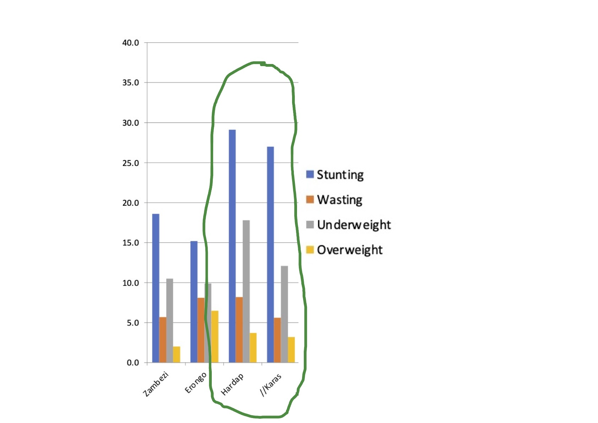
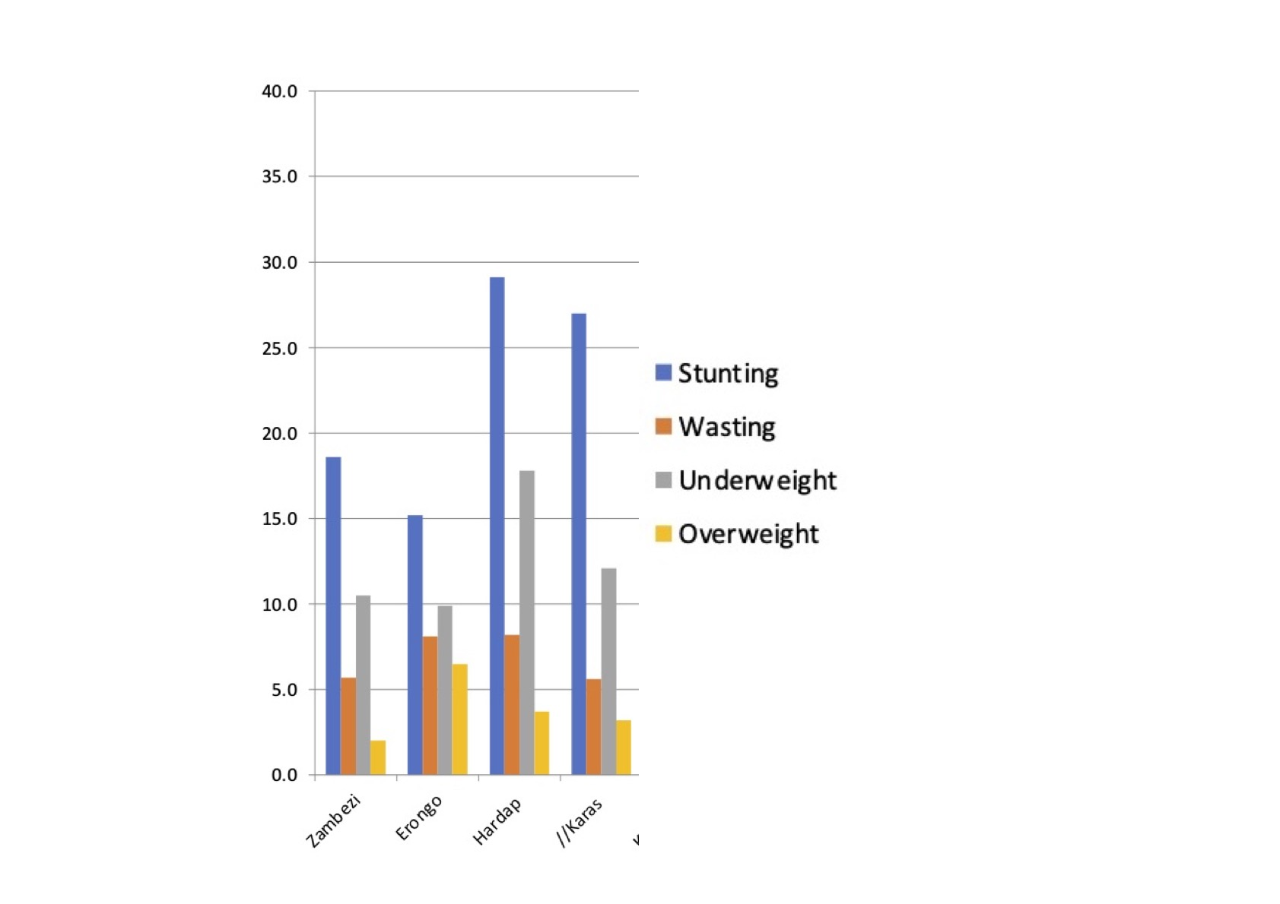

Slide 33
Malnutrition in Erongo & Otjozondjupa

Slide 34
Malnutrition in Kunene & Omusati Regions

