Slide 1
Office of the Prime Minister
Regional Validation Workshops: 22 February – 8 March 2021
Food and Nutrition Security Policy’s IAP =
Implementation Action Plan

Slide 2
Office of the Prime Minister
Regional Validation Workshops: 22 February – 8 March 2021
IAP Structure & Content:
Policy Objectives & Strategies per Objective
Detailed Information on Activities per Strategy
Outputs & Output Indicators, as well as Baseline Indicators
5-year Timelines, incl. Target Indicators & Budgets per year
Lead Implementers + Core Implementing Partner Institutions

Slide 3
Implementation Action Plan - Template

Slide 4
What can we do to reach our Objectives?
TAKING ACTION:
Reduce the Prevalence of Undernourishment = nutrition-specific
Increased National Food Production for Domestic Consumption
Reduce Prevalence of Stunting = nutrition-sensitive
Increased Investment into Food & Nutrition Security + effective implementation & coordination

Slide 5
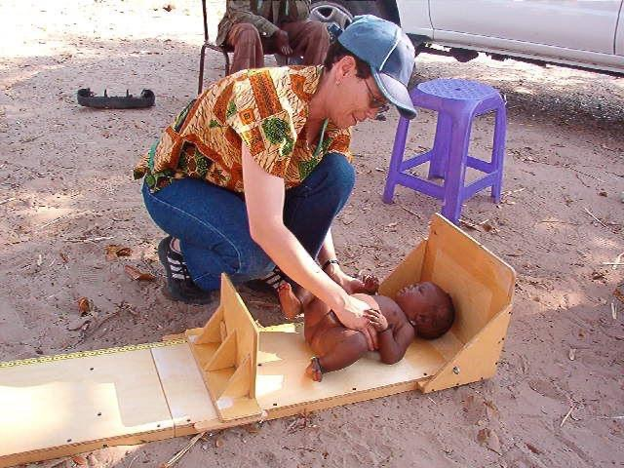
Objective 1:
Reduce the Prevalence of Undernourishment

Slide 6
Objective 1:
Reduce the Prevalence of Undernourishment
1.1. Nutrition-Specific Interventions for Prevention
1.2. Managing & Treating Acute Malnutrition
1.3. Growth Monitoring & Promotion
1.5. Optimal Maternal Nutrition
1.4. Prevent & Control Micronutrient Disorders

Slide 7
Objective 1:
Reduce the Prevalence of Undernourishment
pages 4 - 6
Strategy 1.2.
Increase coverage of interventions to manage and treat acute malnutrition.
Activity 1.2.1.
Provide health facilities with capacity and nutrition commodities to scale up high quality health and nutrition services to detect, treat and prevent the occurrence of acute malnutrition among children under 5 years.
Output:
Health and nutrition services to treat and prevent acute malnourished children under five years are operational and supported in the nearest health facility.

Slide 8
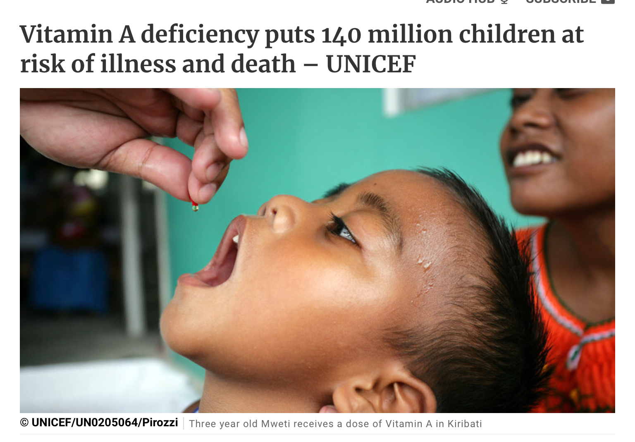
Objective 1:
Reduce the Prevalence of Undernourishment

Slide 9
Objective 1:
Reduce the Prevalence of Undernourishment
pages 8 - 9
Strategy 1.4.
Prevention and control of micronutrient disorders
Activity 1.4.3.
Strengthen the quality and coverage of vitamin A supplementation for children under 5 years and post-partum women.
Output:
Coverage of vitamin A supplementation increased among children < 5 years + p-p women.
Output Indicators:
Percentage of children under five years and post-partum women receiving quality vitamin A supplementation.

Slide 10
Objective 1 – continues…
Reduce the Prevalence of Undernourishment
1.6. Overnutrition and Non-Communicable Diseases
1.7. Nutritional Care for people living with HIV, TB +
1.8. Universal Access & Utilization of 1^{ry} Health Care
1.9. Nutrition Preparedness & Response Plan in Emergencies

Slide 11
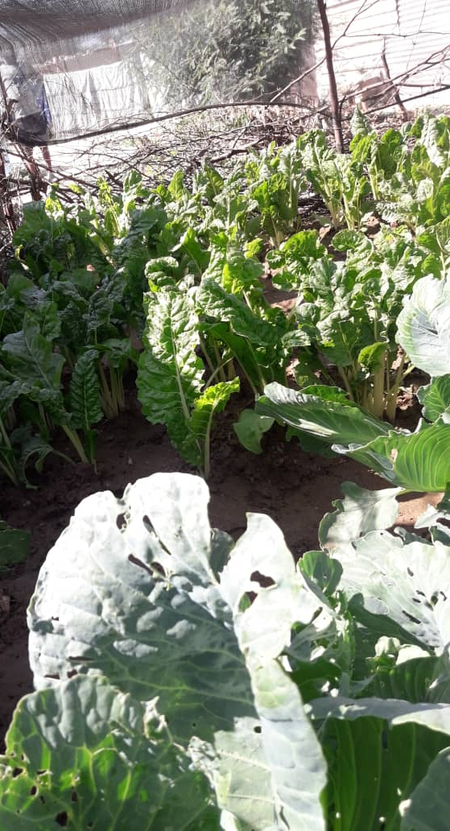
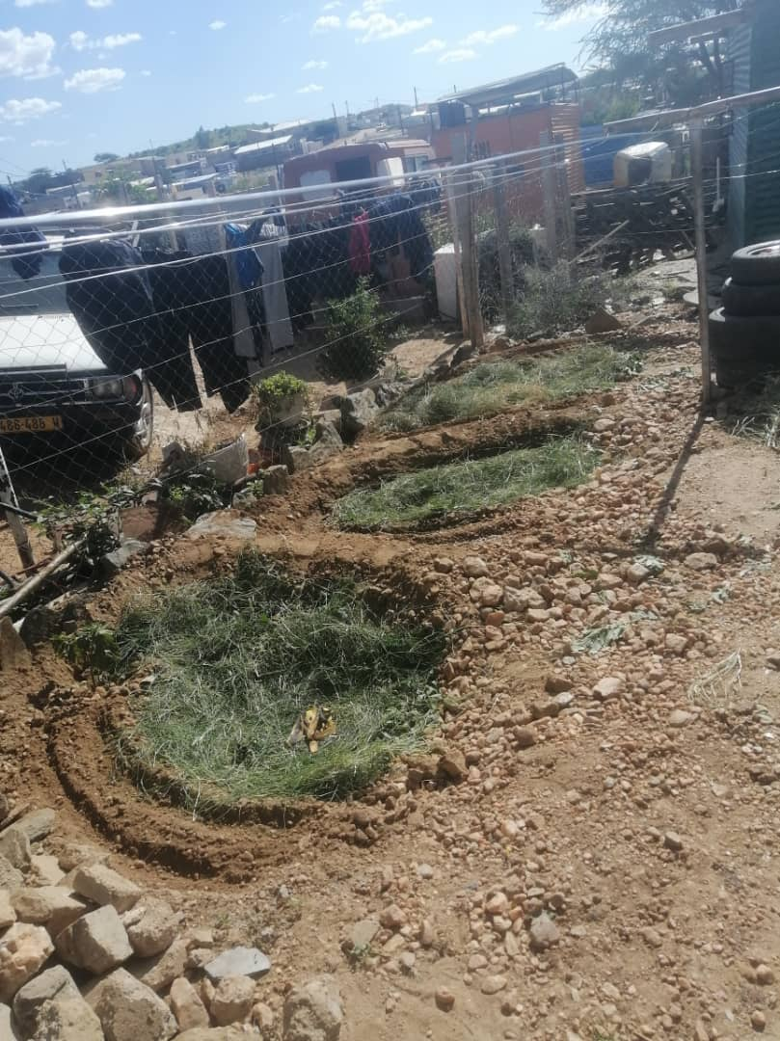
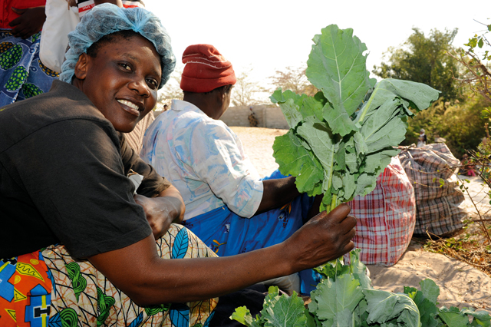
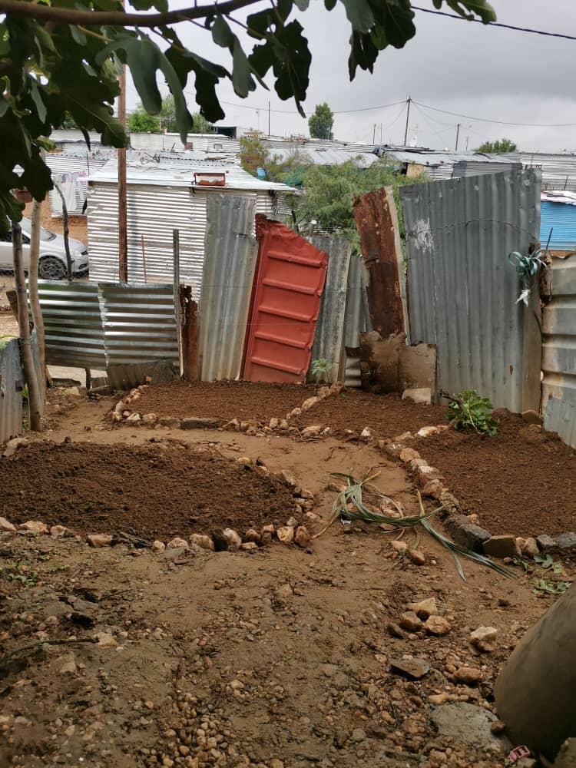
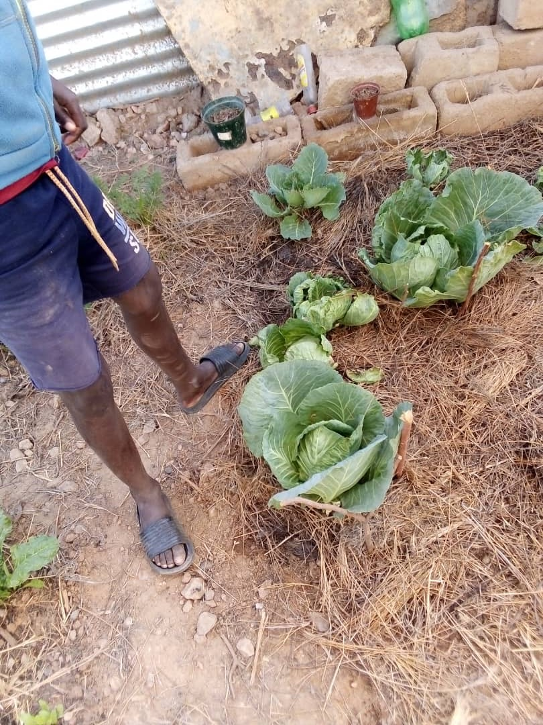
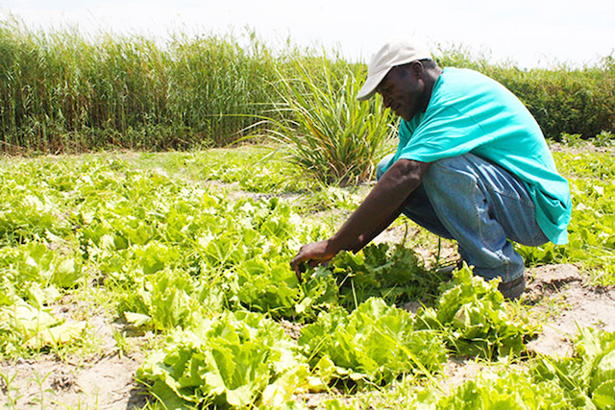
Objective 2:
Increased National Food Production for Domestic Consumption
Rural
& Urban

Slide 12
Objective 2:
Increased National Food Production for Domestic Consumption
2.1. Smallholders’ Farmers produce Safe and Nutritious (S+N) Foods
2.2. Improved Access to Food at Household Levels
2.3. Processing, Storage and Preservation of Food Improved
2.5. Strengthening Households’ Resilience to Various Shocks
2.4. Nutrition-Sensitive Interventions in Agriculture Sector

Slide 13
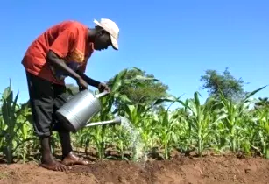
Objective 2:
Increased National Food Production for Domestic Consumption
pages 19 - 20
Strategy 2.1.
Strengthen local production (safe & nutritious), esp. smallhold farmers
Activity 2.1.1.
Enhance use of sustainable agricultural technology --> production, processing, storage + handling of bio-fortified & nutrient-rich food.
Activity 2.1.3.
Promote climate-smart agriculture and conservation.
Activity 2.1.4.
Strengthen agric. input --> enhance growth + food diversification for smallholder farmers that can still not afford agriculture input.

Slide 14
Objective 2:
Increased National Food Production for Domestic Consumption
pages 21 - 22
Strategy 2.2.
Household-level: Improve physical & economic access to safe + nutritious food
Activity 2.2.2.
Support income generating activities of food insecure households via agro-processing + small scale agricultural technologies.
Activity 2.2.5.
Promote/support local food processing & value addition at household and community level.

Slide 15
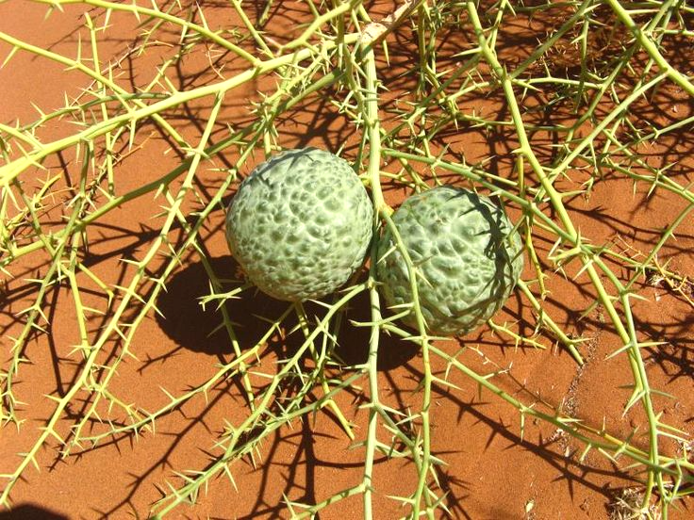
Objective 2:
Increased National Food Production for Domestic Consumption
page 23
Strategy 2.2. cont.
Household-level: Improve physical & economic access to safe + nutritious food
Activity 2.2.6.
Promote production and consumption of indigenous foods to
enhance diet diversification.
Activity 2.2.7.
Scale up the urban and peri- urban horticulture programme.

Slide 16
Objective 2 – continues…
Increased National Food Production for Domestic Consumption
2.6. Agricultural Approaches to Mitigate Negative Impact on Nutrition
2.8. Irrigation & Integrated Water Resource Management
2.9. Sustainable Agricultural Development
2.7. Conducive, Healthy & Safe Food Industry

Slide 17
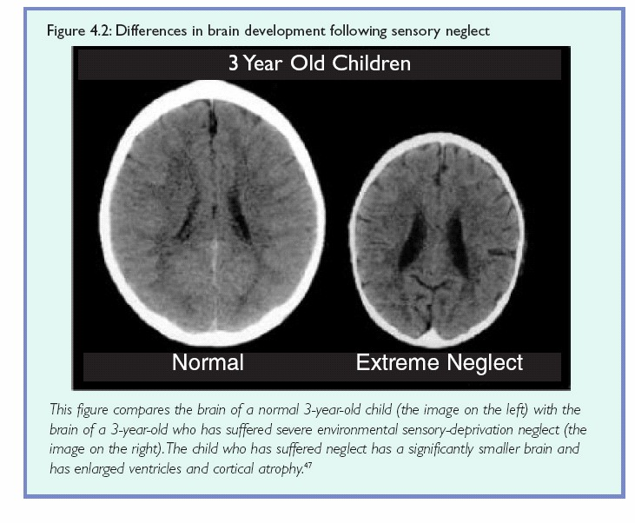
Objective 3:
Reduce Prevalence of Stunting
Effects of STUNTING
In Namibia,
¼ of all Children
are stunted!

Slide 19
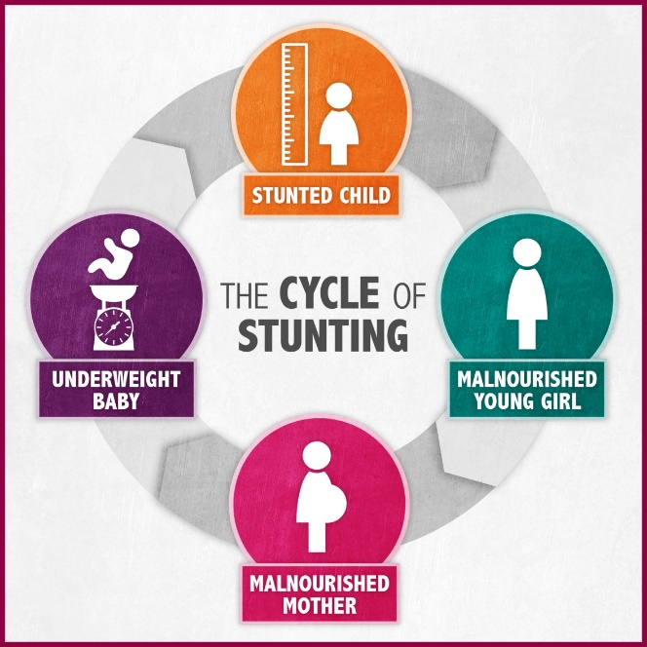

Slide 20
Objective 3:
Reduce Prevalence of Stunting
3.1. Access to Safe Water, Hygiene and Sanitation
3.2. Improved School Nutrition and Nutrition Awareness
3.3. Social Protection Interventions for Improved Nutrition
3.4. Women Empowerment: Households & Communities

Slide 21
Why support to women/girls?
Food for Thought:
Why are condoms for free, but sanitation pads are not?
…while sex is a choice, but
menstruation is not!
Notes:
“Equal distribution of resources = boxes, is NOT enough!”, because the playing field isn’t leveled.”

Slide 22
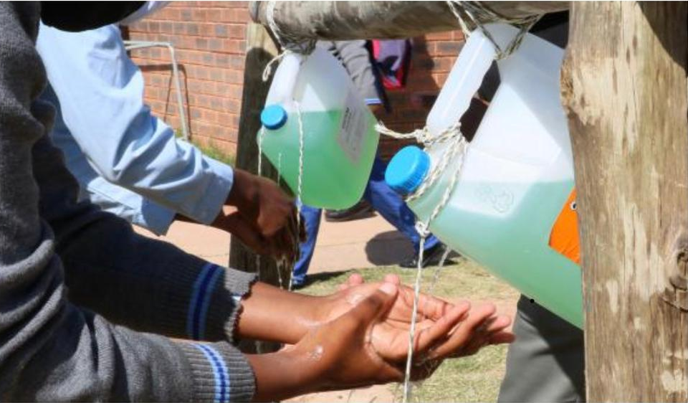
Objective 3:
Reduce Prevalence of Stunting
Strategy 3.2. Improve school nutrition and nutrition awareness
Activity 3.2.5
Promote water, sanitation and hygiene promotion education and practices in institutional settings.
Output:
Implement strategies to improve water provision , sanitation and hygiene in schools and catchment areas.
Output Indicators:
Number of campaigns conducted on strategies to improve water provision, sanitation and hygiene in schools and catchment areas.
.

Slide 23
Objective 4:
Increased Investment into FNS

Slide 24
Objective 4:
Increased Investment into FNS
4.1. Enhanced Capacity for Policy Implementation
4.2. Integrated FNS-Information Management Systems -> Improved Decision Making
4.3. Communication and Advocacy: National Interest & Commitment
4.4. Sustained Commitments: Governance & Resources

Slide 25
Objective 4 – continues…
Increased Investment into FNS
4.5. Mainstream FNS into National, Sectoral, Regional and Local Plans and Frameworks
4.6. Develop FNS - Legislation, Regulations and Guidelines
4.7. Strengthen Framework for Coordination and M&E of FNS - Activities

Slide 26
Lead Partner & Co-partner(s) in the implementation of the FNSIAP
OMAs are Lead Institutions
Civil Society, Academic, Private & International Organizations, UN are Supportive Partners.
Regional Structures, i.e. Regional Councils, Implementers and Implementation Partners are of utmost importance!

Slide 27
Comments ?
Questions ?
Suggestions ?

