Slide 1
Office of the Prime Minister
Food and Nutrition Security
Coordination Structure
February - March 2021

Slide 2
Content of the Coordination structure
1. Foreword by Right Hon. Prime Minister
Highlighting government commitment to ensure efficiency and effectiveness in coordinating the implementation of the food and nutrition security interventions.
How the four levels of operation will enhance involvement of stakeholders from different sectors in planning and implementing related interventions.
Acknowledgement
GRN acknowledging the valuable contributions of all role players in developing this document.
3. Abbreviations and Acronyms
Executive summary providing:
The background and the rational to revise the coordination structure
The descriptions of the four levels of this Coordination Structure.
Information on how to track progress and improve on gaps.
The effective action government will employ, encouraging stakeholders to take up their rightful roles and responsibilities.
Three chapters:
1. Introduction:
2. TORs for all committees (their mandate, membership, roles, meeting schedule)
3. Progress tracking tools
6. Conclusions
7. Annexures: List of contributors
Notes:
Consider taking out…

Slide 3
Background
In September 1994, the Cabinet approved the establishment of a three-tier institutional structure named the Food Security and Nutrition Council (FSNC) at the national level to address food and nutrition security.
Chaired by then Permanent Secretary of Ministry of Health and Social Services.
Technical Committee was chaired MAWRD.
Institutional re-arrangement, led to the division of Rural Development relocated from the then MAWRD to the then MRLG, as a result the Food Security and Nutrition Committee and the entire Council became dormant.
In 2010, the National Alliance for Improved Nutrition (NAFIN) was established, yet in recent years became dormant and didn’t have the proper convening power.
FSNC
FSNS
GOVERMENT MINISTRIES ( 7)
ACADEMIC INSTITUTIONS
NGOS
INTERNATIONAL AGENCIES
CO-OPTED MEMBERS
Notes:
GRN structures existed at all levels but NGOs only existed at National level.

Slide 4
Background Cont…
OPM approached Cabinet with existing challenges.
Cabinet Decision No: 1st/14.02.17/004, resolved that OPM:
Revive the National Food Security and Nutrition Council to be chaired by the Office of the Prime Minister.
Endorse the National Alliance for Improved Nutrition (NAFIN) to serve as a technical partner to advocate for nutrition specific interventions.
OPM established a committee comprising of relevant OMAs and UN Agencies.
In 2019, a participatory process with support from the global SUN (‘Scaling Up Nutrition’) Movement lead to a transition out of NAFIN to the establishment of the Nutrition and Food Security Alliance of Namibia (NAFSAN).
NAFSAN serves as a coordinating platform for civil society organisations, academia, private sector organisations and committed individuals to improve nutrition in Namibia and support government through coordinated efforts.
Notes:
GRN Structure moved to OPM
NAFIN reconstituted itself into NAFSAN

Slide 5
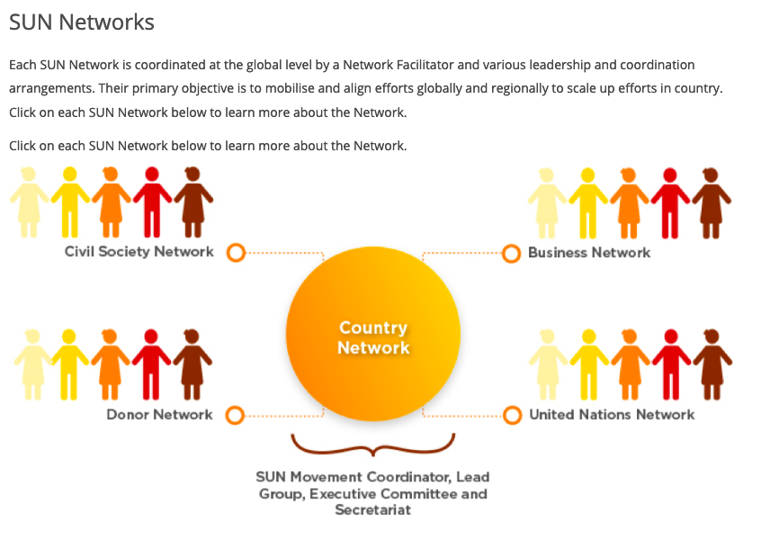
Background cont…. recent development
NAFSAN
Civil Society + Academia
+ Private Sector
+ Individuals
+ UN Agencies as Institutional Supporters
Government
Civil Society
Private Sector
Food and Nutrition Security Council (2020)
Technical Guidance & Regular Feedback
→
Academic Institutions
2010-19
UN/Global Partners
Food and Nutrition Security
INTER-AGENCY STEERING COMMITEE
Country Network
Members
Members
→
Members
Members
Initiate & Support
Implementation
Members
Members
Members
Members
Integrated into and aligned with
Regional Structures
Members
Sensitise & Empower Communities
Facilitating Dialogues, Networking, Advocacy, Sourcing of additional Funding
Integrated into and aligned with
Structures at Constituency Level

Slide 6
To strengthen the Institutional structures
and
To improve coordinated implementation
…to overcome all forms of malnutrition and food insecurity at all levels.
Rationale for revision of the Coordi-nation Structures

Slide 7
Guiding principles: Coordi-nation structure
Implementation and governance of the revised Coordination Structure is founded on the following GUIDING PRINCIPLES:
Effective coordination within and across sectors
Community empowerment and effective involvement.
Decentralization of adequate tools and resources and governance system for better implementation.
Accountability and participation across sectors at national, regional, district and community levels.

Slide 8
Process of revising the Coordi-nation structure
The process included:
wide consultations with representatives from the Government, development partners, academic institutions, non-governmental organizations, private sectors, civil societies and donors.
situation analysis through literature review, sector specific group and individual consultations for content reviews.
validation workshops (now!).

Slide 9
Food and Nutrition Security Coordination Structures: Other Countries
In order to ensure accountability, lessons learned from other countries show that effective coordination of Food and Nutrition Security interventions require:
a neutral,
strategic and
high-level political office with strong convening powers.
Notes:
Rather Take Out

Slide 10
Food and Nutrition Security Coordination Structures: Other Countries
Country | Coordinated by: | Chaired by / Lead Agency | Reference
Republic of Zimbabwe | National Ministerial Task Force on Food and Nutrition Security | Hon. Vice President | Policy Implementation structure: Food and Nutrition Security Policy (launched 2013)
United Republic of Tanzania | High level Steering Committee on Nutrition | PS - OPM | The Tanzania National Multi-Sectoral Nutrition Action Plan 2016-2021
Kingdom of Lesotho | Lesotho Food and Nutrition Council | Chaired by Prime Minister | Lesotho Multi Sectoral Nutrition Governance Capacity Assessment Report - April 2018
Republic of South Africa | National Food and Nutrition Advisory Committee | Chaired by Deputy President | 24 No.37915 – Government Gazette, 22 August 2014 The National Policy on Food and Nutrition Security for SA
Notes:
As for benchmarking, see some countries that we looked at. KEEP SHORT!!!

Slide 11
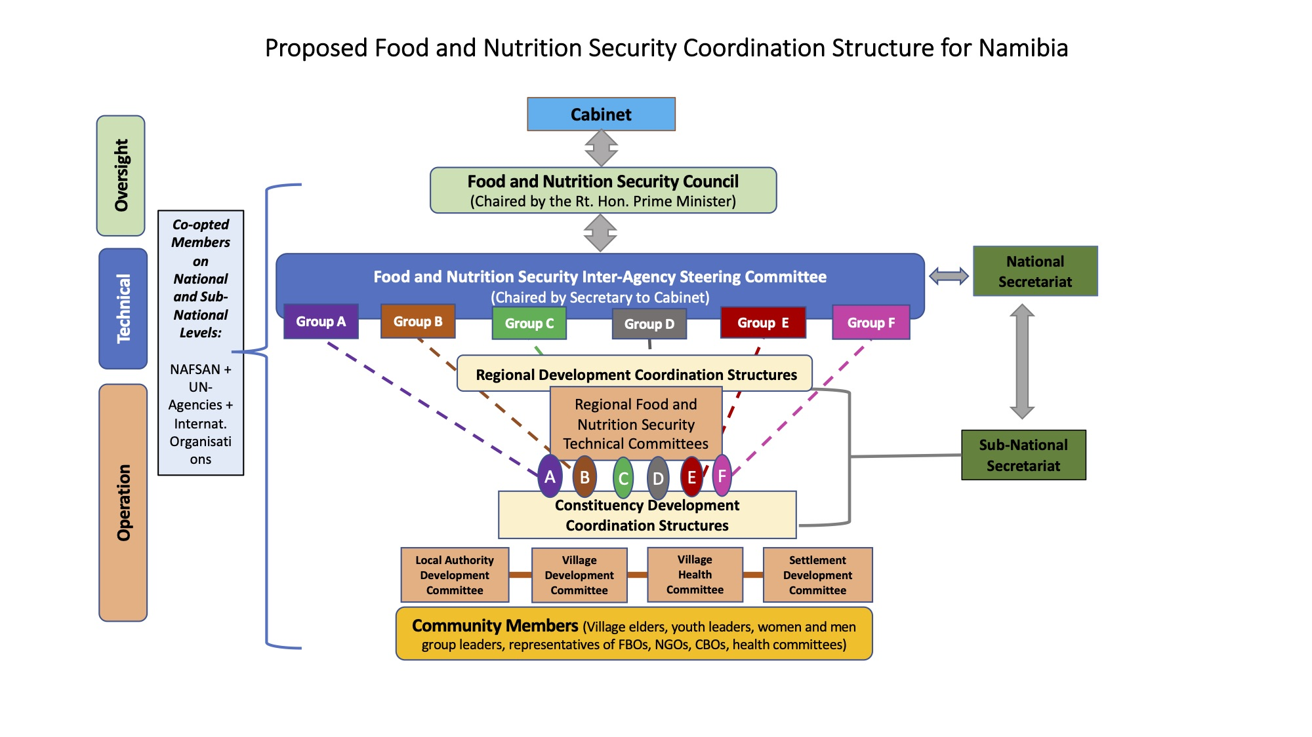

Slide 12
Coordination Structures
(National)
LEVEL 1 - NATIONAL:
Refers to the first and top tier ranking for decision-making in all Food and Nutrition Security Policy implementation directives and emerging concerns.
The national structure comprises of three bodies:
1. The Food and Nutrition Security Council (FNSC):
The over-arching body. Provides critical information on food and nutrition to the Cabinet for approval. Chaired by the Right Honourable Prime Minister.
2. Food and Nutrition Inter-Agency Steering Committee:
The body that provides coordination, management and implementation of Food and Nutrition Security. It is made up of the Executive Directors from the same ministries and technical experts, chaired by Secretary to Cabinet.
This committee addresses all technical issues regarding food and nutrition security in the country.
3. The National Secretariat:
Offers all the administrative support to the coordination bodies at the same time link and coordinate the stakeholders. The National Secretariat will work closely with the Sub-National team. Detailed TORs are provided for.

Slide 13
Sub-National Structures
Coordination Structures Level 2, 3 and 4.
LEVEL 2 - Regional level:
Regional decision-making tier for Food and Nutrition Security program implementation. The Regional Development Coordination Committee is the over-arching supervisory body for the food and nutrition security stakeholders at the region, supervised by Chief Regional Officers.
LEVEL 3 - Constituency level:
In this tier decision making is navigated by Regional Councilors through the constituency development committees. Here, technical matters regarding food and nutrition security will be led by community resource persons and agriculture extension workers.
LEVEL 4 - Community level:
Here decision making is steered through the community leaders, community health workers, community members, and other existing and relevant structure in the community/village. Community health workers will chair the meetings.

Slide 14
Sub-National Secretariat
The functions of Sub-National Secretariat will be the same as of the National Secretariat.
Chief Regional Officers to nominate three staff members under their establishment to serve on the Subnational Secretariat.
Sub-National Secretariat to work in close collaboration with National Secretariat

Slide 15
Regional Secretariat
The Regional Secretariat (NS):
3 nominated staff from existing structures of Regional Council
The functions of the Regional Secretariat:
Initiate and participate in committee meetings as scheduled and as outlined in the respective works plans, take minutes and provide feedback;
Provide administrative support and collaborate with respective chairs in convening meetings;
Meet prior to every scheduled meeting either prior to the Council or Steering Committee meetings;
Keep data base of all committee members (name, department, agency and contact details);
Collaborate with the chairs in preparation of agendas for meetings, invitation of participants and circulation of minutes.
See more detailed functions from page 12 of the Food and Nutrition Security Coordination Structures.
Notes:
Highlight 2 functions and refer to the document

Slide 16
Constituency Development Committee (CDC)
Mandate:
Oversee the actualisation of related programs and determine their achievements, suitability and identify gaps.
The functions of the CDC:
Oversee, monitor and coordinate all stakeholders implementing food and Nutrition security related programs in the constituency,
Identify resources, capacity gaps and challenges experienced by partners when implementing food and nutrition security programs and relay to the Regional FNSTC for action,
In liaison with the CDC, identify communities that are food insecure and share report with RDC,
See more detailed functions from page 15 of the Food and Nutrition Security Coordination Structures.
Notes:
Highlight 2 functions and refer to the document

Slide 17
Village Development Committee (VDC)
Mandate:
Collaborate with stakeholders to ensure food and nutrition security issues are addressed through joint planning, training, implementation and evaluation of programs at community level.
The functions of the VDC:
Convene and coordinate meetings of all stakeholders on monthly basis,
Actively participate in assessing the food and nutrition situation in the community and report to the CDC,
Identify malnutrition cases and food insecure households and report to CDC,
Identify gaps and challenges facing the communities in implementing food and nutrition security programs at the community level,
See more detailed functions from page 16 of the Food and Nutrition Security Coordination Structures.
Notes:
Highlight 2 functions and refer to the document

Slide 18
FOOD SECURITY:
Government commitment to the sub- national level
Agricultural Extension and Engineering Services in Namibia exists to promote adoption of improved agricultural technologies and practices in order to increase agricultural production, empower farmers, and facilitate sustainable improvement in living conditions of rural
communities.
Main objectives:
Provide agricultural extension in the form of communication, advisory and training services to farmers and stakeholders.
Provide subsidies agricultural inputs and services to subsistence farmers
Contribute to the implementation of an effective drought preparedness planning and responsive drought management system,
Establish a mechanism to regulate and manage irrigation on a national basis,
Promote technology development, adaptation and adoption, as well as information dissemination in the agricultural sector,
Identify and implement technological needs and requirements in the area of agronomy, mechanization, animal husbandry, soil conservation and agricultural structures,
Ensure conformity to regulations and policies on plant health and agro-chemicals quality and safety,
Improve the legal environment to improve farming production.
Notes:
Highlight 2 or 3 points and refer to the document

Slide 19
NUTRITION:
Government commitment to the sub- national level
In addition,
it is expected that
Community Health Workers
should:
play an effective role in bringing much needed public healthcare services closer to the people,
and
educate community members on health-related matters in addressing all forms of malnutrition.

Slide 20
Collaboration between Government NAFSAN as Civil Society Alliance
NAFSAN is part of:
Scaling Up Nutrition (SUN) Civil Society Network: 3,000+ member organisations in over 50 countries;
NAFSAN working closely with GRN:
Provide technical guidance and regular feedback on national and sub-national levels;
Initiate and support implementation of activities and play a role in monitoring and evaluation;
Facilitate dialogue platforms around FNS;
Advocate for FNS policies, legislation, research etc.
Sensitize and empower communities around FNS;
Scale new technologies and other innovations;
Mobilise private sector and international donors to invest in food and nutrition security.

Slide 21
List of Contributors
Office of the Prime Minister (Lead)
Line OMAs
National Planning Commission,
Ministry of Health and Social Services,
Ministry of Agriculture, Water and Land Reforms,
Ministry of Gender Equality, Poverty Eradication and Social Welfare, Ministry of Education, Arts and Culture,
Ministry of Higher Education, Technology and Innovation,
Ministry of Urban and Rural Development,
Ministry of Industrialisation and Trade,
Ministry of Information and Communication Technology,
Ministry of Labour, Industrial Relations & Employment Creation,
Ministry of Fisheries and Marine resources , and
Ministry of Environment, Forestry and Tourism.
Regional Councils and Constituency Representatives
Development Partners
UNICEF, WFP, WHO, FAO, USAID etc.
Other coopted partners (Technical support)
NAFSAN (Academia, Civil Society, Private Sector and individuals)

Slide 22
Way Forward
Get final inputs from Regions through Validation processs
OPM will submit the final the Policy, IAP and Coordination structure to Cabinet for approval.
Launch the Policy, IAP and coordination structure together with the revised Policy and IAP.
Government will disseminate final documents (after Cabinet approval) to all stakeholders.
Strengthen the working relationship between government and NAFSAN through an MoU that is flexible for amendments on an annual basis.
We Thank you.

